Slide 1
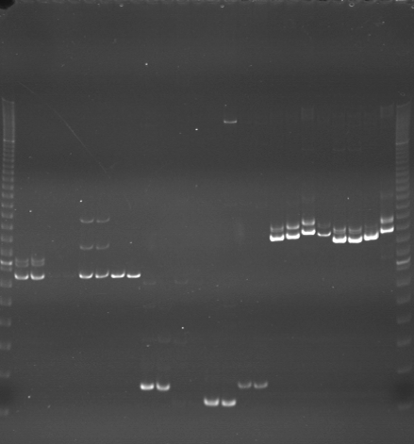
VES0097
VES0098
VES0099
m
Ac
Aw
Bc
Bw
Rc
Rw
Mc
Mw
Ac
Aw
Bc
Bw
Rc
Rw
Mc
Mw
Ac
Aw
Bc
Bw
Rc
Rw
Mc
Mw
m

Slide 2
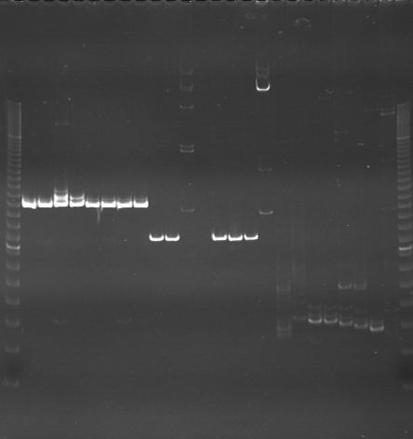
VES0100
VES0101
VES0102
m
Ac
Aw
Bc
Bw
Rc
Rw
Mc
Mw
Ac
Aw
Bc
Bw
Rc
Rw
Mc
Mw
Ac
Aw
Bc
Bw
Rc
Rw
Mc
Mw
m

Slide 3
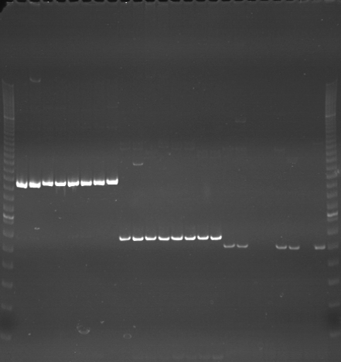
VES0103
VES0104
VES0105
m
Ac
Aw
Bc
Bw
Rc
Rw
Mc
Mw
Ac
Aw
Bc
Bw
Rc
Rw
Mc
Mw
Ac
Aw
Bc
Bw
Rc
Rw
Mc
Mw
m

Slide 4
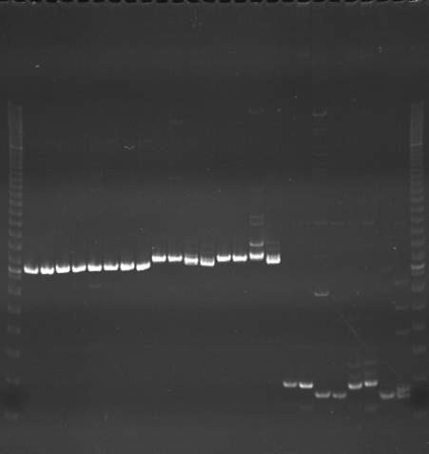
VES0106
VES0107
VES0108
m
Ac
Aw
Bc
Bw
Rc
Rw
Mc
Mw
Ac
Aw
Bc
Bw
Rc
Rw
Mc
Mw
Ac
Aw
Bc
Bw
Rc
Rw
Mc
Mw
m

Slide 5
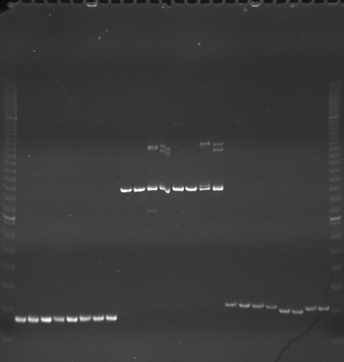
VES0109
VES0110
VES0111
m
Ac
Aw
Bc
Bw
Rc
Rw
Mc
Mw
Ac
Aw
Bc
Bw
Rc
Rw
Mc
Mw
Ac
Aw
Bc
Bw
Rc
Rw
Mc
Mw
m

Slide 6
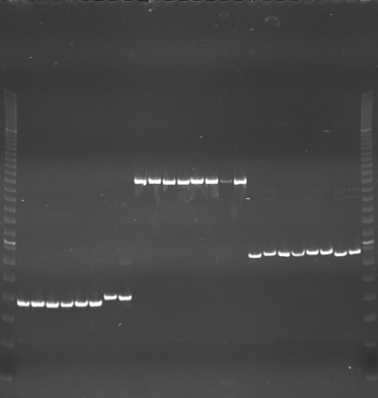
VES0112
VES0113
VES0114
m
Ac
Aw
Bc
Bw
Rc
Rw
Mc
Mw
Ac
Aw
Bc
Bw
Rc
Rw
Mc
Mw
Ac
Aw
Bc
Bw
Rc
Rw
Mc
Mw
m

Slide 7
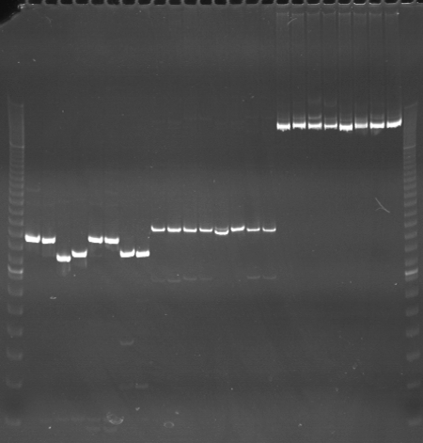
VES0115
VES0116
VES0117
m
Ac
Aw
Bc
Bw
Rc
Rw
Mc
Mw
Ac
Aw
Bc
Bw
Rc
Rw
Mc
Mw
Ac
Aw
Bc
Bw
Rc
Rw
Mc
Mw
m

Slide 8
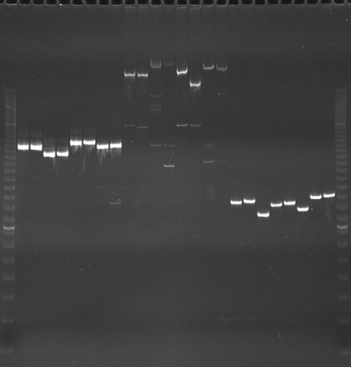
VES0118
VES0119
VES0120
m
Ac
Aw
Bc
Bw
Rc
Rw
Mc
Mw
Ac
Aw
Bc
Bw
Rc
Rw
Mc
Mw
Ac
Aw
Bc
Bw
Rc
Rw
Mc
Mw
m

Slide 9
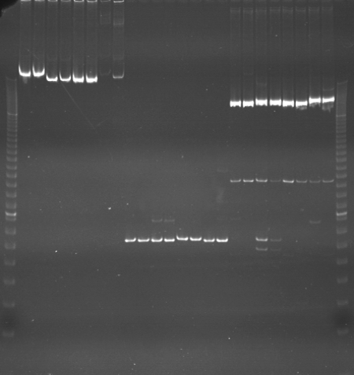
VES0121
VES0122
VES0123
m
Ac
Aw
Bc
Bw
Rc
Rw
Mc
Mw
Ac
Aw
Bc
Bw
Rc
Rw
Mc
Mw
Ac
Aw
Bc
Bw
Rc
Rw
Mc
Mw
m

Slide 10
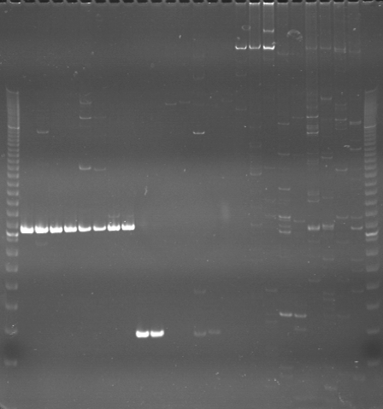
VES0124
VES0125
VES0126
m
Ac
Aw
Bc
Bw
Rc
Rw
Mc
Mw
Ac
Aw
Bc
Bw
Rc
Rw
Mc
Mw
Ac
Aw
Bc
Bw
Rc
Rw
Mc
Mw
m

Slide 11
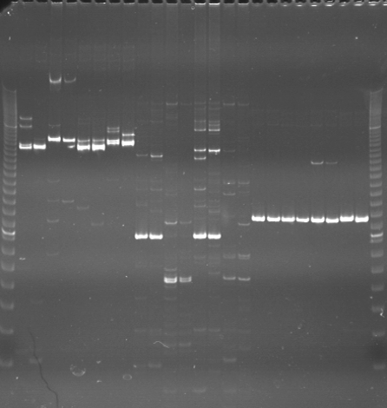
VES0127
VES0128
VES0129
m
Ac
Aw
Bc
Bw
Rc
Rw
Mc
Mw
Ac
Aw
Bc
Bw
Rc
Rw
Mc
Mw
Ac
Aw
Bc
Bw
Rc
Rw
Mc
Mw
m

Slide 12
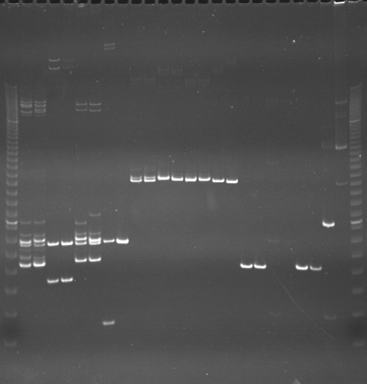
VES0130
VES0131
VES0132
m
Ac
Aw
Bc
Bw
Rc
Rw
Mc
Mw
Ac
Aw
Bc
Bw
Rc
Rw
Mc
Mw
Ac
Aw
Bc
Bw
Rc
Rw
Mc
Mw
m

Slide 13
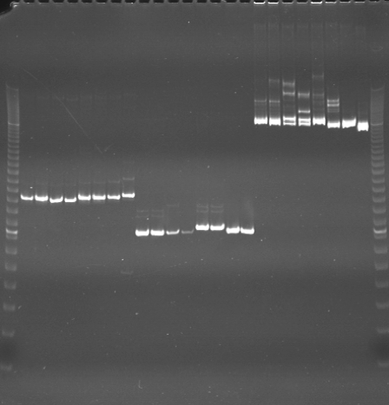
VES0133
VES0134
VES0135
m
Ac
Aw
Bc
Bw
Rc
Rw
Mc
Mw
Ac
Aw
Bc
Bw
Rc
Rw
Mc
Mw
Ac
Aw
Bc
Bw
Rc
Rw
Mc
Mw
m

Slide 14
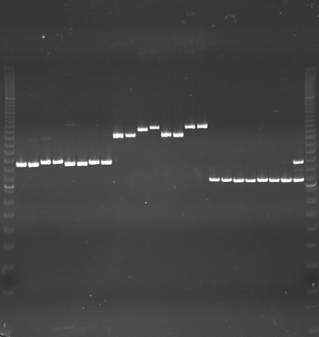
VES0136
VES0137
VES0138
m
Ac
Aw
Bc
Bw
Rc
Rw
Mc
Mw
Ac
Aw
Bc
Bw
Rc
Rw
Mc
Mw
Ac
Aw
Bc
Bw
Rc
Rw
Mc
Mw
m

Slide 15
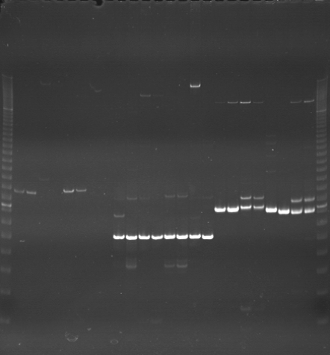
VES0139
VES0140
VES0141
m
Ac
Aw
Bc
Bw
Rc
Rw
Mc
Mw
Ac
Aw
Bc
Bw
Rc
Rw
Mc
Mw
Ac
Aw
Bc
Bw
Rc
Rw
Mc
Mw
m

Slide 16
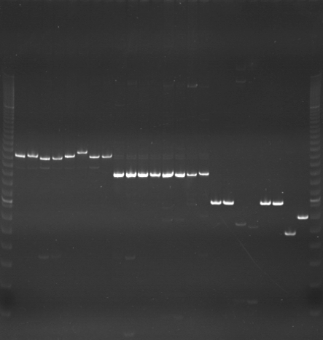
VES0142
VES0143
VES0144
m
Ac
Aw
Bc
Bw
Rc
Rw
Mc
Mw
Ac
Aw
Bc
Bw
Rc
Rw
Mc
Mw
Ac
Aw
Bc
Bw
Rc
Rw
Mc
Mw
m

