Slide 1
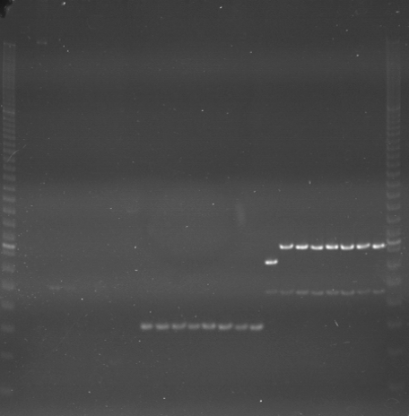
VES0145
VES0146
VES0147
m
Ac
Aw
Bc
Bw
Rc
Rw
Mc
Mw
Ac
Aw
Bc
Bw
Rc
Rw
Mc
Mw
Ac
Aw
Bc
Bw
Rc
Rw
Mc
Mw
m

Slide 2
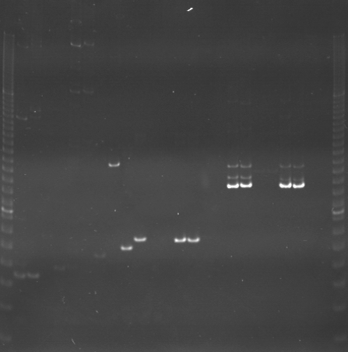
VES0148
VES0149
VES0150
m
Ac
Aw
Bc
Bw
Rc
Rw
Mc
Mw
Ac
Aw
Bc
Bw
Rc
Rw
Mc
Mw
Ac
Aw
Bc
Bw
Rc
Rw
Mc
Mw
m

Slide 3
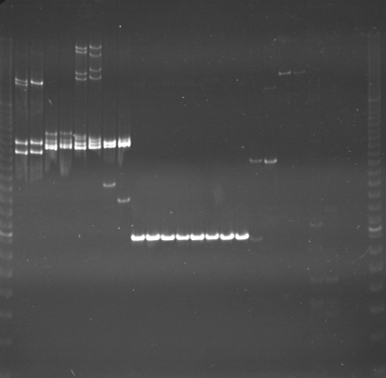
VES0151
VES0152
VES0153
m
Ac
Aw
Bc
Bw
Rc
Rw
Mc
Mw
Ac
Aw
Bc
Bw
Rc
Rw
Mc
Mw
Ac
Aw
Bc
Bw
Rc
Rw
Mc
Mw
m

Slide 4
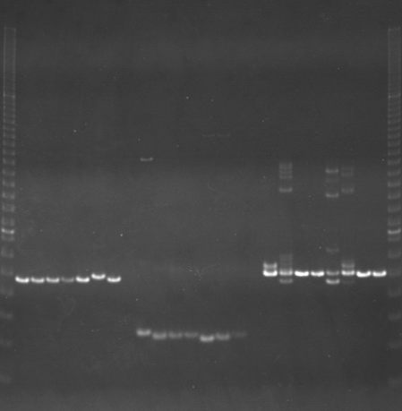
VES0154
VES0155
VES0156
m
Ac
Aw
Bc
Bw
Rc
Rw
Mc
Mw
Ac
Aw
Bc
Bw
Rc
Rw
Mc
Mw
Ac
Aw
Bc
Bw
Rc
Rw
Mc
Mw
m

Slide 5
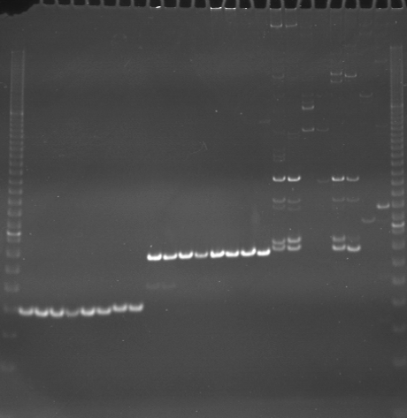
VES0157
VES0158
VES0159
m
Ac
Aw
Bc
Bw
Rc
Rw
Mc
Mw
Ac
Aw
Bc
Bw
Rc
Rw
Mc
Mw
Ac
Aw
Bc
Bw
Rc
Rw
Mc
Mw
m

Slide 6
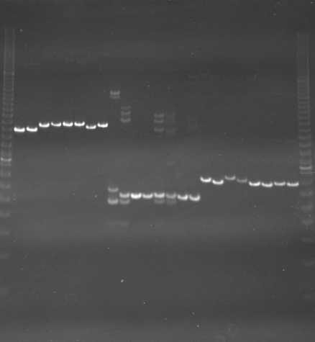
VES0160
VES0161
VES0162
m
Ac
Aw
Bc
Bw
Rc
Rw
Mc
Mw
Ac
Aw
Bc
Bw
Rc
Rw
Mc
Mw
Ac
Aw
Bc
Bw
Rc
Rw
Mc
Mw
m

Slide 7
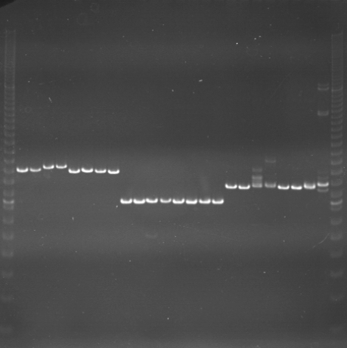
VES0163
VES0164
VES0165
m
Ac
Aw
Bc
Bw
Rc
Rw
Mc
Mw
Ac
Aw
Bc
Bw
Rc
Rw
Mc
Mw
Ac
Aw
Bc
Bw
Rc
Rw
Mc
Mw
m

Slide 8
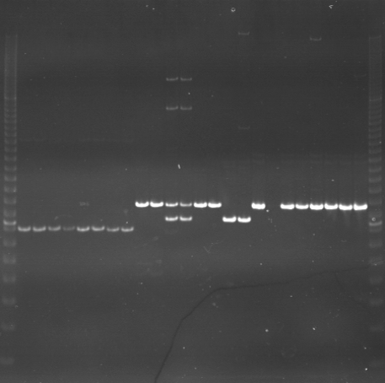
VES0166
VES0167
VES0168
m
Ac
Aw
Bc
Bw
Rc
Rw
Mc
Mw
Ac
Aw
Bc
Bw
Rc
Rw
Mc
Mw
Ac
Aw
Bc
Bw
Rc
Rw
Mc
Mw
m

Slide 9
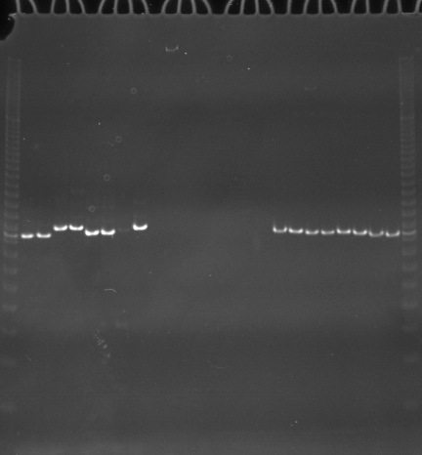
VES0169
VES0170
VES0171
m
Ac
Aw
Bc
Bw
Rc
Rw
Mc
Mw
Ac
Aw
Bc
Bw
Rc
Rw
Mc
Mw
Ac
Aw
Bc
Bw
Rc
Rw
Mc
Mw
m

Slide 10
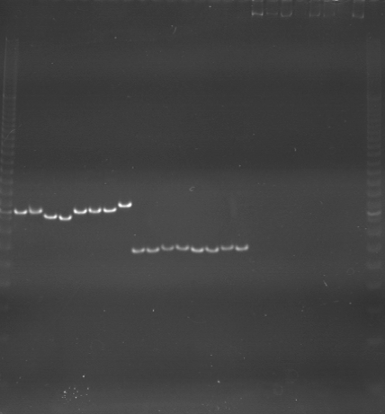
VES0172
VES0173
VES0174
m
Ac
Aw
Bc
Bw
Rc
Rw
Mc
Mw
Ac
Aw
Bc
Bw
Rc
Rw
Mc
Mw
Ac
Aw
Bc
Bw
Rc
Rw
Mc
Mw
m

Slide 11
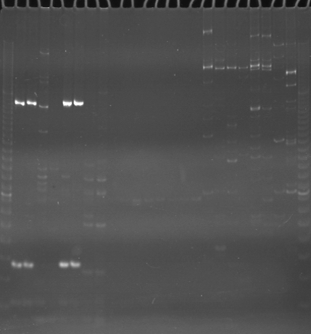
VES0175
VES0176
VES0003177
m
Ac
Aw
Bc
Bw
Rc
Rw
Mc
Mw
Ac
Aw
Bc
Bw
Rc
Rw
Mc
Mw
Ac
Aw
Bc
Bw
Rc
Rw
Mc
Mw
m

Slide 12
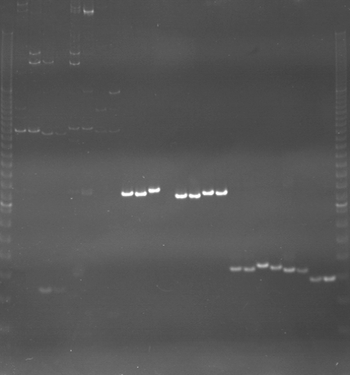
VES0178
VES0179
VES0180
m
Ac
Aw
Bc
Bw
Rc
Rw
Mc
Mw
Ac
Aw
Bc
Bw
Rc
Rw
Mc
Mw
Ac
Aw
Bc
Bw
Rc
Rw
Mc
Mw
m

Slide 13
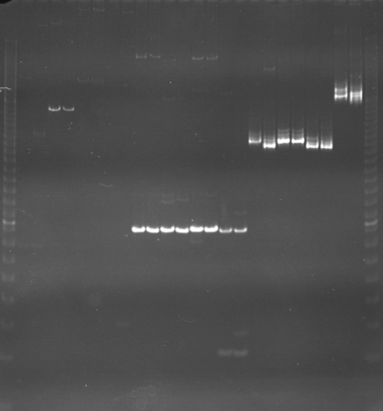
VES0181
VES0182
VES0183
m
Ac
Aw
Bc
Bw
Rc
Rw
Mc
Mw
Ac
Aw
Bc
Bw
Rc
Rw
Mc
Mw
Ac
Aw
Bc
Bw
Rc
Rw
Mc
Mw
m

Slide 14
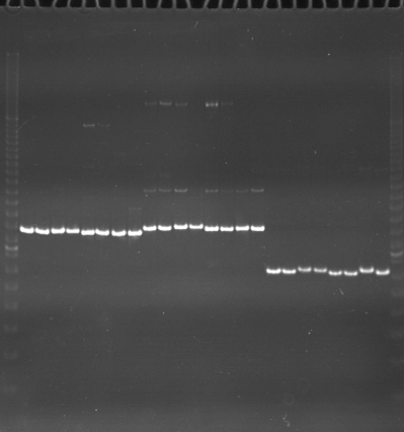
VES0184
VES0185
VES0186
m
Ac
Aw
Bc
Bw
Rc
Rw
Mc
Mw
Ac
Aw
Bc
Bw
Rc
Rw
Mc
Mw
Ac
Aw
Bc
Bw
Rc
Rw
Mc
Mw
m

Slide 15
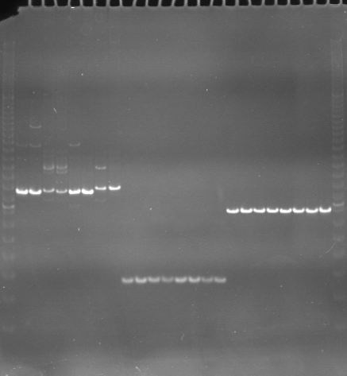
VES0187
VES0188
VES0189
m
Ac
Aw
Bc
Bw
Rc
Rw
Mc
Mw
Ac
Aw
Bc
Bw
Rc
Rw
Mc
Mw
Ac
Aw
Bc
Bw
Rc
Rw
Mc
Mw
m

Slide 16
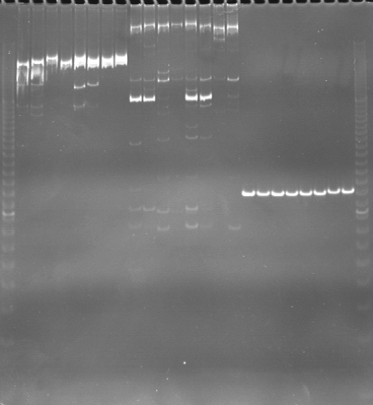
VES0190
VES0191
VES0192
m
Ac
Aw
Bc
Bw
Rc
Rw
Mc
Mw
Ac
Aw
Bc
Bw
Rc
Rw
Mc
Mw
Ac
Aw
Bc
Bw
Rc
Rw
Mc
Mw
m

