Slide 1
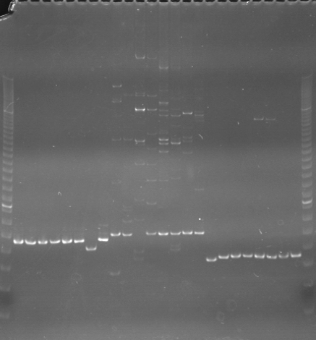
VES0193
VES0194
VES0195
m
Ac
Aw
Bc
Bw
Rc
Rw
Mc
Mw
Ac
Aw
Bc
Bw
Rc
Rw
Mc
Mw
Ac
Aw
Bc
Bw
Rc
Rw
Mc
Mw
m

Slide 2
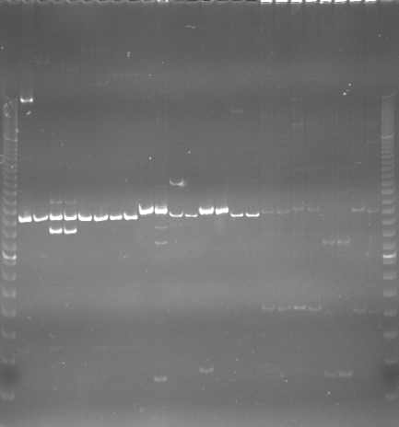
VES0196
VES0197
VES0198
m
Ac
Aw
Bc
Bw
Rc
Rw
Mc
Mw
Ac
Aw
Bc
Bw
Rc
Rw
Mc
Mw
Ac
Aw
Bc
Bw
Rc
Rw
Mc
Mw
m

Slide 3
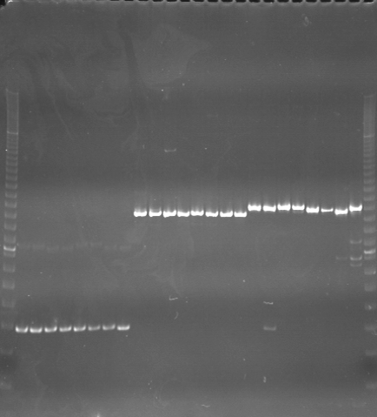
VES0199
VES0200
VES0201
m
Ac
Aw
Bc
Bw
Rc
Rw
Mc
Mw
Ac
Aw
Bc
Bw
Rc
Rw
Mc
Mw
Ac
Aw
Bc
Bw
Rc
Rw
Mc
Mw
m

Slide 4
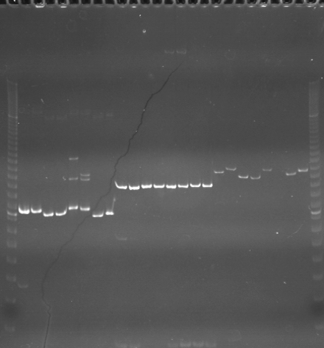
VES0202
VES0203
VES0204
m
Ac
Aw
Bc
Bw
Rc
Rw
Mc
Mw
Ac
Aw
Bc
Bw
Rc
Rw
Mc
Mw
Ac
Aw
Bc
Bw
Rc
Rw
Mc
Mw
m

Slide 5
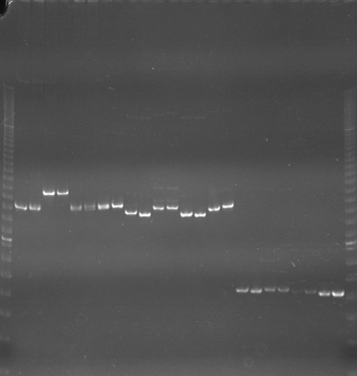
VES0205
VES0206
VES0207
m
Ac
Aw
Bc
Bw
Rc
Rw
Mc
Mw
Ac
Aw
Bc
Bw
Rc
Rw
Mc
Mw
Ac
Aw
Bc
Bw
Rc
Rw
Mc
Mw
m

Slide 6
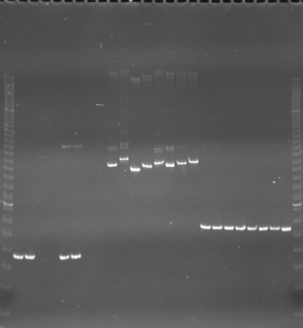
VES0208
VES0209
VES0210
m
Ac
Aw
Bc
Bw
Rc
Rw
Mc
Mw
Ac
Aw
Bc
Bw
Rc
Rw
Mc
Mw
Ac
Aw
Bc
Bw
Rc
Rw
Mc
Mw
m

Slide 7
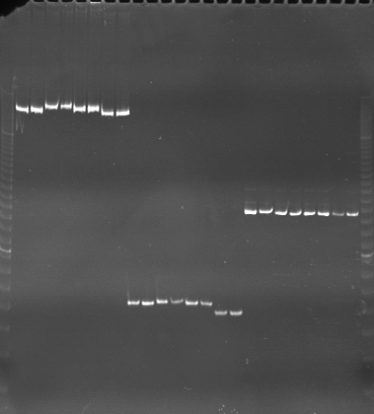
VES0211
VES0212
VES0213
m
Ac
Aw
Bc
Bw
Rc
Rw
Mc
Mw
Ac
Aw
Bc
Bw
Rc
Rw
Mc
Mw
Ac
Aw
Bc
Bw
Rc
Rw
Mc
Mw
m

Slide 8
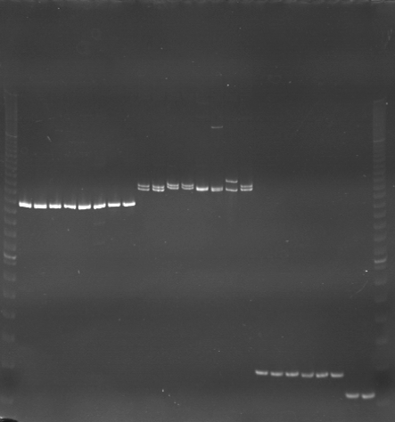
VES0214
VES0215
VES0216
m
Ac
Aw
Bc
Bw
Rc
Rw
Mc
Mw
Ac
Aw
Bc
Bw
Rc
Rw
Mc
Mw
Ac
Aw
Bc
Bw
Rc
Rw
Mc
Mw
m

Slide 9
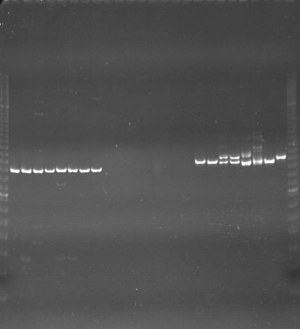
VES0217
VES0218
VES0219
m
Ac
Aw
Bc
Bw
Rc
Rw
Mc
Mw
Ac
Aw
Bc
Bw
Rc
Rw
Mc
Mw
Ac
Aw
Bc
Bw
Rc
Rw
Mc
Mw
m

Slide 10
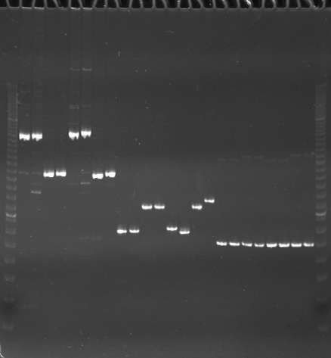
VES0220
VES0221
VES0222
m
Ac
Aw
Bc
Bw
Rc
Rw
Mc
Mw
Ac
Aw
Bc
Bw
Rc
Rw
Mc
Mw
Ac
Aw
Bc
Bw
Rc
Rw
Mc
Mw
m

Slide 11
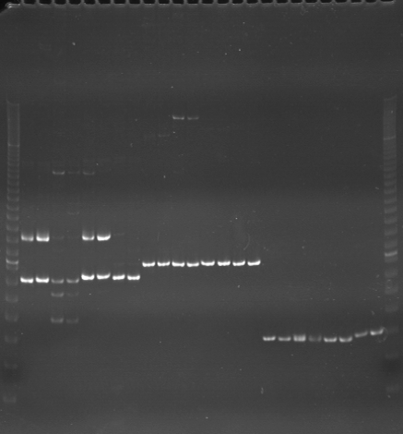
VES0223
VES0224
VES0225
m
Ac
Aw
Bc
Bw
Rc
Rw
Mc
Mw
Ac
Aw
Bc
Bw
Rc
Rw
Mc
Mw
Ac
Aw
Bc
Bw
Rc
Rw
Mc
Mw
m

Slide 12
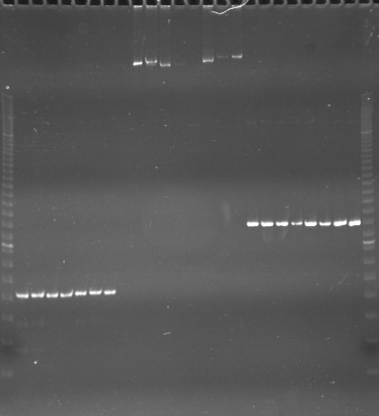
VES0226
VES0227
VES0228
m
Ac
Aw
Bc
Bw
Rc
Rw
Mc
Mw
Ac
Aw
Bc
Bw
Rc
Rw
Mc
Mw
Ac
Aw
Bc
Bw
Rc
Rw
Mc
Mw
m

Slide 13
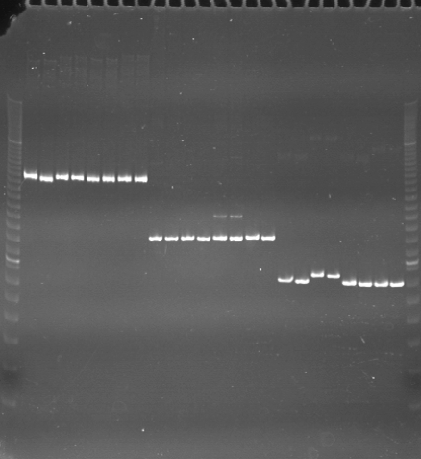
VES0229
VES0230
VES0231
m
Ac
Aw
Bc
Bw
Rc
Rw
Mc
Mw
Ac
Aw
Bc
Bw
Rc
Rw
Mc
Mw
Ac
Aw
Bc
Bw
Rc
Rw
Mc
Mw
m

Slide 14
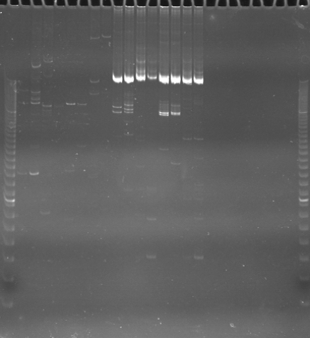
VES0232
VES0233
VES0234
m
Ac
Aw
Bc
Bw
Rc
Rw
Mc
Mw
Ac
Aw
Bc
Bw
Rc
Rw
Mc
Mw
Ac
Aw
Bc
Bw
Rc
Rw
Mc
Mw
m

Slide 15
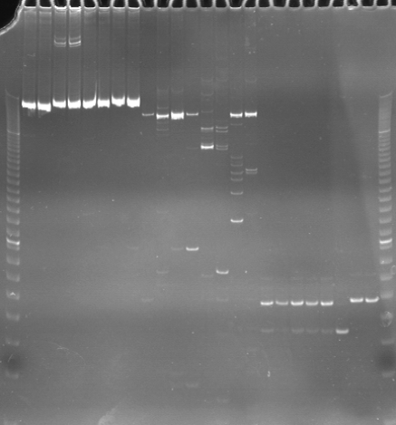
VES0235
VES0236
VES0237
m
Ac
Aw
Bc
Bw
Rc
Rw
Mc
Mw
Ac
Aw
Bc
Bw
Rc
Rw
Mc
Mw
Ac
Aw
Bc
Bw
Rc
Rw
Mc
Mw
m

Slide 16
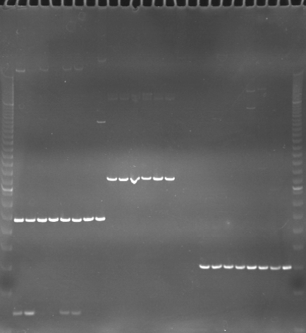
VES0238
VES0239
VES0240
m
Ac
Aw
Bc
Bw
Rc
Rw
Mc
Mw
Ac
Aw
Bc
Bw
Rc
Rw
Mc
Mw
Ac
Aw
Bc
Bw
Rc
Rw
Mc
Mw
m

