Slide 1
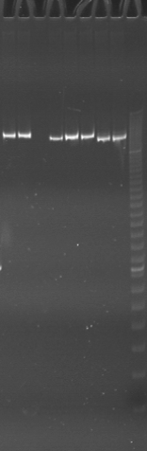
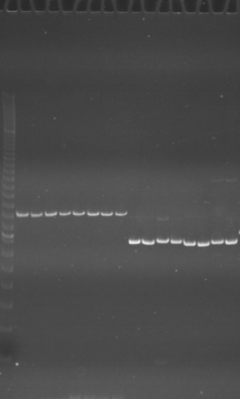
VES0241
VES0242
VES0243
Ac
Aw
Bc
Bw
Rc
Rw
Mc
Mw
m
m
Ac
Aw
Bc
Bw
Rc
Rw
Mc
Mw
Ac
Aw
Bc
Bw
Rc
Rw
Mc
Mw

Slide 2
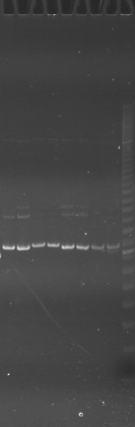
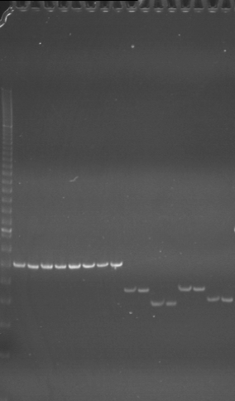
VES0244
VES0245
VES0246
Ac
Aw
Bc
Bw
Rc
Rw
Mc
Mw
m
m
Ac
Aw
Bc
Bw
Rc
Rw
Mc
Mw
Ac
Aw
Bc
Bw
Rc
Rw
Mc
Mw

Slide 3
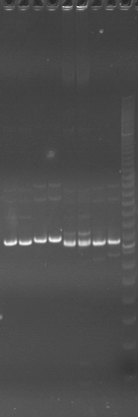
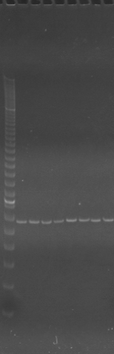
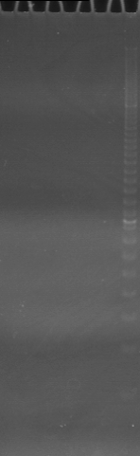
VES0247
VES0248
VES0249
Ac
Aw
Bc
Bw
Rc
Rw
Mc
Mw
m
m
Ac
Aw
Bc
Bw
Rc
Rw
Mc
Mw
Ac
Aw
m
Bc
Bw
Rc
Rw
Mc
Mw

Slide 4
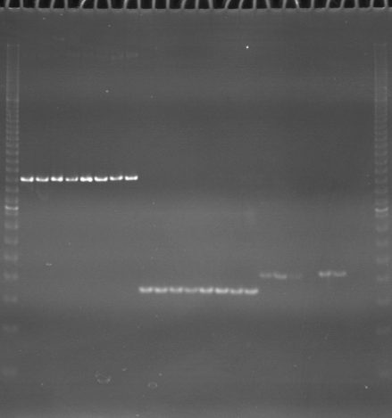
VES0250
VES0251
VES0252
m
Ac
Aw
Bc
Bw
Rc
Rw
Mc
Mw
Ac
Aw
Bc
Bw
Rc
Rw
Mc
Mw
Ac
Aw
Bc
Bw
Rc
Rw
Mc
Mw
m

Slide 5
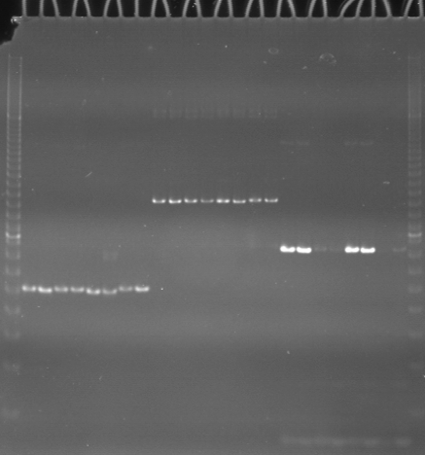
VES0253
VES0254
VES0255
m
Ac
Aw
Bc
Bw
Rc
Rw
Mc
Mw
Ac
Aw
Bc
Bw
Rc
Rw
Mc
Mw
Ac
Aw
Bc
Bw
Rc
Rw
Mc
Mw
m

Slide 6
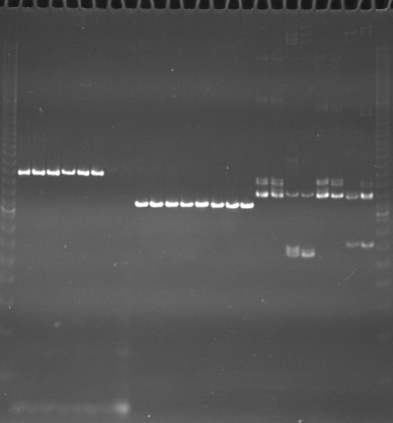
VES0256
VES0257
VES0258
m
Ac
Aw
Bc
Bw
Rc
Rw
Mc
Mw
Ac
Aw
Bc
Bw
Rc
Rw
Mc
Mw
Ac
Aw
Bc
Bw
Rc
Rw
Mc
Mw
m

Slide 7
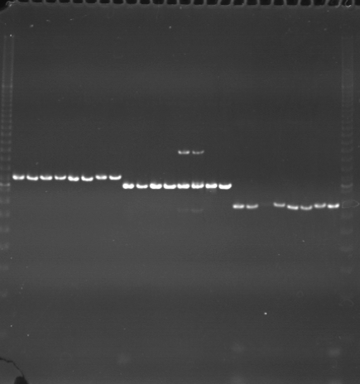
VES0259
VES0260
VES0261
m
Ac
Aw
Bc
Bw
Rc
Rw
Mc
Mw
Ac
Aw
Bc
Bw
Rc
Rw
Mc
Mw
Ac
Aw
Bc
Bw
Rc
Rw
Mc
Mw
m

Slide 8
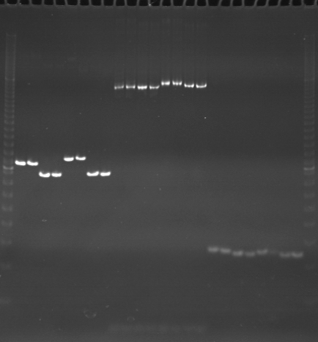
VES0262
VES0263
VES0264
m
Ac
Aw
Bc
Bw
Rc
Rw
Mc
Mw
Ac
Aw
Bc
Bw
Rc
Rw
Mc
Mw
Ac
Aw
Bc
Bw
Rc
Rw
Mc
Mw
m

Slide 9
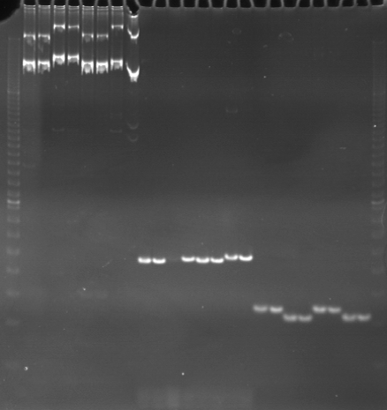
VES0265
VES0266
VES0267
m
Ac
Aw
Bc
Bw
Rc
Rw
Mc
Mw
Ac
Aw
Bc
Bw
Rc
Rw
Mc
Mw
Ac
Aw
Bc
Bw
Rc
Rw
Mc
Mw
m

Slide 10
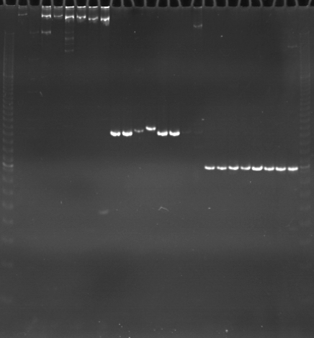
VES0268
VES0269
VES0270
m
Ac
Aw
Bc
Bw
Rc
Rw
Mc
Mw
Ac
Aw
Bc
Bw
Rc
Rw
Mc
Mw
Ac
Aw
Bc
Bw
Rc
Rw
Mc
Mw
m

Slide 11
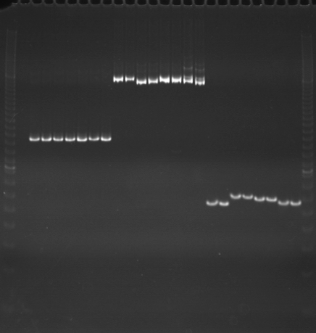
VES0271
VES0272
VES0273
m
Ac
Aw
Bc
Bw
Rc
Rw
Mc
Mw
Ac
Aw
Bc
Bw
Rc
Rw
Mc
Mw
Ac
Aw
Bc
Bw
Rc
Rw
Mc
Mw
m

Slide 12
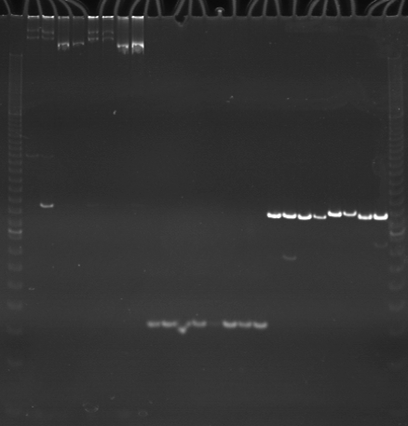
VES0274
VES0275
VES0276
m
Ac
Aw
Bc
Bw
Rc
Rw
Mc
Mw
Ac
Aw
Bc
Bw
Rc
Rw
Mc
Mw
Ac
Aw
Bc
Bw
Rc
Rw
Mc
Mw
m

Slide 13
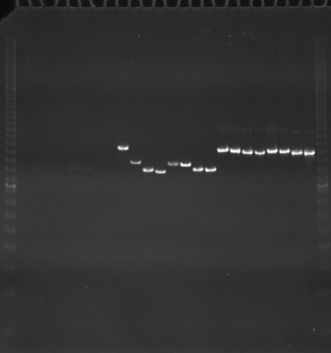
VES0277
VES0278
VES0279
m
Ac
Aw
Bc
Bw
Rc
Rw
Mc
Mw
Ac
Aw
Bc
Bw
Rc
Rw
Mc
Mw
Ac
Aw
Bc
Bw
Rc
Rw
Mc
Mw
m

Slide 14
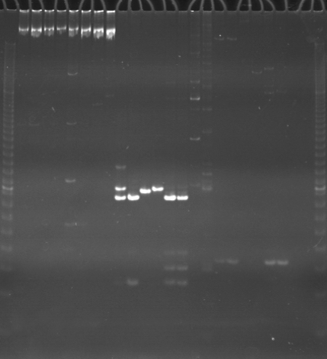
VES0280
VES0281
VES0282
m
Ac
Aw
Bc
Bw
Rc
Rw
Mc
Mw
Ac
Aw
Bc
Bw
Rc
Rw
Mc
Mw
Ac
Aw
Bc
Bw
Rc
Rw
Mc
Mw
m

Slide 15
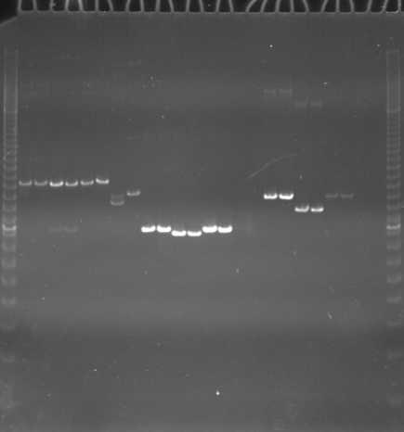
VES0283
VES0284
VES0285
m
Ac
Aw
Bc
Bw
Rc
Rw
Mc
Mw
Ac
Aw
Bc
Bw
Rc
Rw
Mc
Mw
Ac
Aw
Bc
Bw
Rc
Rw
Mc
Mw
m

Slide 16
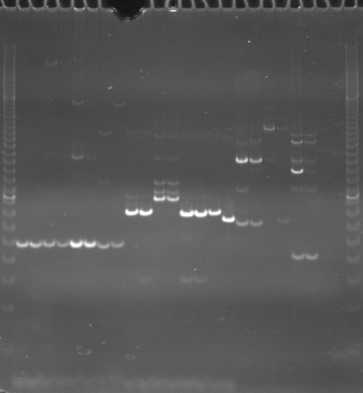
VES0286
VES0287
VES0288
m
Ac
Aw
Bc
Bw
Rc
Rw
Mc
Mw
Ac
Aw
Bc
Bw
Rc
Rw
Mc
Mw
Ac
Aw
Bc
Bw
Rc
Rw
Mc
Mw
m

