Slide 1
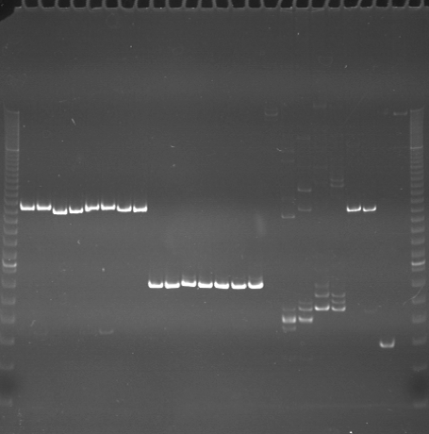
VES0289
VES0290
VES0291
m
Ac
Aw
Bc
Bw
Rc
Rw
Mc
Mw
Ac
Aw
Bc
Bw
Rc
Rw
Mc
Mw
Ac
Aw
Bc
Bw
Rc
Rw
Mc
Mw
m

Slide 2
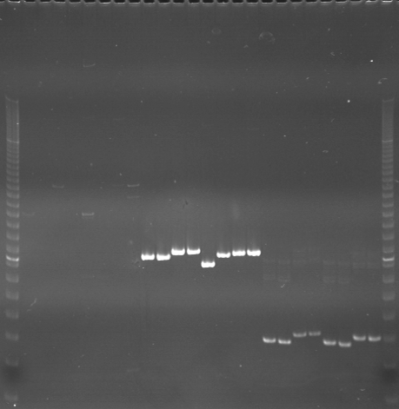
VES0292
VES0293
VES0294
m
Ac
Aw
Bc
Bw
Rc
Rw
Mc
Mw
Ac
Aw
Bc
Bw
Rc
Rw
Mc
Mw
Ac
Aw
Bc
Bw
Rc
Rw
Mc
Mw
m

Slide 3
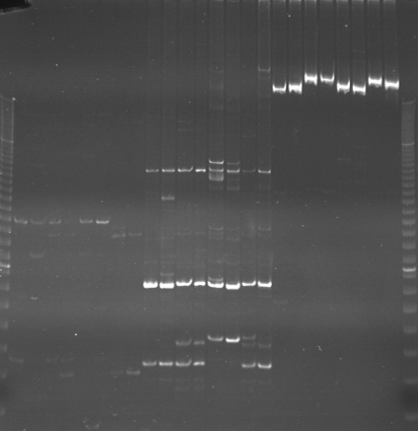
VES0295
VES0296
VES0297
m
Ac
Aw
Bc
Bw
Rc
Rw
Mc
Mw
Ac
Aw
Bc
Bw
Rc
Rw
Mc
Mw
Ac
Aw
Bc
Bw
Rc
Rw
Mc
Mw
m

Slide 4
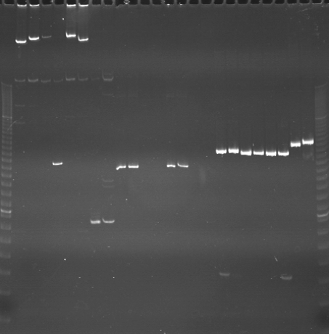
VES0298
VES0299
VES0300
m
Ac
Aw
Bc
Bw
Rc
Rw
Mc
Mw
Ac
Aw
Bc
Bw
Rc
Rw
Mc
Mw
Ac
Aw
Bc
Bw
Rc
Rw
Mc
Mw
m

Slide 5
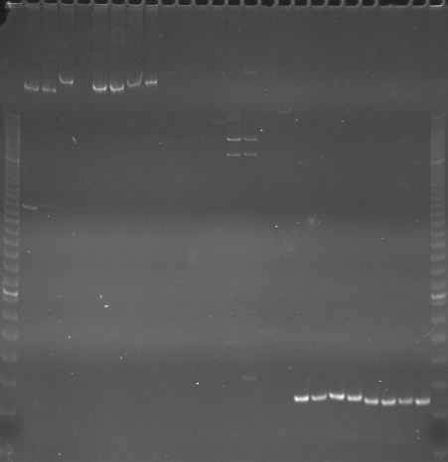
VES0301
VES0302
VES0303
m
Ac
Aw
Bc
Bw
Rc
Rw
Mc
Mw
Ac
Aw
Bc
Bw
Rc
Rw
Mc
Mw
Ac
Aw
Bc
Bw
Rc
Rw
Mc
Mw
m

Slide 6
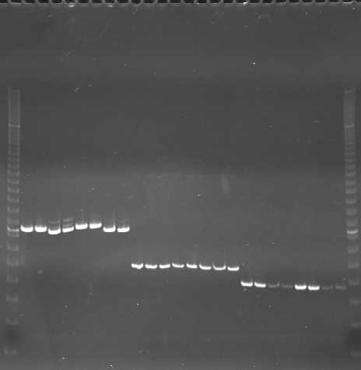
VES0304
VES0305
VES0306
m
Ac
Aw
Bc
Bw
Rc
Rw
Mc
Mw
Ac
Aw
Bc
Bw
Rc
Rw
Mc
Mw
Ac
Aw
Bc
Bw
Rc
Rw
Mc
Mw
m

Slide 7
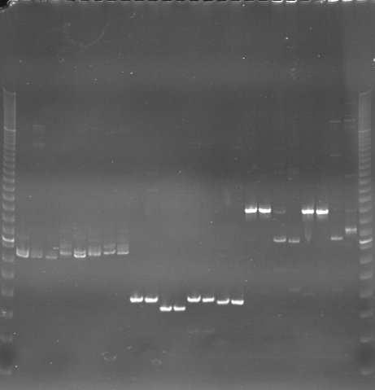
VES0307
VES0308
VES0309
m
Ac
Aw
Bc
Bw
Rc
Rw
Mc
Mw
Ac
Aw
Bc
Bw
Rc
Rw
Mc
Mw
Ac
Aw
Bc
Bw
Rc
Rw
Mc
Mw
m

Slide 8
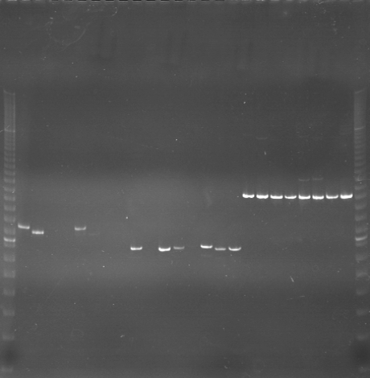
VES0310
VES0311
VES0312
m
Ac
Aw
Bc
Bw
Rc
Rw
Mc
Mw
Ac
Aw
Bc
Bw
Rc
Rw
Mc
Mw
Ac
Aw
Bc
Bw
Rc
Rw
Mc
Mw
m

Slide 9
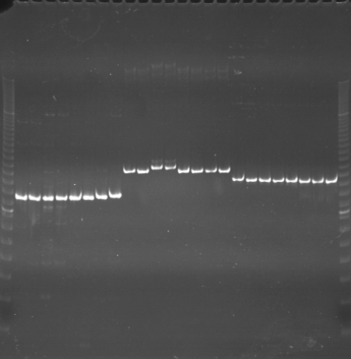
VES0313
VES0314
VES0315
m
Ac
Aw
Bc
Bw
Rc
Rw
Mc
Mw
Ac
Aw
Bc
Bw
Rc
Rw
Mc
Mw
Ac
Aw
Bc
Bw
Rc
Rw
Mc
Mw
m

Slide 10
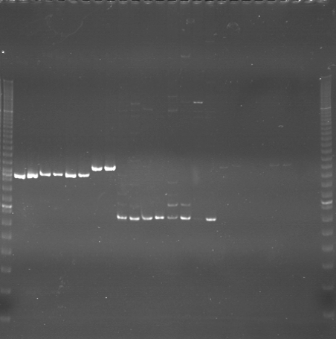
VES0316
VES0317
VES0318
m
Ac
Aw
Bc
Bw
Rc
Rw
Mc
Mw
Ac
Aw
Bc
Bw
Rc
Rw
Mc
Mw
Ac
Aw
Bc
Bw
Rc
Rw
Mc
Mw
m

Slide 11
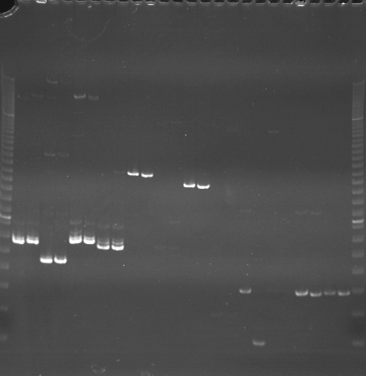
VES0319
VES0320
VES0321
m
Ac
Aw
Bc
Bw
Rc
Rw
Mc
Mw
Ac
Aw
Bc
Bw
Rc
Rw
Mc
Mw
Ac
Aw
Bc
Bw
Rc
Rw
Mc
Mw
m

Slide 12
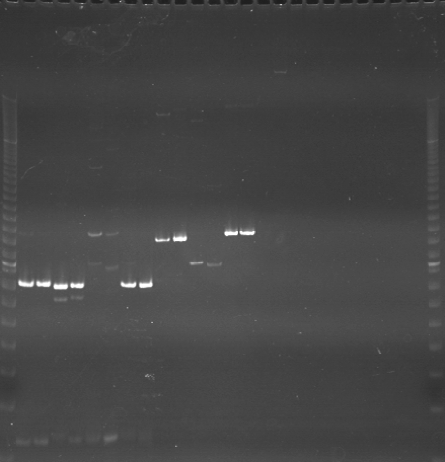
VES0322
VES0323
VES0324
m
Ac
Aw
Bc
Bw
Rc
Rw
Mc
Mw
Ac
Aw
Bc
Bw
Rc
Rw
Mc
Mw
Ac
Aw
Bc
Bw
Rc
Rw
Mc
Mw
m

Slide 13
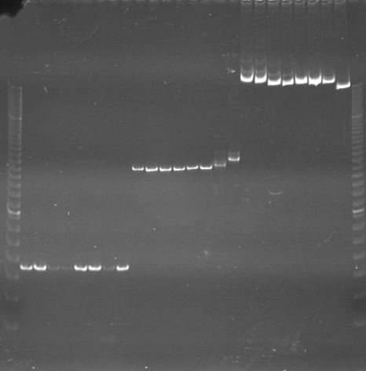
VES0325
VES0326
VES0327
m
Ac
Aw
Bc
Bw
Rc
Rw
Mc
Mw
Ac
Aw
Bc
Bw
Rc
Rw
Mc
Mw
Ac
Aw
Bc
Bw
Rc
Rw
Mc
Mw
m

Slide 14
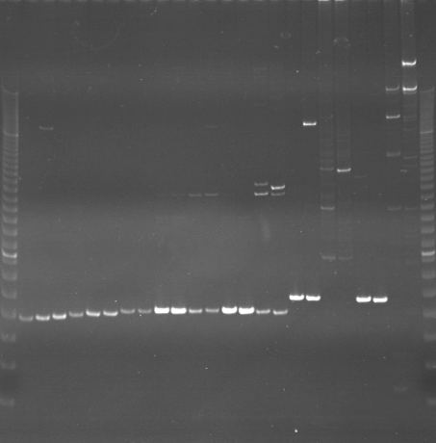
VES0328
VES0329
VES00330
m
Ac
Aw
Bc
Bw
Rc
Rw
Mc
Mw
Ac
Aw
Bc
Bw
Rc
Rw
Mc
Mw
Ac
Aw
Bc
Bw
Rc
Rw
Mc
Mw
m

Slide 15
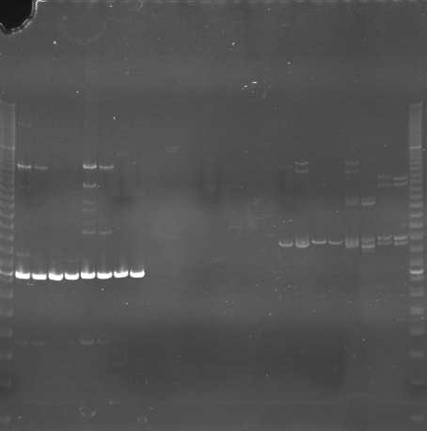
VES0331
VES0332
VES0333
m
Ac
Aw
Bc
Bw
Rc
Rw
Mc
Mw
Ac
Aw
Bc
Bw
Rc
Rw
Mc
Mw
Ac
Aw
Bc
Bw
Rc
Rw
Mc
Mw
m

Slide 16
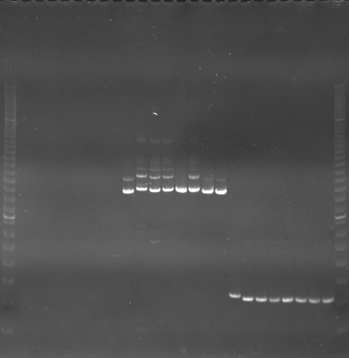
VES0334
VES0335
VES0336
m
Ac
Aw
Bc
Bw
Rc
Rw
Mc
Mw
Ac
Aw
Bc
Bw
Rc
Rw
Mc
Mw
Ac
Aw
Bc
Bw
Rc
Rw
Mc
Mw
m

