Slide 1
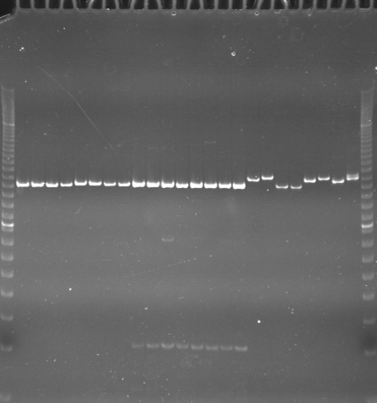
VES0433
VES0434
VES0435
m
Ac
Aw
Bc
Bw
Rc
Rw
Mc
Mw
Ac
Aw
Bc
Bw
Rc
Rw
Mc
Mw
Ac
Aw
Bc
Bw
Rc
Rw
Mc
Mw
m

Slide 2
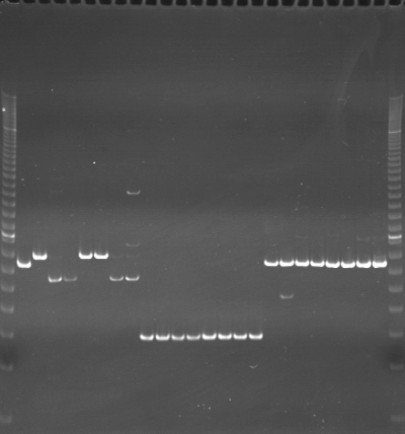
VES0436
VES0437
VES0438
m
Ac
Aw
Bc
Bw
Rc
Rw
Mc
Mw
Ac
Aw
Bc
Bw
Rc
Rw
Mc
Mw
Ac
Aw
Bc
Bw
Rc
Rw
Mc
Mw
m

Slide 3
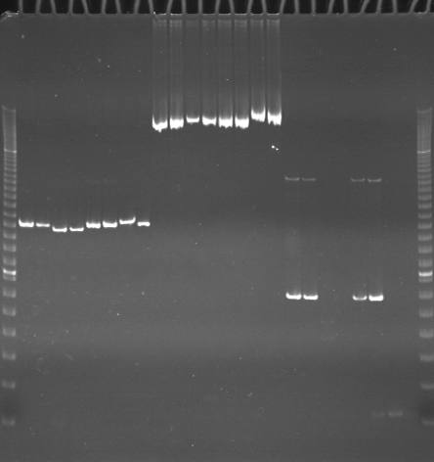
VES0439
VES0440
VES0441
m
Ac
Aw
Bc
Bw
Rc
Rw
Mc
Mw
Ac
Aw
Bc
Bw
Rc
Rw
Mc
Mw
Ac
Aw
Bc
Bw
Rc
Rw
Mc
Mw
m

Slide 4
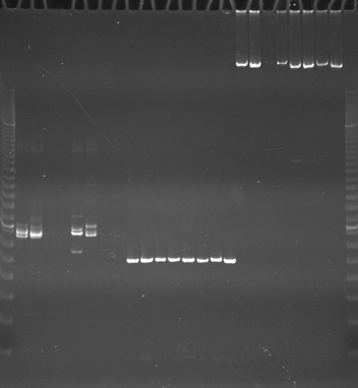
VES0443
VES0444
VES0445
m
Ac
Aw
Bc
Bw
Rc
Rw
Mc
Mw
Ac
Aw
Bc
Bw
Rc
Rw
Mc
Mw
Ac
Aw
Bc
Bw
Rc
Rw
Mc
Mw
m

Slide 5
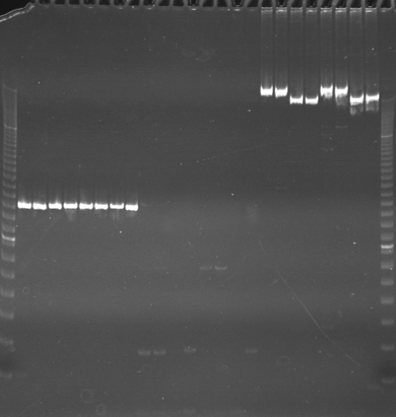
VES0445
VES0446
VES0447
m
Ac
Aw
Bc
Bw
Rc
Rw
Mc
Mw
Ac
Aw
Bc
Bw
Rc
Rw
Mc
Mw
Ac
Aw
Bc
Bw
Rc
Rw
Mc
Mw
m

Slide 6
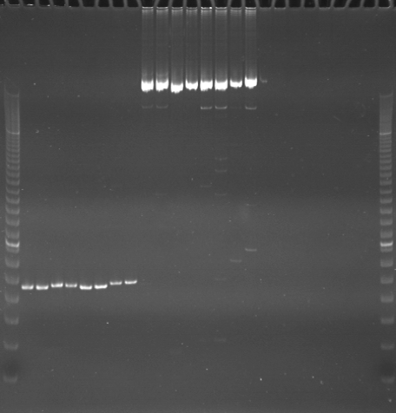
VES0448
VES0449
VES0450
m
Ac
Aw
Bc
Bw
Rc
Rw
Mc
Mw
Ac
Aw
Bc
Bw
Rc
Rw
Mc
Mw
Ac
Aw
Bc
Bw
Rc
Rw
Mc
Mw
m

Slide 7
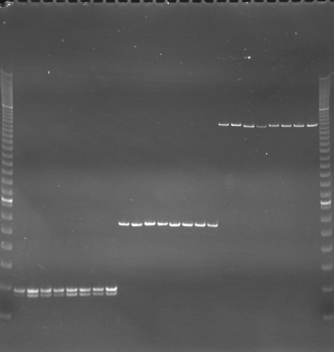
VES0451
VES0452
VES0453
m
Ac
Aw
Bc
Bw
Rc
Rw
Mc
Mw
Ac
Aw
Bc
Bw
Rc
Rw
Mc
Mw
Ac
Aw
Bc
Bw
Rc
Rw
Mc
Mw
m

Slide 8
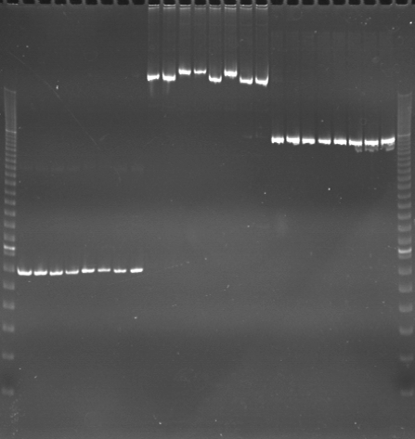
VES0454
VES0455
VES0456
m
Ac
Aw
Bc
Bw
Rc
Rw
Mc
Mw
Ac
Aw
Bc
Bw
Rc
Rw
Mc
Mw
Ac
Aw
Bc
Bw
Rc
Rw
Mc
Mw
m

Slide 9
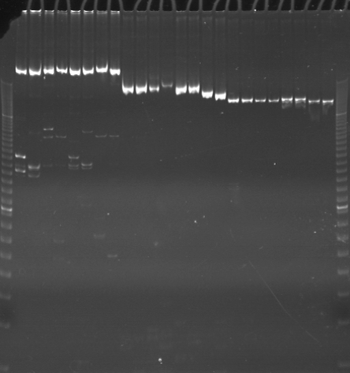
VES0457
VES0458
VES0459
m
Ac
Aw
Bc
Bw
Rc
Rw
Mc
Mw
Ac
Aw
Bc
Bw
Rc
Rw
Mc
Mw
Ac
Aw
Bc
Bw
Rc
Rw
Mc
Mw
m

Slide 10
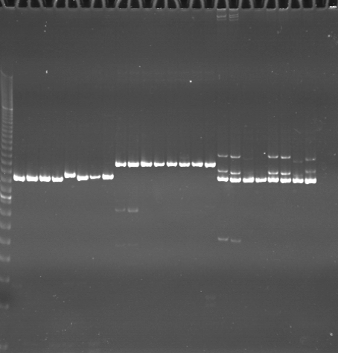
VES0460
VES0461
VES0462
m
Ac
Aw
Bc
Bw
Rc
Rw
Mc
Mw
Ac
Aw
Bc
Bw
Rc
Rw
Mc
Mw
Ac
Aw
Bc
Bw
Rc
Rw
Mc
Mw
m

Slide 11
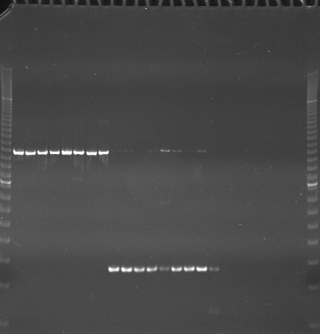
VES0463
VES0464
VES0465
m
Ac
Aw
Bc
Bw
Rc
Rw
Mc
Mw
Ac
Aw
Bc
Bw
Rc
Rw
Mc
Mw
Ac
Aw
Bc
Bw
Rc
Rw
Mc
Mw
m

Slide 12
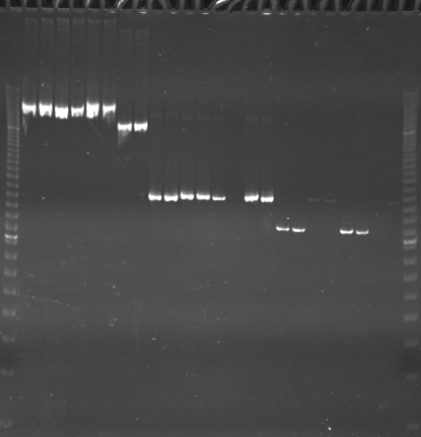
VES0466
VES0467
VES0468
m
Ac
Aw
Bc
Bw
Rc
Rw
Mc
Mw
Ac
Aw
Bc
Bw
Rc
Rw
Mc
Mw
Ac
Aw
Bc
Bw
Rc
Rw
Mc
Mw
m

Slide 13
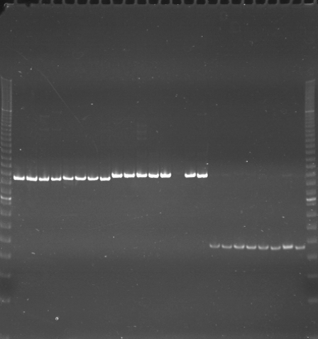
VES0469
VES0470
VES0471
m
Ac
Aw
Bc
Bw
Rc
Rw
Mc
Mw
Ac
Aw
Bc
Bw
Rc
Rw
Mc
Mw
Ac
Aw
Bc
Bw
Rc
Rw
Mc
Mw
m

Slide 14
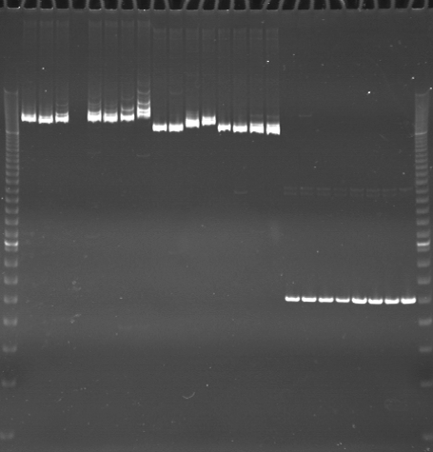
VES0472
VES0473
VES0474
m
Ac
Aw
Bc
Bw
Rc
Rw
Mc
Mw
Ac
Aw
Bc
Bw
Rc
Rw
Mc
Mw
Ac
Aw
Bc
Bw
Rc
Rw
Mc
Mw
m

Slide 15
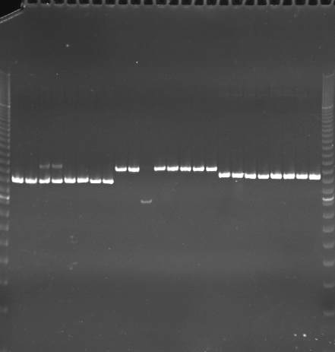
VES0475
VES0476
VES0477
m
Ac
Aw
Bc
Bw
Rc
Rw
Mc
Mw
Ac
Aw
Bc
Bw
Rc
Rw
Mc
Mw
Ac
Aw
Bc
Bw
Rc
Rw
Mc
Mw
m

Slide 16
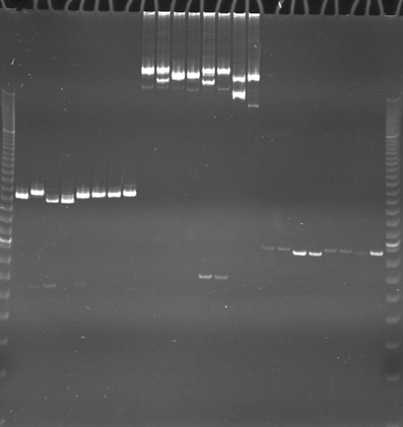
VES0478
VES0479
VES0480
m
Ac
Aw
Bc
Bw
Rc
Rw
Mc
Mw
Ac
Aw
Bc
Bw
Rc
Rw
Mc
Mw
Ac
Aw
Bc
Bw
Rc
Rw
Mc
Mw
m

