Slide 1
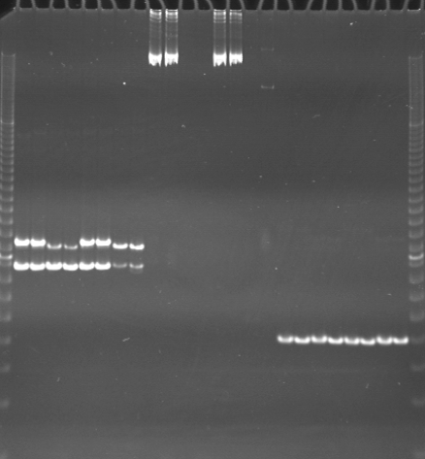
VES0481
VES0482
VES0483
m
Ac
Aw
Bc
Bw
Rc
Rw
Mc
Mw
Ac
Aw
Bc
Bw
Rc
Rw
Mc
Mw
Ac
Aw
Bc
Bw
Rc
Rw
Mc
Mw
m

Slide 2
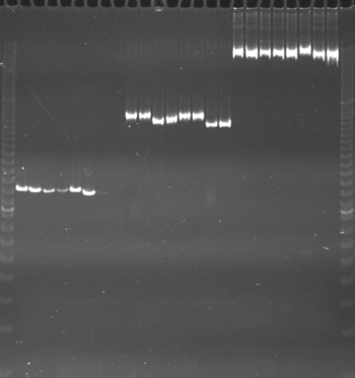
VES0484
VES0485
VES0486
m
Ac
Aw
Bc
Bw
Rc
Rw
Mc
Mw
Ac
Aw
Bc
Bw
Rc
Rw
Mc
Mw
Ac
Aw
Bc
Bw
Rc
Rw
Mc
Mw
m

Slide 3
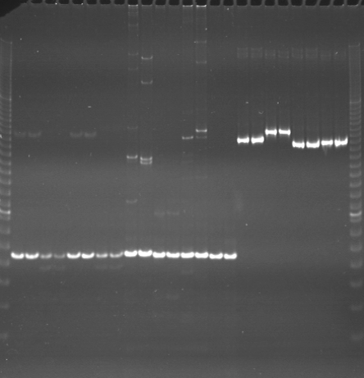
VES0487
VES0488
VES0489
m
Ac
Aw
Bc
Bw
Rc
Rw
Mc
Mw
Ac
Aw
Bc
Bw
Rc
Rw
Mc
Mw
Ac
Aw
Bc
Bw
Rc
Rw
Mc
Mw
m

Slide 4
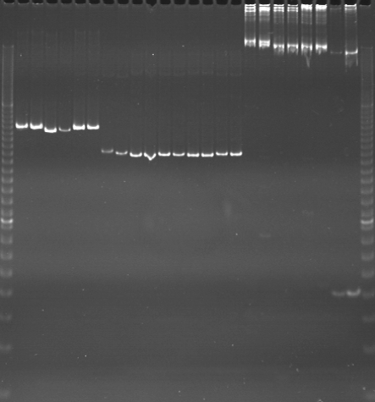
VES0490
VES0491
VES0492
m
Ac
Aw
Bc
Bw
Rc
Rw
Mc
Mw
Ac
Aw
Bc
Bw
Rc
Rw
Mc
Mw
Ac
Aw
Bc
Bw
Rc
Rw
Mc
Mw
m

Slide 5
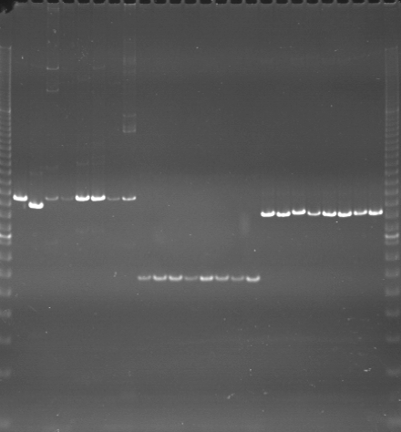
VES0493
VES0494
VES0495
m
Ac
Aw
Bc
Bw
Rc
Rw
Mc
Mw
Ac
Aw
Bc
Bw
Rc
Rw
Mc
Mw
Ac
Aw
Bc
Bw
Rc
Rw
Mc
Mw
m

Slide 6
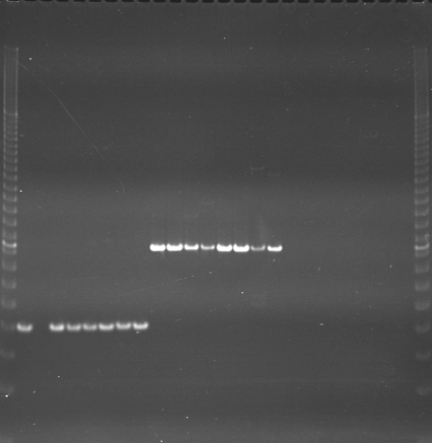
VES0496
VES0497
VES0498
m
Ac
Aw
Bc
Bw
Rc
Rw
Mc
Mw
Ac
Aw
Bc
Bw
Rc
Rw
Mc
Mw
Ac
Aw
Bc
Bw
Rc
Rw
Mc
Mw
m

Slide 7
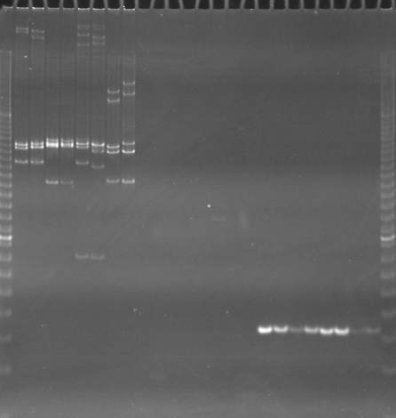
VES0499
VES0500
VES0003501
m
Ac
Aw
Bc
Bw
Rc
Rw
Mc
Mw
Ac
Aw
Bc
Bw
Rc
Rw
Mc
Mw
Ac
Aw
Bc
Bw
Rc
Rw
Mc
Mw
m

Slide 8
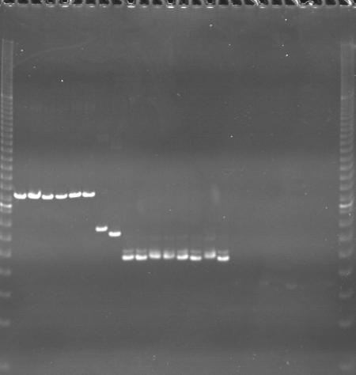
VES0502
VES0503
VES0504
m
Ac
Aw
Bc
Bw
Rc
Rw
Mc
Mw
Ac
Aw
Bc
Bw
Rc
Rw
Mc
Mw
Ac
Aw
Bc
Bw
Rc
Rw
Mc
Mw
m

Slide 9
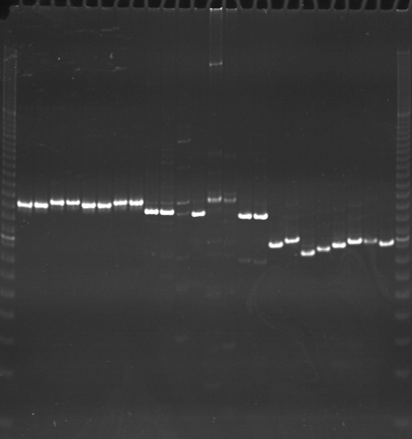
VES0505
VES0506
VES0507
m
Ac
Aw
Bc
Bw
Rc
Rw
Mc
Mw
Ac
Aw
Bc
Bw
Rc
Rw
Mc
Mw
Ac
Aw
Bc
Bw
Rc
Rw
Mc
Mw
m

Slide 10
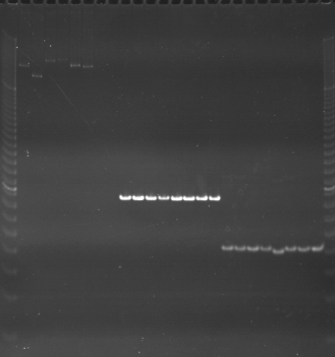
VES0508
VES0509
VES0510
m
Ac
Aw
Bc
Bw
Rc
Rw
Mc
Mw
Ac
Aw
Bc
Bw
Rc
Rw
Mc
Mw
Ac
Aw
Bc
Bw
Rc
Rw
Mc
Mw
m

Slide 11
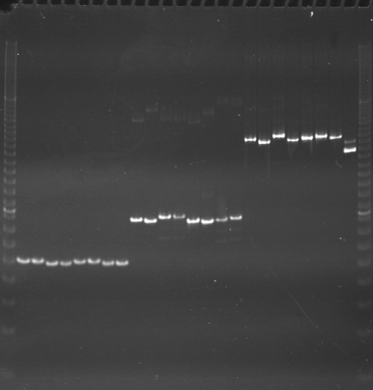
VES0511
VES0512
VES0513
m
Ac
Aw
Bc
Bw
Rc
Rw
Mc
Mw
Ac
Aw
Bc
Bw
Rc
Rw
Mc
Mw
Ac
Aw
Bc
Bw
Rc
Rw
Mc
Mw
m

Slide 12
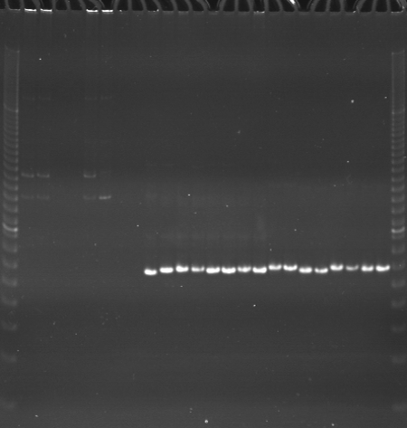
VES0514
VES0515
VES0516
m
Ac
Aw
Bc
Bw
Rc
Rw
Mc
Mw
Ac
Aw
Bc
Bw
Rc
Rw
Mc
Mw
Ac
Aw
Bc
Bw
Rc
Rw
Mc
Mw
m

Slide 13
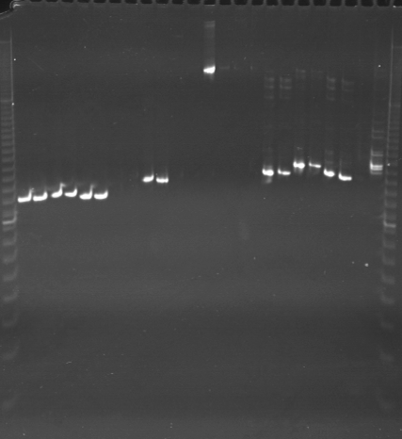
VES0517
VES0518
VES0519
m
Ac
Aw
Bc
Bw
Rc
Rw
Mc
Mw
Ac
Aw
Bc
Bw
Rc
Rw
Mc
Mw
Ac
Aw
Bc
Bw
Rc
Rw
Mc
Mw
m

Slide 14
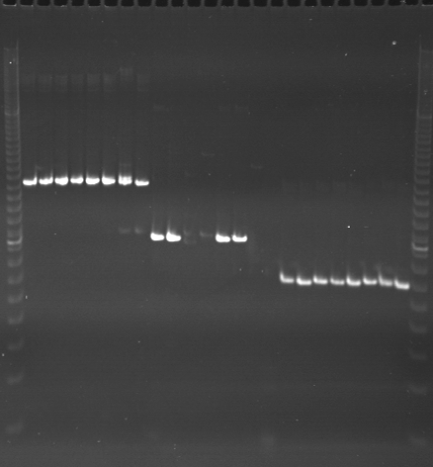
VES0520
VES0521
VES0522
m
Ac
Aw
Bc
Bw
Rc
Rw
Mc
Mw
Ac
Aw
Bc
Bw
Rc
Rw
Mc
Mw
Ac
Aw
Bc
Bw
Rc
Rw
Mc
Mw
m

Slide 15
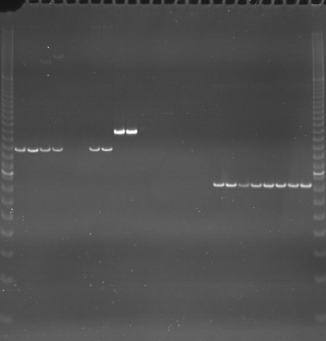
VES0523
VES0524
VES0525
m
Ac
Aw
Bc
Bw
Rc
Rw
Mc
Mw
Ac
Aw
Bc
Bw
Rc
Rw
Mc
Mw
Ac
Aw
Bc
Bw
Rc
Rw
Mc
Mw
m

Slide 16
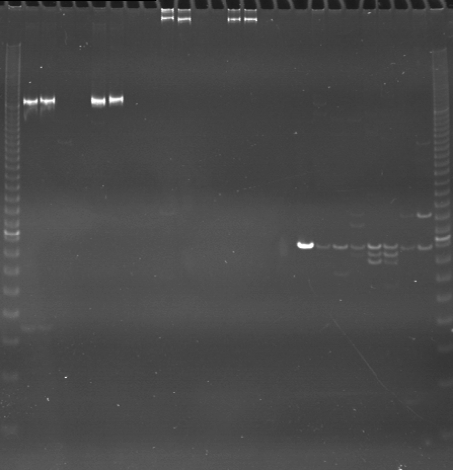
VES0526
VES0527
VES0528
m
Ac
Aw
Bc
Bw
Rc
Rw
Mc
Mw
Ac
Aw
Bc
Bw
Rc
Rw
Mc
Mw
Ac
Aw
Bc
Bw
Rc
Rw
Mc
Mw
m

