Slide 1
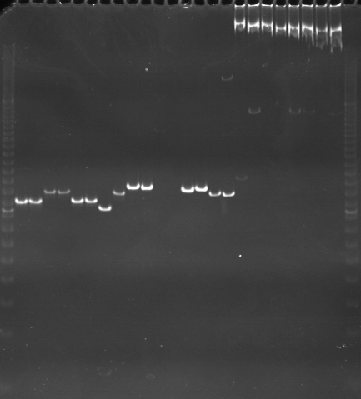
VES0577
VES0578
VES0579
m
Ac
Aw
Bc
Bw
Rc
Rw
Mc
Mw
Ac
Aw
Bc
Bw
Rc
Rw
Mc
Mw
Ac
Aw
Bc
Bw
Rc
Rw
Mc
Mw
m

Slide 2
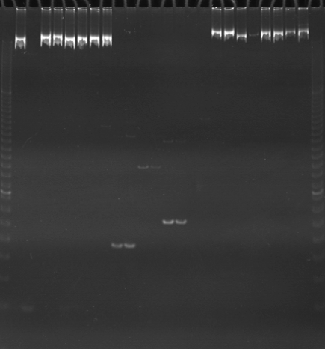
VES0580
VES0581
VES0582
m
Ac
Aw
Bc
Bw
Rc
Rw
Mc
Mw
Ac
Aw
Bc
Bw
Rc
Rw
Mc
Mw
Ac
Aw
Bc
Bw
Rc
Rw
Mc
Mw
m

Slide 3
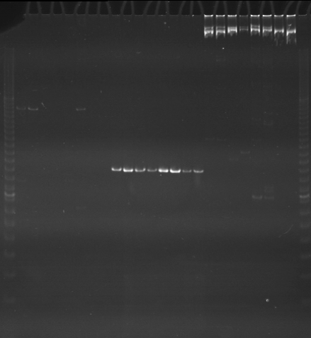
VES0583
VES0584
VES0585
m
Ac
Aw
Bc
Bw
Rc
Rw
Mc
Mw
Ac
Aw
Bc
Bw
Rc
Rw
Mc
Mw
Ac
Aw
Bc
Bw
Rc
Rw
Mc
Mw
m

Slide 4
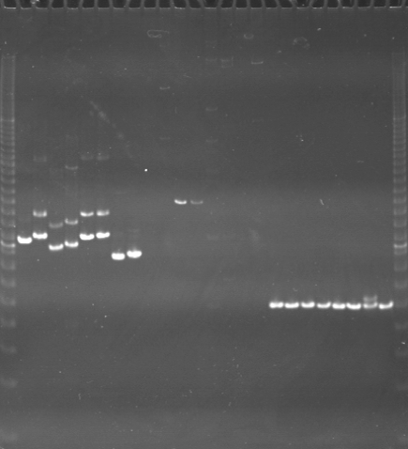
VES0586
VES0587
VES0588
m
Ac
Aw
Bc
Bw
Rc
Rw
Mc
Mw
Ac
Aw
Bc
Bw
Rc
Rw
Mc
Mw
Ac
Aw
Bc
Bw
Rc
Rw
Mc
Mw
m

Slide 5
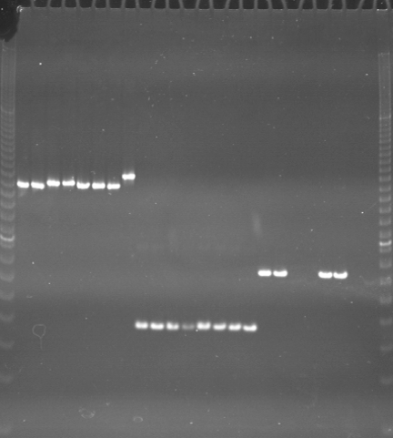
VES0589
VES0590
VES0591
m
Ac
Aw
Bc
Bw
Rc
Rw
Mc
Mw
Ac
Aw
Bc
Bw
Rc
Rw
Mc
Mw
Ac
Aw
Bc
Bw
Rc
Rw
Mc
Mw
m

Slide 6
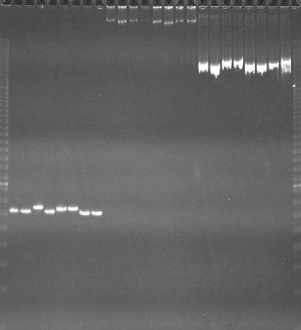
VES0592
VES0593
VES0594
m
Ac
Aw
Bc
Bw
Rc
Rw
Mc
Mw
Ac
Aw
Bc
Bw
Rc
Rw
Mc
Mw
Ac
Aw
Bc
Bw
Rc
Rw
Mc
Mw
m

Slide 7
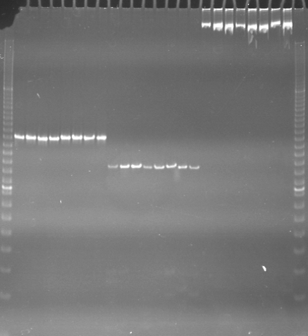
VES0595
VES0596
VES0597
m
Ac
Aw
Bc
Bw
Rc
Rw
Mc
Mw
Ac
Aw
Bc
Bw
Rc
Rw
Mc
Mw
Ac
Aw
Bc
Bw
Rc
Rw
Mc
Mw
m

Slide 8
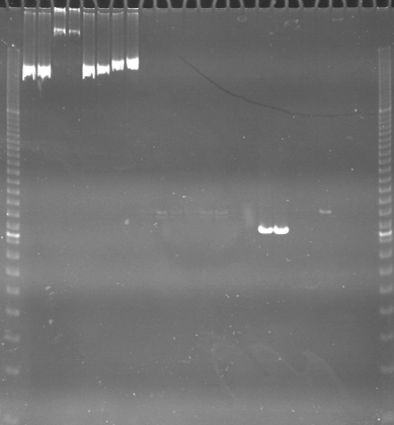
VES0598
VES0599
VES0600
m
Ac
Aw
Bc
Bw
Rc
Rw
Mc
Mw
Ac
Aw
Bc
Bw
Rc
Rw
Mc
Mw
Ac
Aw
Bc
Bw
Rc
Rw
Mc
Mw
m

Slide 9
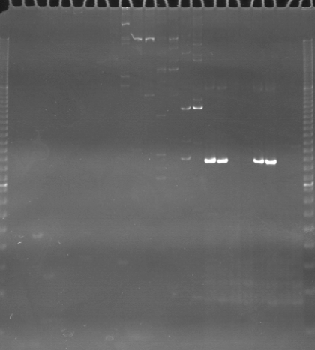
VES0601
VES0602
VES0603
m
Ac
Aw
Bc
Bw
Rc
Rw
Mc
Mw
Ac
Aw
Bc
Bw
Rc
Rw
Mc
Mw
Ac
Aw
Bc
Bw
Rc
Rw
Mc
Mw
m

Slide 10
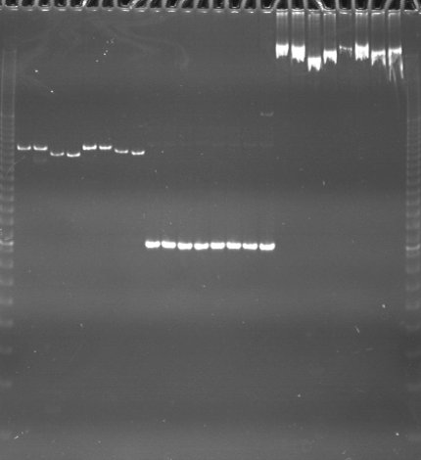
VES0604
VES0604
VES0606
m
Ac
Aw
Bc
Bw
Rc
Rw
Mc
Mw
Ac
Aw
Bc
Bw
Rc
Rw
Mc
Mw
Ac
Aw
Bc
Bw
Rc
Rw
Mc
Mw
m

Slide 11
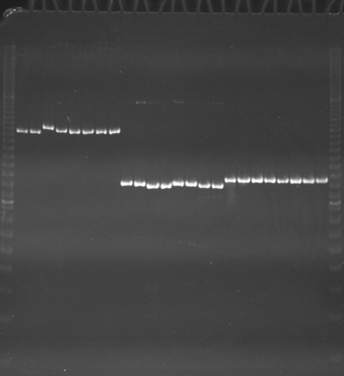
VES0607
VES0608
VES0609
m
Ac
Aw
Bc
Bw
Rc
Rw
Mc
Mw
Ac
Aw
Bc
Bw
Rc
Rw
Mc
Mw
Ac
Aw
Bc
Bw
Rc
Rw
Mc
Mw
m

Slide 12
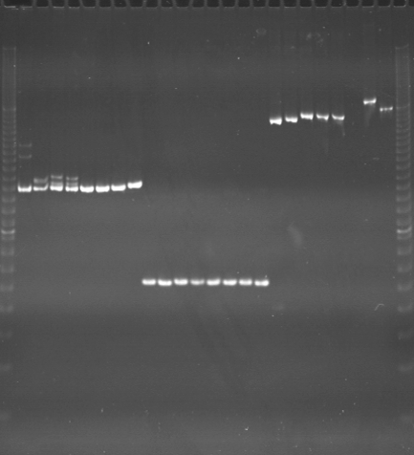
VES0610
VES0611
VES0612
m
Ac
Aw
Bc
Bw
Rc
Rw
Mc
Mw
Ac
Aw
Bc
Bw
Rc
Rw
Mc
Mw
Ac
Aw
Bc
Bw
Rc
Rw
Mc
Mw
m

Slide 13
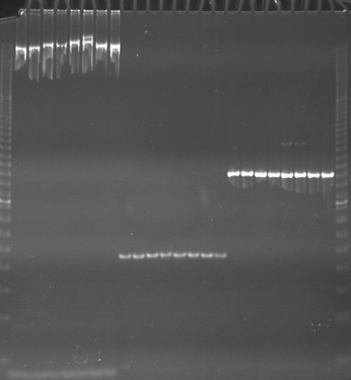
VES0613
VES0614
VES0615
m
Ac
Aw
Bc
Bw
Rc
Rw
Mc
Mw
Ac
Aw
Bc
Bw
Rc
Rw
Mc
Mw
Ac
Aw
Bc
Bw
Rc
Rw
Mc
Mw
m

Slide 14
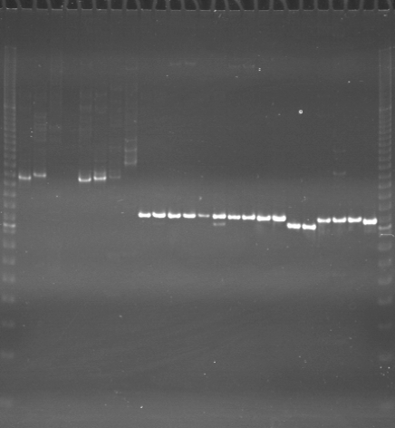
VES0616
VES0617
VES0618
m
Ac
Aw
Bc
Bw
Rc
Rw
Mc
Mw
Ac
Aw
Bc
Bw
Rc
Rw
Mc
Mw
Ac
Aw
Bc
Bw
Rc
Rw
Mc
Mw
m

Slide 15
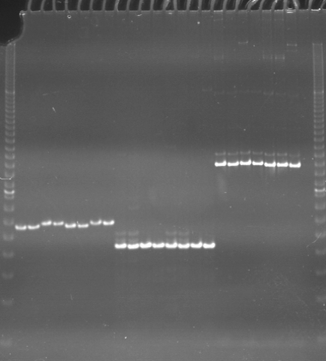
VES0619
VES0620
VES0621
m
Ac
Aw
Bc
Bw
Rc
Rw
Mc
Mw
Ac
Aw
Bc
Bw
Rc
Rw
Mc
Mw
Ac
Aw
Bc
Bw
Rc
Rw
Mc
Mw
m

Slide 16
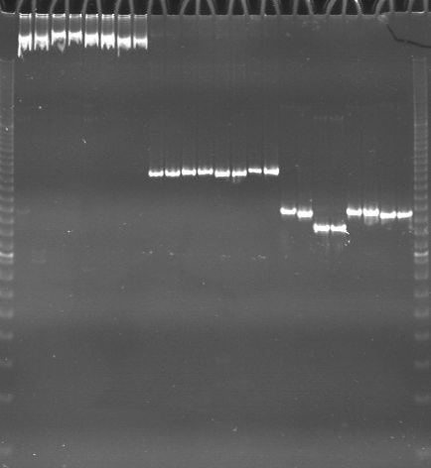
VES0622
VES0623
VES0624
m
Ac
Aw
Bc
Bw
Rc
Rw
Mc
Mw
Ac
Aw
Bc
Bw
Rc
Rw
Mc
Mw
Ac
Aw
Bc
Bw
Rc
Rw
Mc
Mw
m

