Slide 1
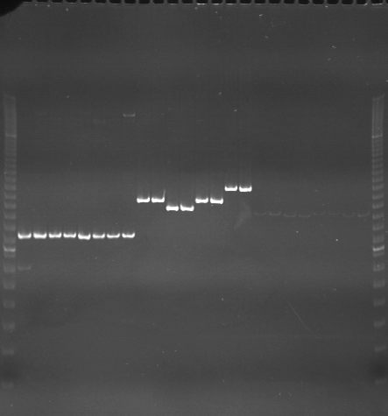
VES0625
VES0626
VES0627
m
Ac
Aw
Bc
Bw
Rc
Rw
Mc
Mw
Ac
Aw
Bc
Bw
Rc
Rw
Mc
Mw
Ac
Aw
Bc
Bw
Rc
Rw
Mc
Mw
m

Slide 2
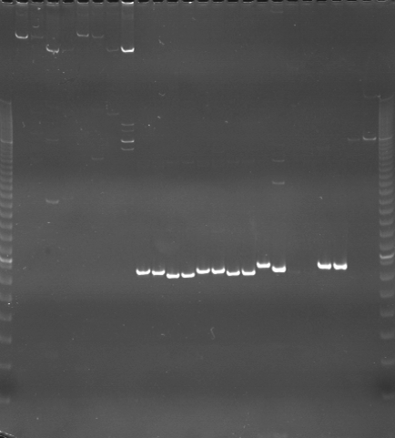
VES0628
VES0629
VES0630
m
Ac
Aw
Bc
Bw
Rc
Rw
Mc
Mw
Ac
Aw
Bc
Bw
Rc
Rw
Mc
Mw
Ac
Aw
Bc
Bw
Rc
Rw
Mc
Mw
m

Slide 3
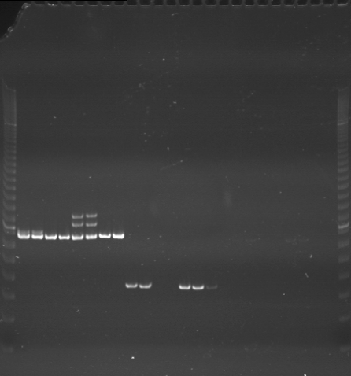
VES0631
VES0632
VES0633
m
Ac
Aw
Bc
Bw
Rc
Rw
Mc
Mw
Ac
Aw
Bc
Bw
Rc
Rw
Mc
Mw
Ac
Aw
Bc
Bw
Rc
Rw
Mc
Mw
m

Slide 4
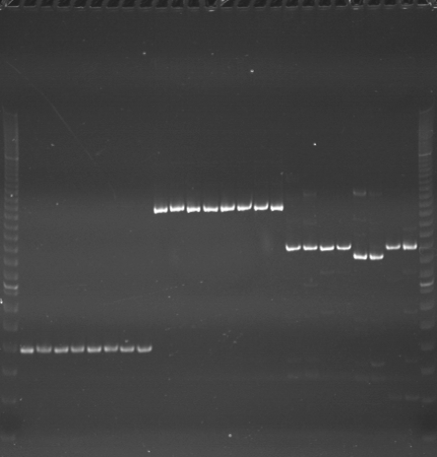
VES0634
VES0635
VES0636
m
Ac
Aw
Bc
Bw
Rc
Rw
Mc
Mw
Ac
Aw
Bc
Bw
Rc
Rw
Mc
Mw
Ac
Aw
Bc
Bw
Rc
Rw
Mc
Mw
m

Slide 5
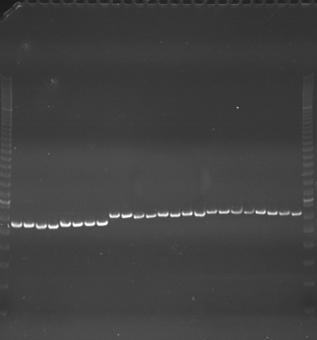
VES0637
VES0638
VES0639
m
Ac
Aw
Bc
Bw
Rc
Rw
Mc
Mw
Ac
Aw
Bc
Bw
Rc
Rw
Mc
Mw
Ac
Aw
Bc
Bw
Rc
Rw
Mc
Mw
m

Slide 6
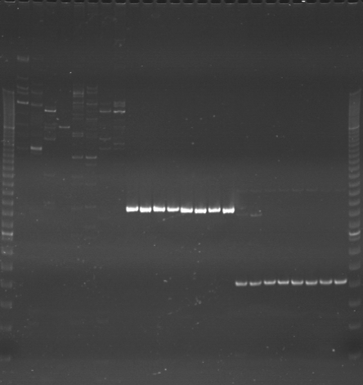
VES0640
VES0641
VES0642
m
Ac
Aw
Bc
Bw
Rc
Rw
Mc
Mw
Ac
Aw
Bc
Bw
Rc
Rw
Mc
Mw
Ac
Aw
Bc
Bw
Rc
Rw
Mc
Mw
m

Slide 7
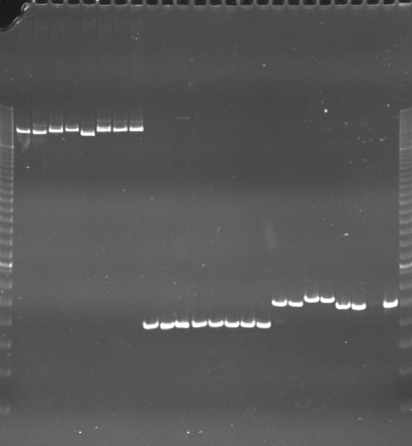
VES0643
VES0644
VES0645
m
Ac
Aw
Bc
Bw
Rc
Rw
Mc
Mw
Ac
Aw
Bc
Bw
Rc
Rw
Mc
Mw
Ac
Aw
Bc
Bw
Rc
Rw
Mc
Mw
m

Slide 8
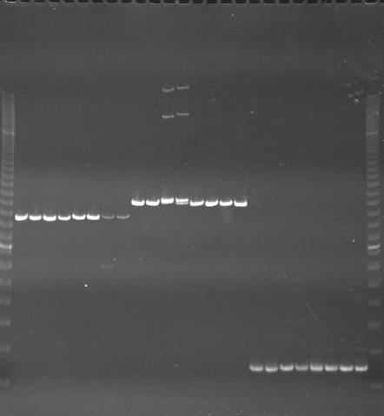
VES0646
VES0647
VES0648
m
Ac
Aw
Bc
Bw
Rc
Rw
Mc
Mw
Ac
Aw
Bc
Bw
Rc
Rw
Mc
Mw
Ac
Aw
Bc
Bw
Rc
Rw
Mc
Mw
m

Slide 9
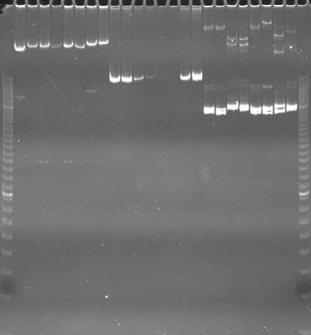
VES0649
VES0650
VES0651
m
Ac
Aw
Bc
Bw
Rc
Rw
Mc
Mw
Ac
Aw
Bc
Bw
Rc
Rw
Mc
Mw
Ac
Aw
Bc
Bw
Rc
Rw
Mc
Mw
m

Slide 10
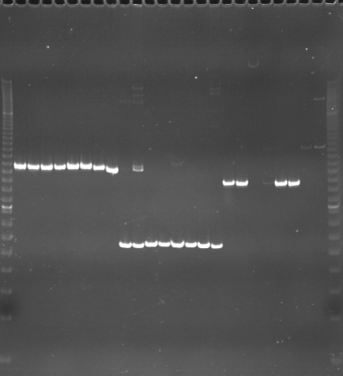
VES0652
VES0653
VES0654
m
Ac
Aw
Bc
Bw
Rc
Rw
Mc
Mw
Ac
Aw
Bc
Bw
Rc
Rw
Mc
Mw
Ac
Aw
Bc
Bw
Rc
Rw
Mc
Mw
m

Slide 11
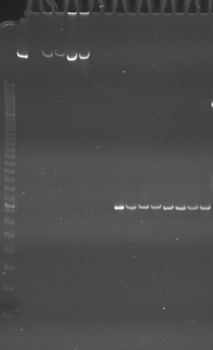
VES0655
VES0656
m
Ac
Aw
Bc
Bw
Rc
Rw
Mc
Mw
Ac
Aw
Bc
Bw
Rc
Rw
Mc
Mw

