Slide 1
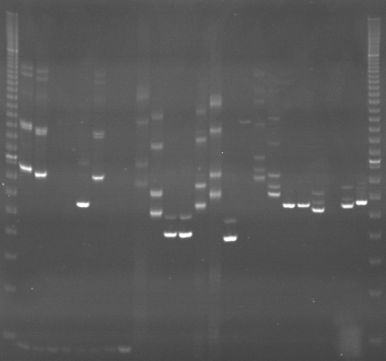
VES0657
VES0658
VES0659
m
Ac
Aw
Bc
Bw
Rc
Rw
Mc
Mw
Ac
Aw
Bc
Bw
Rc
Rw
Mc
Mw
Ac
Aw
Bc
Bw
Rc
Rw
Mc
Mw
m

Slide 2
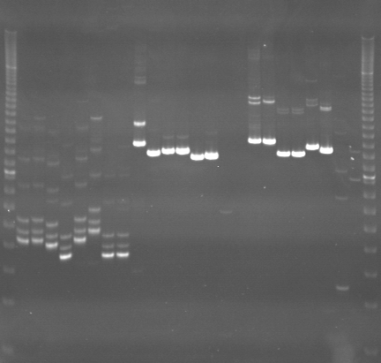
VES0660
VES0661
VES0662
m
Ac
Aw
Bc
Bw
Rc
Rw
Mc
Mw
Ac
Aw
Bc
Bw
Rc
Rw
Mc
Mw
Ac
Aw
Bc
Bw
Rc
Rw
Mc
Mw
m

Slide 3
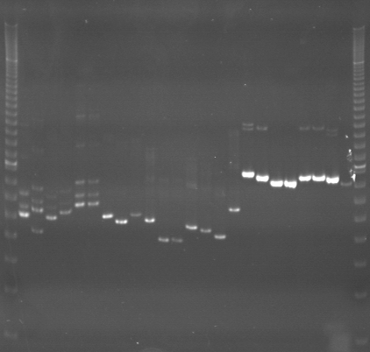
VES0663
VES0664
VES0665
m
Ac
Aw
Bc
Bw
Rc
Rw
Mc
Mw
Ac
Aw
Bc
Bw
Rc
Rw
Mc
Mw
Ac
Aw
Bc
Bw
Rc
Rw
Mc
Mw
m

Slide 4
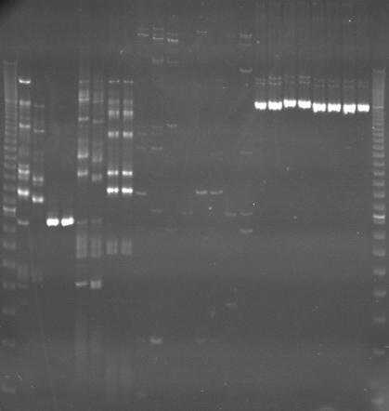
VES0666
VES0667
VES0668
m
Ac
Aw
Bc
Bw
Rc
Rw
Mc
Mw
Ac
Aw
Bc
Bw
Rc
Rw
Mc
Mw
Ac
Aw
Bc
Bw
Rc
Rw
Mc
Mw
m

Slide 5
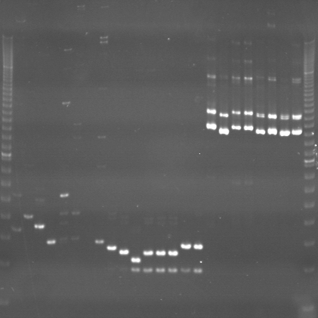
VES0669
VES0670
VES0671
m
Ac
Aw
Bc
Bw
Rc
Rw
Mc
Mw
Ac
Aw
Bc
Bw
Rc
Rw
Mc
Mw
Ac
Aw
Bc
Bw
Rc
Rw
Mc
Mw
m

Slide 6
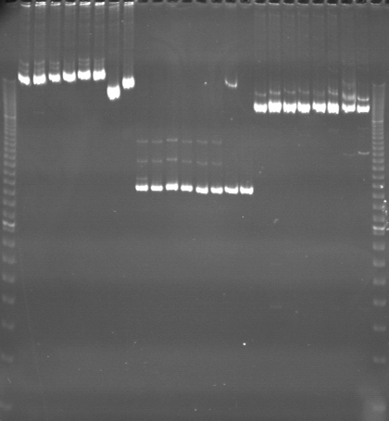
VES0672
VES0673
VES0674
m
Ac
Aw
Bc
Bw
Rc
Rw
Mc
Mw
Ac
Aw
Bc
Bw
Rc
Rw
Mc
Mw
Ac
Aw
Bc
Bw
Rc
Rw
Mc
Mw
m

Slide 7
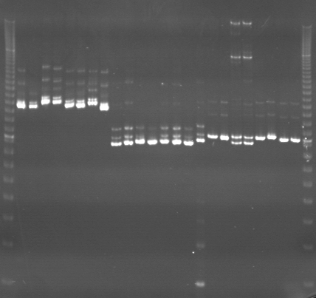
VES0675
VES0676
VES0677
m
Ac
Aw
Bc
Bw
Rc
Rw
Mc
Mw
Ac
Aw
Bc
Bw
Rc
Rw
Mc
Mw
Ac
Aw
Bc
Bw
Rc
Rw
Mc
Mw
m

Slide 8
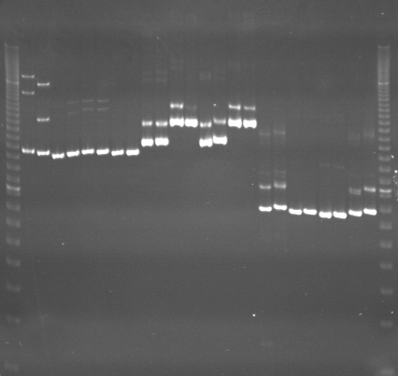
VES0678
VES0679
VES0680
m
Ac
Aw
Bc
Bw
Rc
Rw
Mc
Mw
Ac
Aw
Bc
Bw
Rc
Rw
Mc
Mw
Ac
Aw
Bc
Bw
Rc
Rw
Mc
Mw
m

Slide 9
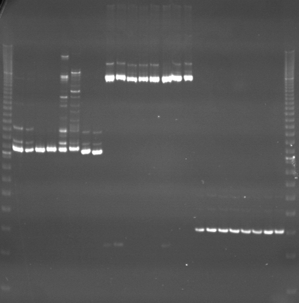
VES0681
VES0682
VES0683
m
Ac
Aw
Bc
Bw
Rc
Rw
Mc
Mw
Ac
Aw
Bc
Bw
Rc
Rw
Mc
Mw
Ac
Aw
Bc
Bw
Rc
Rw
Mc
Mw
m

Slide 10
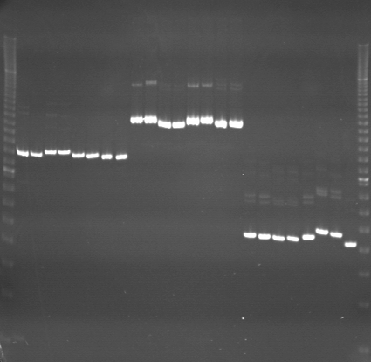
VES0684
VES0685
VES0686
m
Ac
Aw
Bc
Bw
Rc
Rw
Mc
Mw
Ac
Aw
Bc
Bw
Rc
Rw
Mc
Mw
Ac
Aw
Bc
Bw
Rc
Rw
Mc
Mw
m

Slide 11
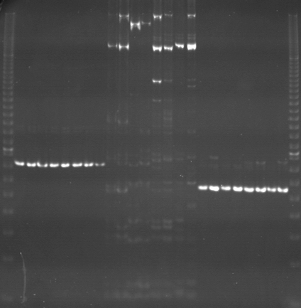
VES0687
VES0688
VES0689
m
Ac
Aw
Bc
Bw
Rc
Rw
Mc
Mw
Ac
Aw
Bc
Bw
Rc
Rw
Mc
Mw
Ac
Aw
Bc
Bw
Rc
Rw
Mc
Mw
m

Slide 12
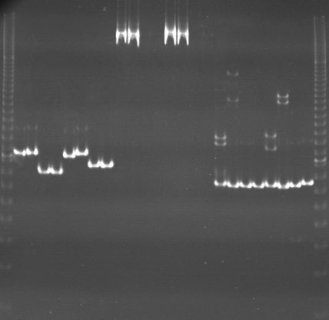
VES0690
VES0691
VES0692
m
Ac
Aw
Bc
Bw
Rc
Rw
Mc
Mw
Ac
Aw
Bc
Bw
Rc
Rw
Mc
Mw
Ac
Aw
Bc
Bw
Rc
Rw
Mc
Mw
m

Slide 13
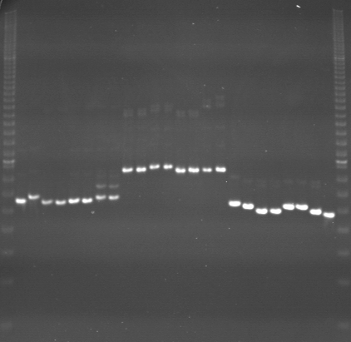
VES0693
VES0694
VES0695
m
Ac
Aw
Bc
Bw
Rc
Rw
Mc
Mw
Ac
Aw
Bc
Bw
Rc
Rw
Mc
Mw
Ac
Aw
Bc
Bw
Rc
Rw
Mc
Mw
m

Slide 14
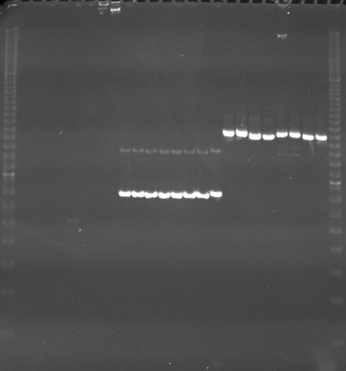
VES0696
VES0697
VES0698
m
Ac
Aw
Bc
Bw
Rc
Rw
Mc
Mw
Ac
Aw
Bc
Bw
Rc
Rw
Mc
Mw
Ac
Aw
Bc
Bw
Rc
Rw
Mc
Mw
m

Slide 15
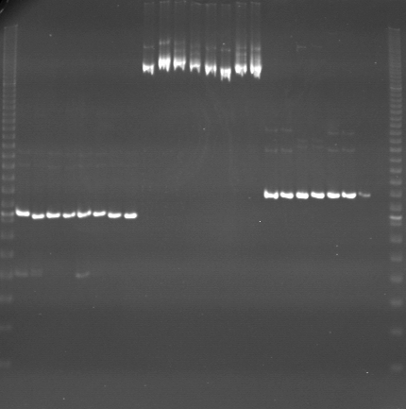
VES0699
VES0700
VES0701
m
Ac
Aw
Bc
Bw
Rc
Rw
Mc
Mw
Ac
Aw
Bc
Bw
Rc
Rw
Mc
Mw
Ac
Aw
Bc
Bw
Rc
Rw
Mc
Mw
m

Slide 16
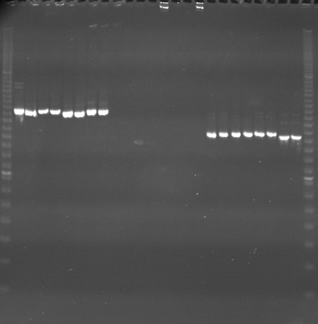
VES0702
VES0703
VES0704
m
Ac
Aw
Bc
Bw
Rc
Rw
Mc
Mw
Ac
Aw
Bc
Bw
Rc
Rw
Mc
Mw
Ac
Aw
Bc
Bw
Rc
Rw
Mc
Mw
m

