Slide 1
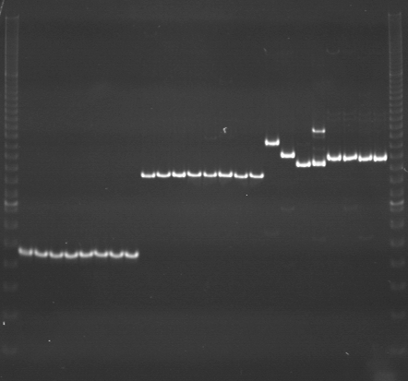
VES0801
VES0802
VES0803
m
Ac
Aw
Bc
Bw
Rc
Rw
Mc
Mw
Ac
Aw
Bc
Bw
Rc
Rw
Mc
Mw
Ac
Aw
Bc
Bw
Rc
Rw
Mc
Mw
m

Slide 2
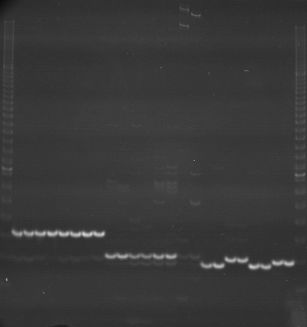
VES0804
VES0805
VES0806
m
Ac
Aw
Bc
Bw
Rc
Rw
Mc
Mw
Ac
Aw
Bc
Bw
Rc
Rw
Mc
Mw
Ac
Aw
Bc
Bw
Rc
Rw
Mc
Mw
m

Slide 3
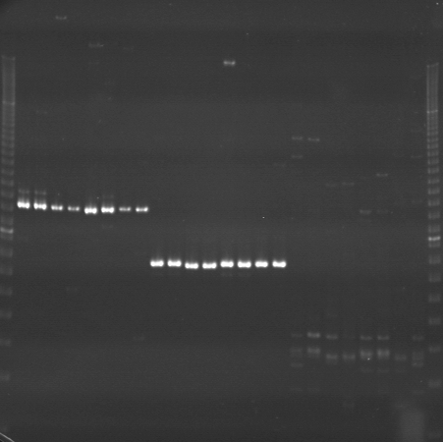
VES0807
VES0808
VES0809
m
Ac
Aw
Bc
Bw
Rc
Rw
Mc
Mw
Ac
Aw
Bc
Bw
Rc
Rw
Mc
Mw
Ac
Aw
Bc
Bw
Rc
Rw
Mc
Mw
m

Slide 4
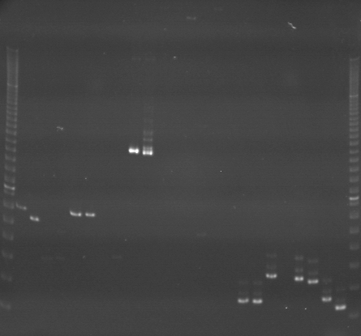
VES0810
VES0811
VES0812
m
Ac
Aw
Bc
Bw
Rc
Rw
Mc
Mw
Ac
Aw
Bc
Bw
Rc
Rw
Mc
Mw
Ac
Aw
Bc
Bw
Rc
Rw
Mc
Mw
m

Slide 5
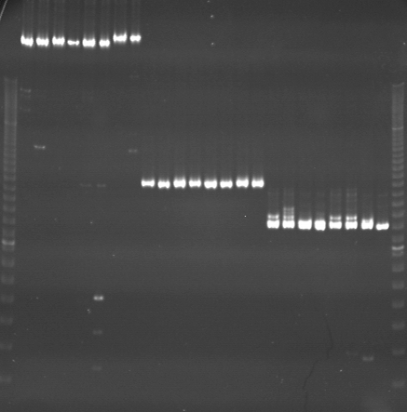
VES0813
VES0814
VES0815
m
Ac
Aw
Bc
Bw
Rc
Rw
Mc
Mw
Ac
Aw
Bc
Bw
Rc
Rw
Mc
Mw
Ac
Aw
Bc
Bw
Rc
Rw
Mc
Mw
m

Slide 6
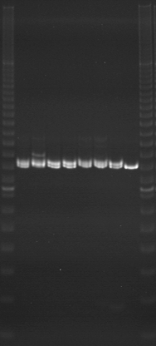
VES0815（再泳動）
m
Ac
Aw
Bc
Bw
Rc
Rw
Mc
Mw
m

Slide 7
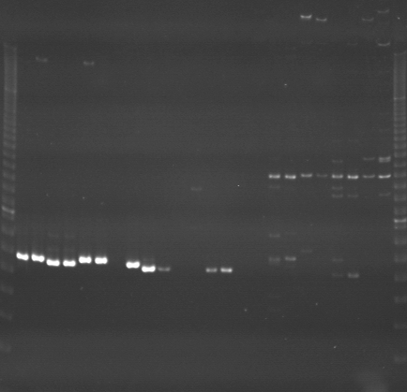
VES0816
VES0817
VES0818
m
Ac
Aw
Bc
Bw
Rc
Rw
Mc
Mw
Ac
Aw
Bc
Bw
Rc
Rw
Mc
Mw
Ac
Aw
Bc
Bw
Rc
Rw
Mc
Mw
m

Slide 8
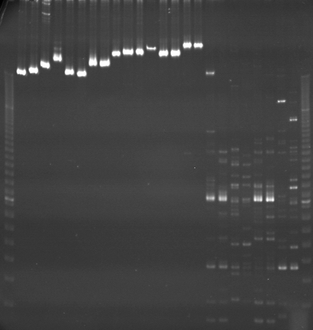
VES0819
VES0820
VES0821
m
Ac
Aw
Bc
Bw
Rc
Rw
Mc
Mw
Ac
Aw
Bc
Bw
Rc
Rw
Mc
Mw
Ac
Aw
Bc
Bw
Rc
Rw
Mc
Mw
m

Slide 9
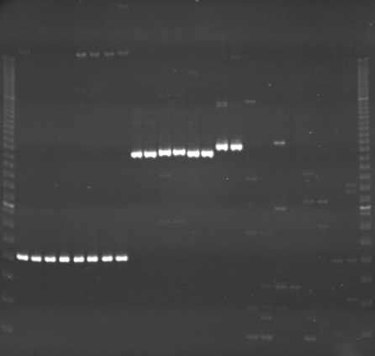
VES0822
VES0823
VES0824
m
Ac
Aw
Bc
Bw
Rc
Rw
Mc
Mw
Ac
Aw
Bc
Bw
Rc
Rw
Mc
Mw
Ac
Aw
Bc
Bw
Rc
Rw
Mc
Mw
m

Slide 10
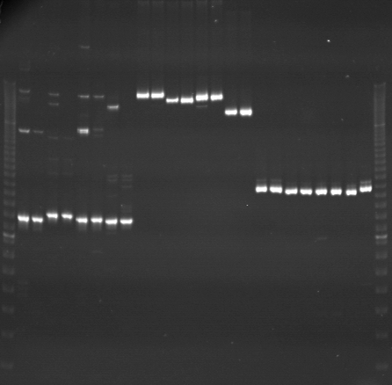
VES0825
VES0826
VES0827
m
Ac
Aw
Bc
Bw
Rc
Rw
Mc
Mw
Ac
Aw
Bc
Bw
Rc
Rw
Mc
Mw
Ac
Aw
Bc
Bw
Rc
Rw
Mc
Mw
m

Slide 11
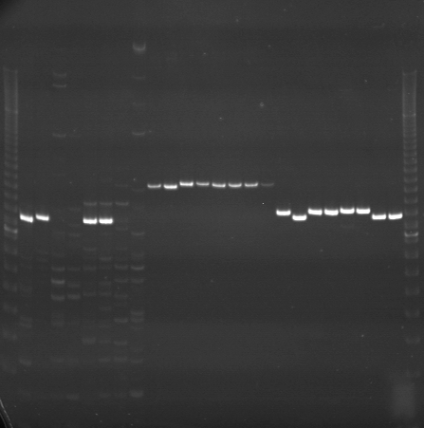
VES0828
VES0829
VES0830
m
Ac
Aw
Bc
Bw
Rc
Rw
Mc
Mw
Ac
Aw
Bc
Bw
Rc
Rw
Mc
Mw
Ac
Aw
Bc
Bw
Rc
Rw
Mc
Mw
m

Slide 12
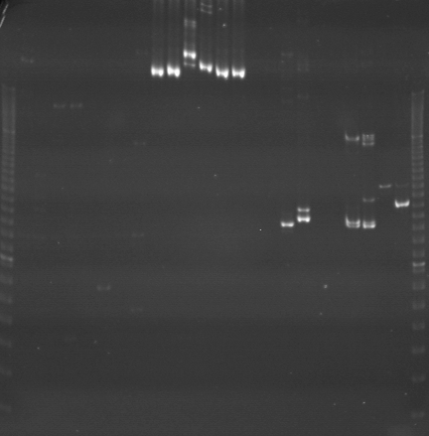
VES0831
VES0832
VES0833
m
Ac
Aw
Bc
Bw
Rc
Rw
Mc
Mw
Ac
Aw
Bc
Bw
Rc
Rw
Mc
Mw
Ac
Aw
Bc
Bw
Rc
Rw
Mc
Mw
m

Slide 13
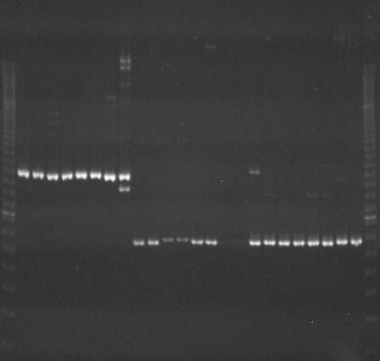
VES0834
VES0835
VES0836
m
Ac
Aw
Bc
Bw
Rc
Rw
Mc
Mw
Ac
Aw
Bc
Bw
Rc
Rw
Mc
Mw
Ac
Aw
Bc
Bw
Rc
Rw
Mc
Mw
m

Slide 14
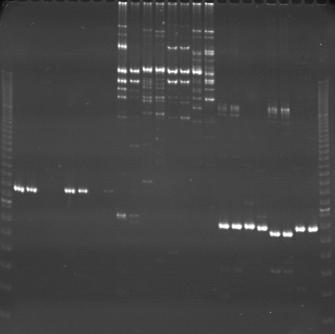
VES0837
VES0838
VES0839
m
Ac
Aw
Bc
Bw
Rc
Rw
Mc
Mw
Ac
Aw
Bc
Bw
Rc
Rw
Mc
Mw
Ac
Aw
Bc
Bw
Rc
Rw
Mc
Mw
m

Slide 15
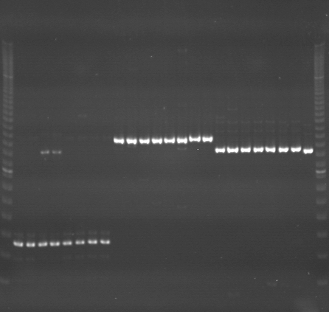
VES0840
VES0841
VES0842
m
Ac
Aw
Bc
Bw
Rc
Rw
Mc
Mw
Ac
Aw
Bc
Bw
Rc
Rw
Mc
Mw
Ac
Aw
Bc
Bw
Rc
Rw
Mc
Mw
m

Slide 16
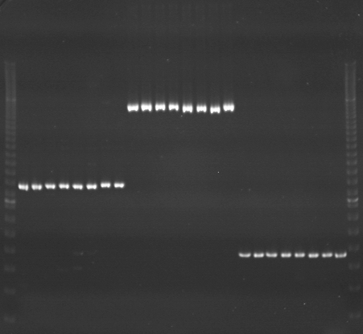
VES0843
VES0844
VES0845
m
Ac
Aw
Bc
Bw
Rc
Rw
Mc
Mw
Ac
Aw
Bc
Bw
Rc
Rw
Mc
Mw
Ac
Aw
Bc
Bw
Rc
Rw
Mc
Mw
m

Slide 17
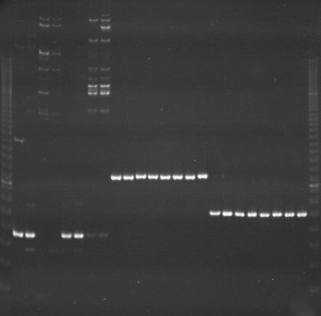
VES0846
VES0847
VES0848
m
Ac
Aw
Bc
Bw
Rc
Rw
Mc
Mw
Ac
Aw
Bc
Bw
Rc
Rw
Mc
Mw
Ac
Aw
Bc
Bw
Rc
Rw
Mc
Mw
m

