Slide 1
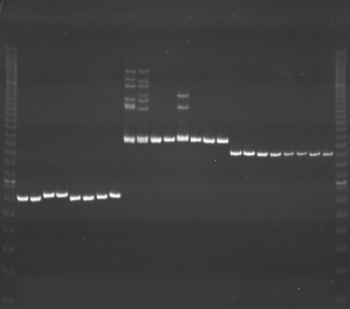
VES0849
VES0850
VES0851
m
Ac
Aw
Bc
Bw
Rc
Rw
Mc
Mw
Ac
Aw
Bc
Bw
Rc
Rw
Mc
Mw
Ac
Aw
Bc
Bw
Rc
Rw
Mc
Mw
m

Slide 2
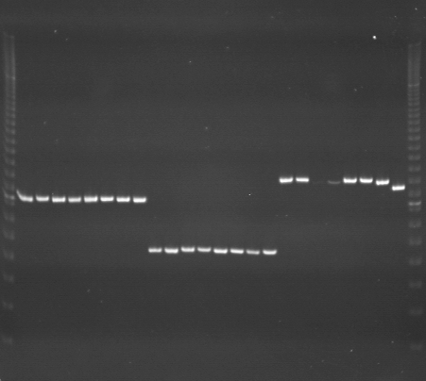
VES0852
VES0853
VES0854
m
Ac
Aw
Bc
Bw
Rc
Rw
Mc
Mw
Ac
Aw
Bc
Bw
Rc
Rw
Mc
Mw
Ac
Aw
Bc
Bw
Rc
Rw
Mc
Mw
m

Slide 3
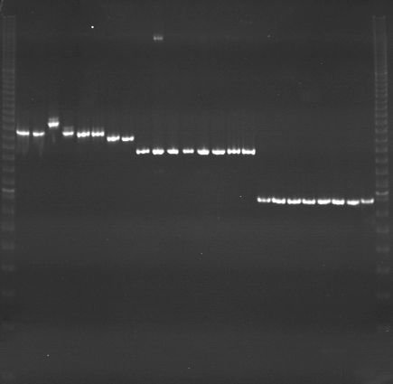
VES0855
VES0856
VES0857
m
Ac
Aw
Bc
Bw
Rc
Rw
Mc
Mw
Ac
Aw
Bc
Bw
Rc
Rw
Mc
Mw
Ac
Aw
Bc
Bw
Rc
Rw
Mc
Mw
m

Slide 4
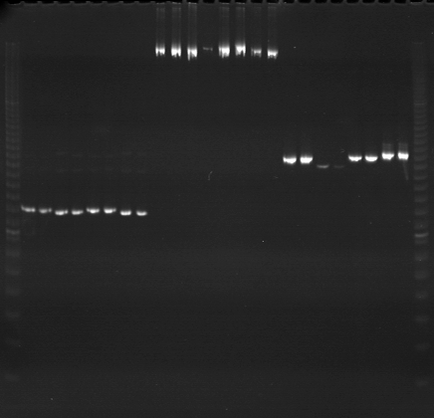
VES0858
VES0859
VES0860
m
Ac
Aw
Bc
Bw
Rc
Rw
Mc
Mw
Ac
Aw
Bc
Bw
Rc
Rw
Mc
Mw
Ac
Aw
Bc
Bw
Rc
Rw
Mc
Mw
m

Slide 5
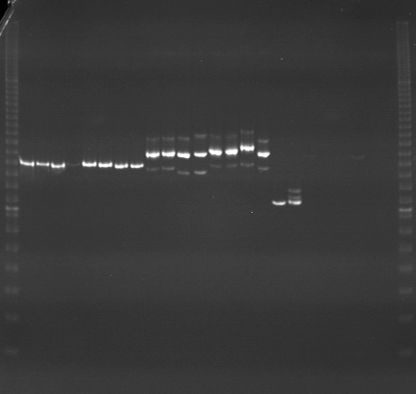
VES0861
VES0862
VES0863
m
Ac
Aw
Bc
Bw
Rc
Rw
Mc
Mw
Ac
Aw
Bc
Bw
Rc
Rw
Mc
Mw
Ac
Aw
Bc
Bw
Rc
Rw
Mc
Mw
m

Slide 6
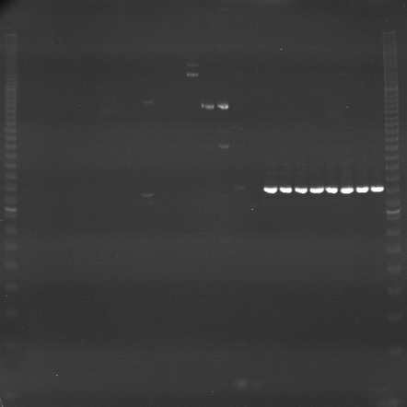
VES0864
VES0865
VES0866
m
Ac
Aw
Bc
Bw
Rc
Rw
Mc
Mw
Ac
Aw
Bc
Bw
Rc
Rw
Mc
Mw
Ac
Aw
Bc
Bw
Rc
Rw
Mc
Mw
m

Slide 7
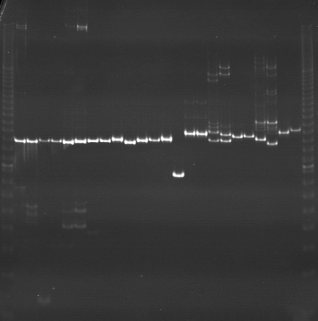
VES0867
VES0868
VES0869
m
Ac
Aw
Bc
Bw
Rc
Rw
Mc
Mw
Ac
Aw
Bc
Bw
Rc
Rw
Mc
Mw
Ac
Aw
Bc
Bw
Rc
Rw
Mc
Mw
m

Slide 8
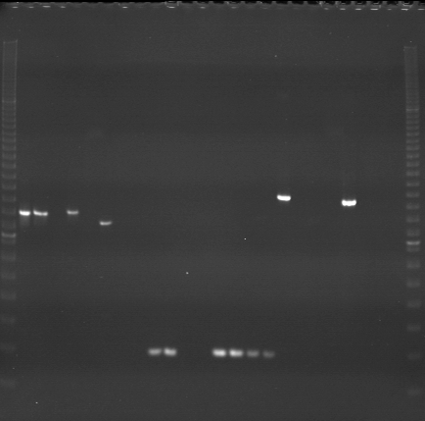
VES0870
VES0871
VES0872
m
Ac
Aw
Bc
Bw
Rc
Rw
Mc
Mw
Ac
Aw
Bc
Bw
Rc
Rw
Mc
Mw
Ac
Aw
Bc
Bw
Rc
Rw
Mc
Mw
m

Slide 9
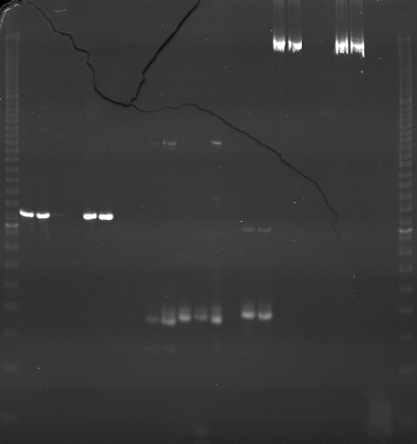
VES0873
VES0874
VES0875
m
Ac
Aw
Bc
Bw
Rc
Rw
Mc
Mw
Ac
Aw
Bc
Bw
Rc
Rw
Mc
Mw
Ac
Aw
Bc
Bw
Rc
Rw
Mc
Mw
m

Slide 10
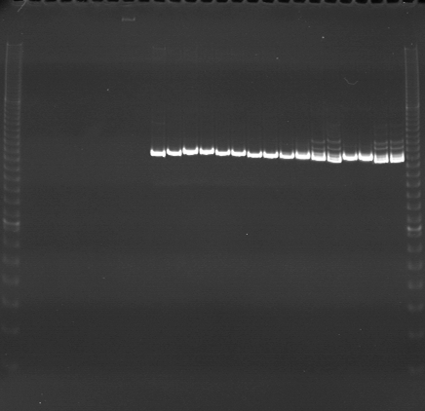
VES0876
VES0877
VES0878
m
Ac
Aw
Bc
Bw
Rc
Rw
Mc
Mw
Ac
Aw
Bc
Bw
Rc
Rw
Mc
Mw
Ac
Aw
Bc
Bw
Rc
Rw
Mc
Mw
m

Slide 11
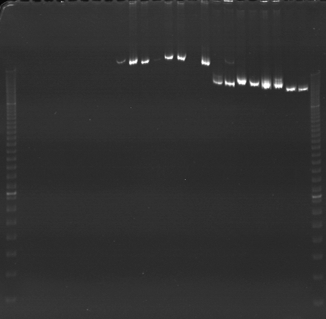
VES0879
VES0880
VES0881
m
Ac
Aw
Bc
Bw
Rc
Rw
Mc
Mw
Ac
Aw
Bc
Bw
Rc
Rw
Mc
Mw
Ac
Aw
Bc
Bw
Rc
Rw
Mc
Mw
m

Slide 12
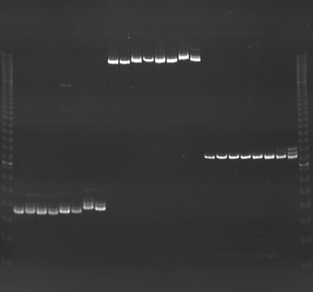
VES0882
VES0883
VES0884
m
Ac
Aw
Bc
Bw
Rc
Rw
Mc
Mw
Ac
Aw
Bc
Bw
Rc
Rw
Mc
Mw
Ac
Aw
Bc
Bw
Rc
Rw
Mc
Mw
m

Slide 13
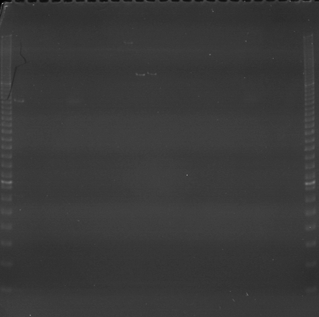
VES0885
VES0886
VES0887
m
Ac
Aw
Bc
Bw
Rc
Rw
Mc
Mw
Ac
Aw
Bc
Bw
Rc
Rw
Mc
Mw
Ac
Aw
Bc
Bw
Rc
Rw
Mc
Mw
m

Slide 14
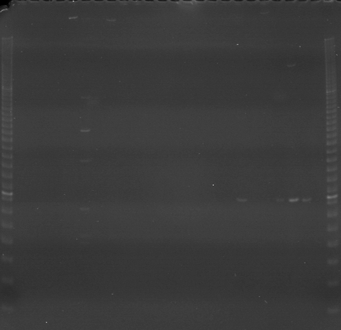
VES0888
VES0889
VES0890
m
Ac
Aw
Bc
Bw
Rc
Rw
Mc
Mw
Ac
Aw
Bc
Bw
Rc
Rw
Mc
Mw
Ac
Aw
Bc
Bw
Rc
Rw
Mc
Mw
m

Slide 15
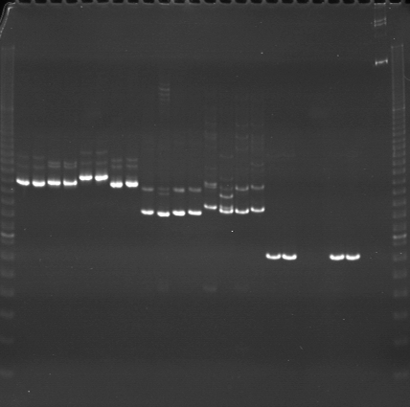
VES0891
VES0892
VES0893
m
Ac
Aw
Bc
Bw
Rc
Rw
Mc
Mw
Ac
Aw
Bc
Bw
Rc
Rw
Mc
Mw
Ac
Aw
Bc
Bw
Rc
Rw
Mc
Mw
m

Slide 16
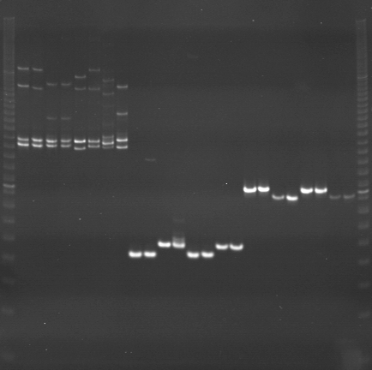
VES0894
VES0895
VES0896
m
Ac
Aw
Bc
Bw
Rc
Rw
Mc
Mw
Ac
Aw
Bc
Bw
Rc
Rw
Mc
Mw
Ac
Aw
Bc
Bw
Rc
Rw
Mc
Mw
m

