Slide 1
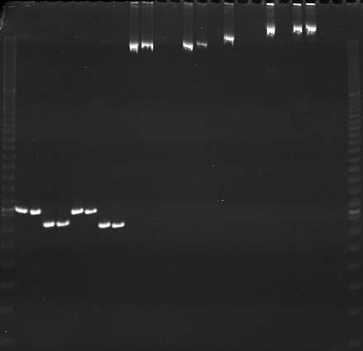
VES0993
VES0994
VES0995
m
Ac
Aw
Bc
Bw
Rc
Rw
Mc
Mw
Ac
Aw
Bc
Bw
Rc
Rw
Mc
Mw
Ac
Aw
Bc
Bw
Rc
Rw
Mc
Mw
m

Slide 2
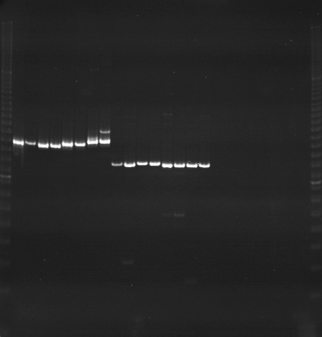
VES0996
VES0997
VES0998
m
Ac
Aw
Bc
Bw
Rc
Rw
Mc
Mw
Ac
Aw
Bc
Bw
Rc
Rw
Mc
Mw
Ac
Aw
Bc
Bw
Rc
Rw
Mc
Mw
m

Slide 3
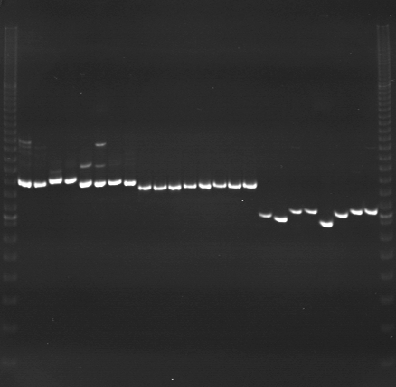
VES0999
VES1000
VES1001
m
Ac
Aw
Bc
Bw
Rc
Rw
Mc
Mw
Ac
Aw
Bc
Bw
Rc
Rw
Mc
Mw
Ac
Aw
Bc
Bw
Rc
Rw
Mc
Mw
m

Slide 4
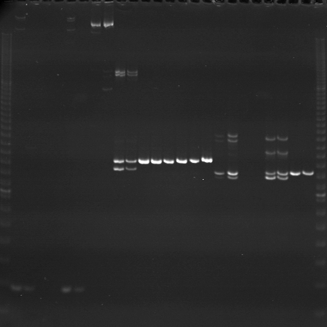
VES1002
VES1003
VES1004
m
Ac
Aw
Bc
Bw
Rc
Rw
Mc
Mw
Ac
Aw
Bc
Bw
Rc
Rw
Mc
Mw
Ac
Aw
Bc
Bw
Rc
Rw
Mc
Mw
m

Slide 5
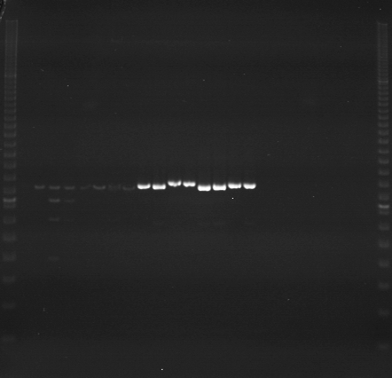
VES1005
VES1006
VES1007
m
Ac
Aw
Bc
Bw
Rc
Rw
Mc
Mw
Ac
Aw
Bc
Bw
Rc
Rw
Mc
Mw
Ac
Aw
Bc
Bw
Rc
Rw
Mc
Mw
m

Slide 6
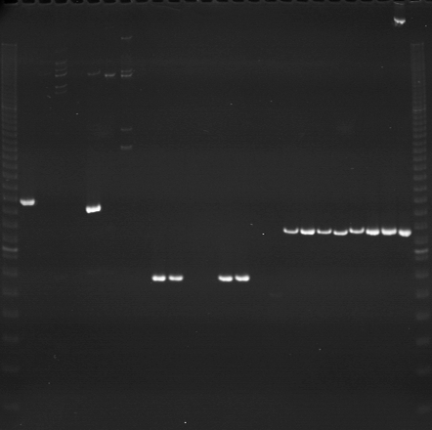
VES1008
VES1009
VES1010
m
Ac
Aw
Bc
Bw
Rc
Rw
Mc
Mw
Ac
Aw
Bc
Bw
Rc
Rw
Mc
Mw
Ac
Aw
Bc
Bw
Rc
Rw
Mc
Mw
m

Slide 7
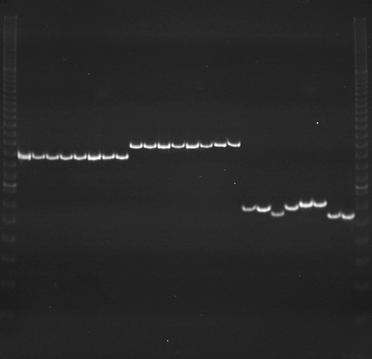
VES1011
VES1012
VES1013
m
Ac
Aw
Bc
Bw
Rc
Rw
Mc
Mw
Ac
Aw
Bc
Bw
Rc
Rw
Mc
Mw
Ac
Aw
Bc
Bw
Rc
Rw
Mc
Mw
m

Slide 8
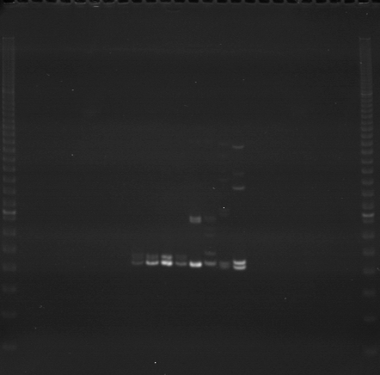
VES1014
VES1015
VES1016
m
Ac
Aw
Bc
Bw
Rc
Rw
Mc
Mw
Ac
Aw
Bc
Bw
Rc
Rw
Mc
Mw
Ac
Aw
Bc
Bw
Rc
Rw
Mc
Mw
m

Slide 9
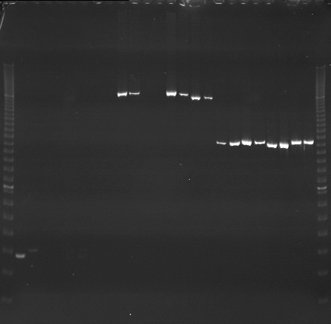
VES1017
VES1018
VES1019
m
Ac
Aw
Bc
Bw
Rc
Rw
Mc
Mw
Ac
Aw
Bc
Bw
Rc
Rw
Mc
Mw
Ac
Aw
Bc
Bw
Rc
Rw
Mc
Mw
m

Slide 10
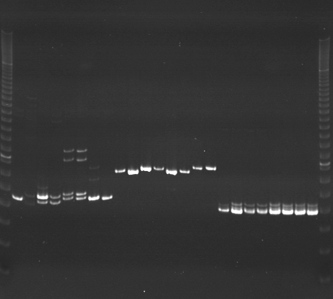
VES1020
VES1021
VES1022
m
Ac
Aw
Bc
Bw
Rc
Rw
Mc
Mw
Ac
Aw
Bc
Bw
Rc
Rw
Mc
Mw
Ac
Aw
Bc
Bw
Rc
Rw
Mc
Mw
m

Slide 11
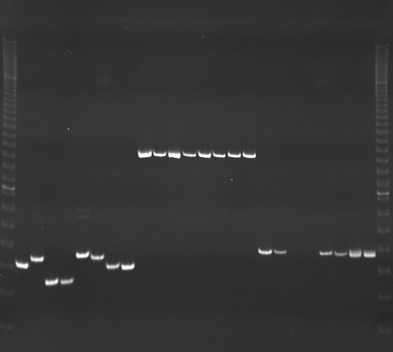
VES1023
VES1024
VES1025
m
Ac
Aw
Bc
Bw
Rc
Rw
Mc
Mw
Ac
Aw
Bc
Bw
Rc
Rw
Mc
Mw
Ac
Aw
Bc
Bw
Rc
Rw
Mc
Mw
m

Slide 12
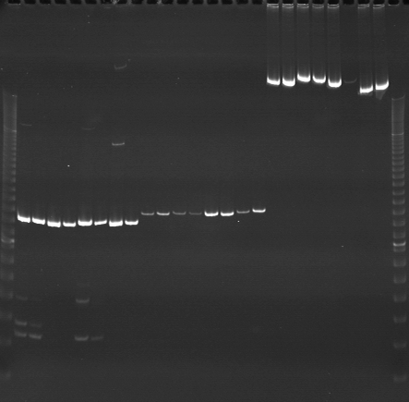
VES1026
VES1027
VES1028
m
Ac
Aw
Bc
Bw
Rc
Rw
Mc
Mw
Ac
Aw
Bc
Bw
Rc
Rw
Mc
Mw
Ac
Aw
Bc
Bw
Rc
Rw
Mc
Mw
m

Slide 13
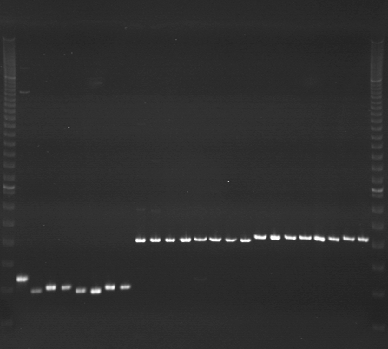
VES1029
VES1030
VES1031
m
Ac
Aw
Bc
Bw
Rc
Rw
Mc
Mw
Ac
Aw
Bc
Bw
Rc
Rw
Mc
Mw
Ac
Aw
Bc
Bw
Rc
Rw
Mc
Mw
m

Slide 14
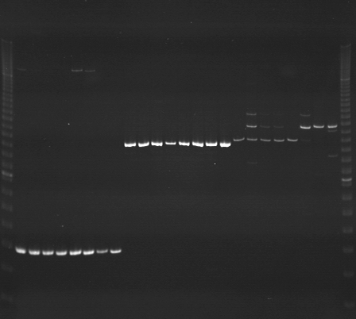
VES1032
VES1033
VES1034
m
Ac
Aw
Bc
Bw
Rc
Rw
Mc
Mw
Ac
Aw
Bc
Bw
Rc
Rw
Mc
Mw
Ac
Aw
Bc
Bw
Rc
Rw
Mc
Mw
m

Slide 15
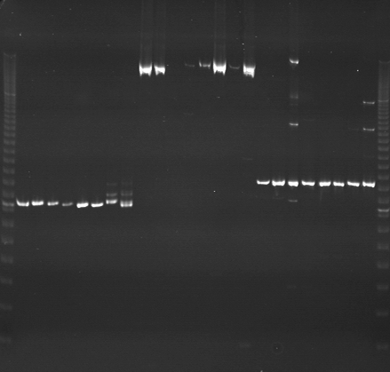
VES1035
VES1036
VES1037
m
Ac
Aw
Bc
Bw
Rc
Rw
Mc
Mw
Ac
Aw
Bc
Bw
Rc
Rw
Mc
Mw
Ac
Aw
Bc
Bw
Rc
Rw
Mc
Mw
m

Slide 16
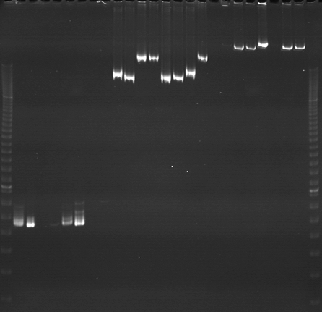
VES1038
VES1039
VES1040
m
Ac
Aw
Bc
Bw
Rc
Rw
Mc
Mw
Ac
Aw
Bc
Bw
Rc
Rw
Mc
Mw
Ac
Aw
Bc
Bw
Rc
Rw
Mc
Mw
m

