Slide 1
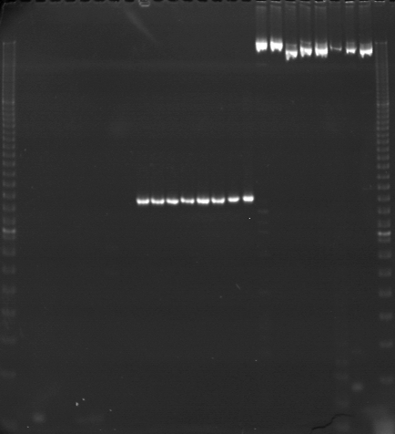
VES1089
VES1090
VES1091
m
Ac
Aw
Bc
Bw
Rc
Rw
Mc
Mw
Ac
Aw
Bc
Bw
Rc
Rw
Mc
Mw
Ac
Aw
Bc
Bw
Rc
Rw
Mc
Mw
m

Slide 2
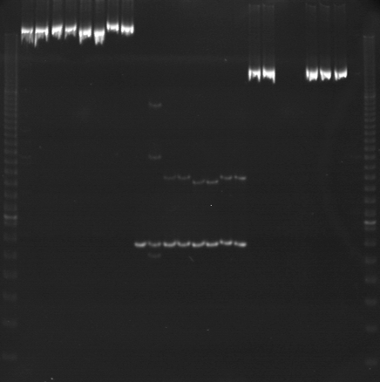
VES1092
VES1093
VES1094
m
Ac
Aw
Bc
Bw
Rc
Rw
Mc
Mw
Ac
Aw
Bc
Bw
Rc
Rw
Mc
Mw
Ac
Aw
Bc
Bw
Rc
Rw
Mc
Mw
m

Slide 3
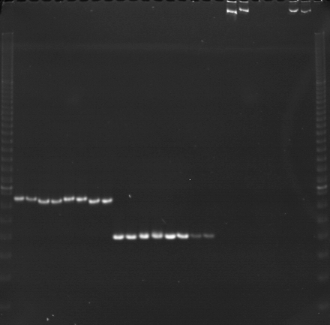
VES1095
VES1096
VES1097
m
Ac
Aw
Bc
Bw
Rc
Rw
Mc
Mw
Ac
Aw
Bc
Bw
Rc
Rw
Mc
Mw
Ac
Aw
Bc
Bw
Rc
Rw
Mc
Mw
m

Slide 4
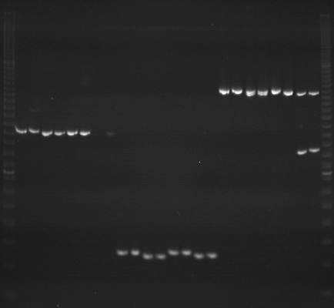
VES1098
VES1099
VES1100
m
Ac
Aw
Bc
Bw
Rc
Rw
Mc
Mw
Ac
Aw
Bc
Bw
Rc
Rw
Mc
Mw
Ac
Aw
Bc
Bw
Rc
Rw
Mc
Mw
m

Slide 5
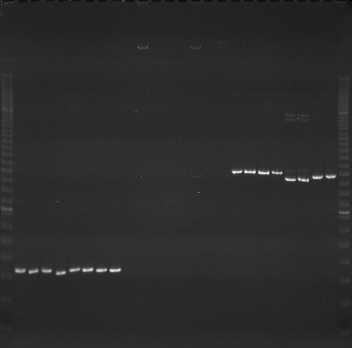
VES1101
VES1102
VES1103
m
Ac
Aw
Bc
Bw
Rc
Rw
Mc
Mw
Ac
Aw
Bc
Bw
Rc
Rw
Mc
Mw
Ac
Aw
Bc
Bw
Rc
Rw
Mc
Mw
m

Slide 6
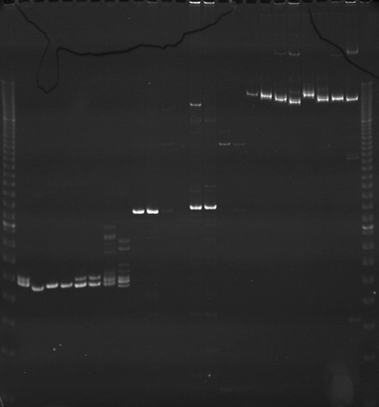
VES1104
VES1105
VES1106
m
Ac
Aw
Bc
Bw
Rc
Rw
Mc
Mw
Ac
Aw
Bc
Bw
Rc
Rw
Mc
Mw
Ac
Aw
Bc
Bw
Rc
Rw
Mc
Mw
m

Slide 7
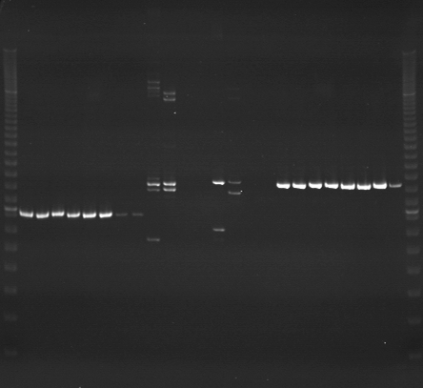
VES1107
VES1108
VES1109
m
Ac
Aw
Bc
Bw
Rc
Rw
Mc
Mw
Ac
Aw
Bc
Bw
Rc
Rw
Mc
Mw
Ac
Aw
Bc
Bw
Rc
Rw
Mc
Mw
m

Slide 8
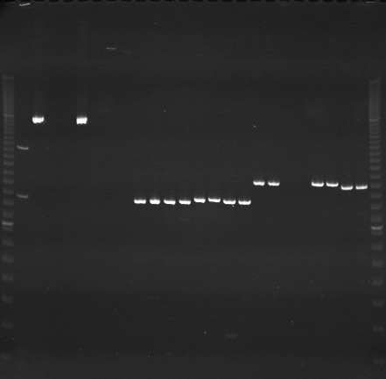
VES1110
VES1111
VES1112
m
Ac
Aw
Bc
Bw
Rc
Rw
Mc
Mw
Ac
Aw
Bc
Bw
Rc
Rw
Mc
Mw
Ac
Aw
Bc
Bw
Rc
Rw
Mc
Mw
m

Slide 9
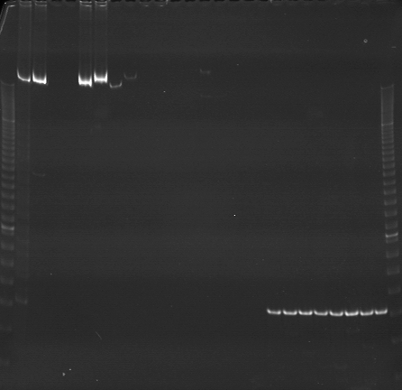
VES1113
VES1114
VES1115
m
Ac
Aw
Bc
Bw
Rc
Rw
Mc
Mw
Ac
Aw
Bc
Bw
Rc
Rw
Mc
Mw
Ac
Aw
Bc
Bw
Rc
Rw
Mc
Mw
m

Slide 10
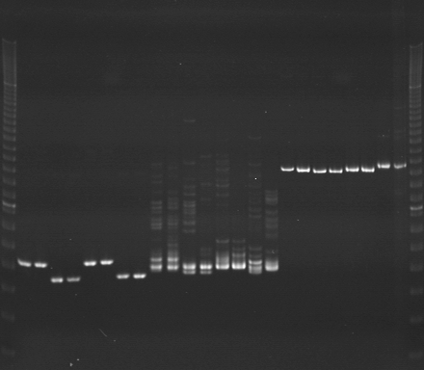
VES1116
VES1117
VES1118
m
Ac
Aw
Bc
Bw
Rc
Rw
Mc
Mw
Ac
Aw
Bc
Bw
Rc
Rw
Mc
Mw
Ac
Aw
Bc
Bw
Rc
Rw
Mc
Mw
m

Slide 11
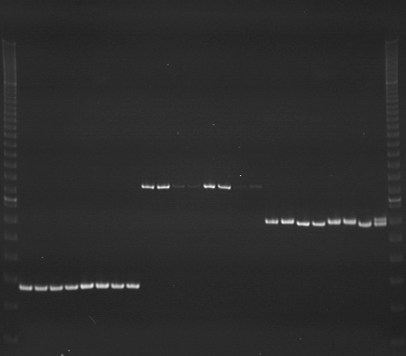
VES1119
VES1120
VES1121
m
Ac
Aw
Bc
Bw
Rc
Rw
Mc
Mw
Ac
Aw
Bc
Bw
Rc
Rw
Mc
Mw
Ac
Aw
Bc
Bw
Rc
Rw
Mc
Mw
m

Slide 12
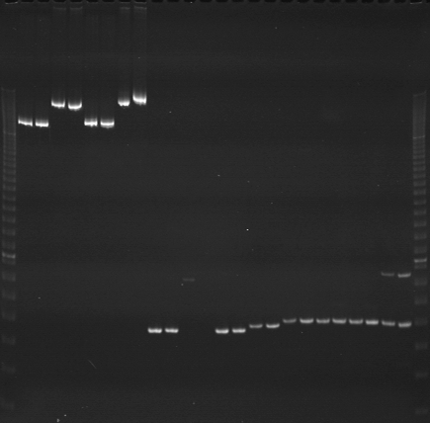
VES1122
VES1123
VES1124
m
Ac
Aw
Bc
Bw
Rc
Rw
Mc
Mw
Ac
Aw
Bc
Bw
Rc
Rw
Mc
Mw
Ac
Aw
Bc
Bw
Rc
Rw
Mc
Mw
m

Slide 13
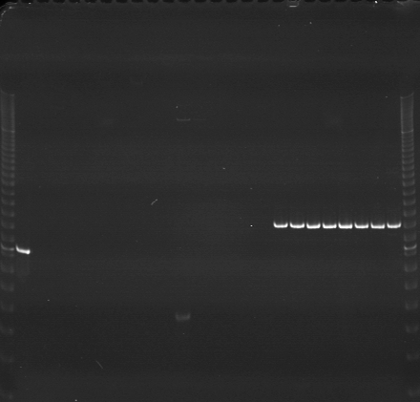
VES1125
VES1126
VES1127
m
Ac
Aw
Bc
Bw
Rc
Rw
Mc
Mw
Ac
Aw
Bc
Bw
Rc
Rw
Mc
Mw
Ac
Aw
Bc
Bw
Rc
Rw
Mc
Mw
m

Slide 14
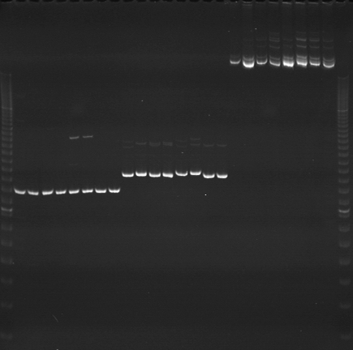
VES1128
VES1129
VES1130
m
Ac
Aw
Bc
Bw
Rc
Rw
Mc
Mw
Ac
Aw
Bc
Bw
Rc
Rw
Mc
Mw
Ac
Aw
Bc
Bw
Rc
Rw
Mc
Mw
m

Slide 15
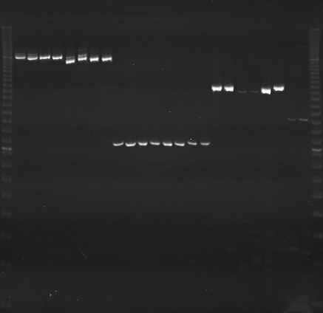
VES1131
VES1132
VES1133
m
Ac
Aw
Bc
Bw
Rc
Rw
Mc
Mw
Ac
Aw
Bc
Bw
Rc
Rw
Mc
Mw
Ac
Aw
Bc
Bw
Rc
Rw
Mc
Mw
m

Slide 16
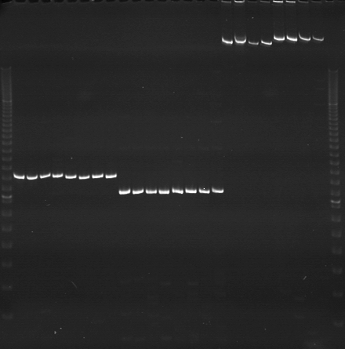
VES1134
VES1135
VES1136
m
Ac
Aw
Bc
Bw
Rc
Rw
Mc
Mw
Ac
Aw
Bc
Bw
Rc
Rw
Mc
Mw
Ac
Aw
Bc
Bw
Rc
Rw
Mc
Mw
m

