Slide 1
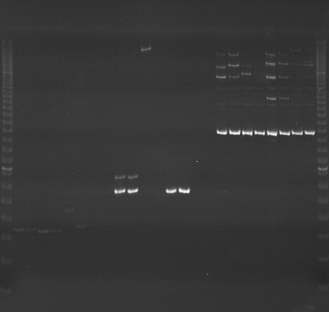
VES1185
VES1186
VES1187
m
Ac
Aw
Bc
Bw
Rc
Rw
Mc
Mw
Ac
Aw
Bc
Bw
Rc
Rw
Mc
Mw
Ac
Aw
Bc
Bw
Rc
Rw
Mc
Mw
m

Slide 2
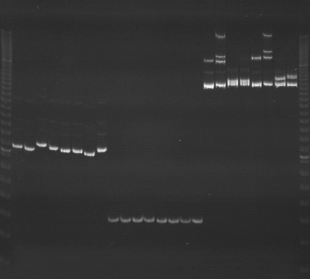
VES1188
VES1189
VES1190
m
Ac
Aw
Bc
Bw
Rc
Rw
Mc
Mw
Ac
Aw
Bc
Bw
Rc
Rw
Mc
Mw
Ac
Aw
Bc
Bw
Rc
Rw
Mc
Mw
m

Slide 3
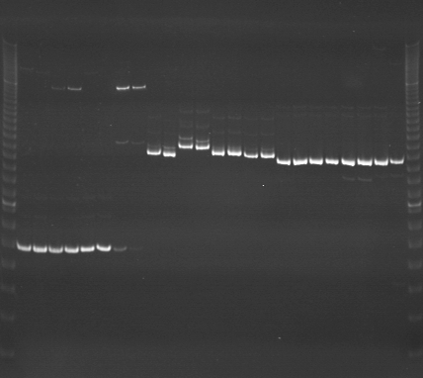
VES1191
VES1192
VES1193
m
Ac
Aw
Bc
Bw
Rc
Rw
Mc
Mw
Ac
Aw
Bc
Bw
Rc
Rw
Mc
Mw
Ac
Aw
Bc
Bw
Rc
Rw
Mc
Mw
m

Slide 4
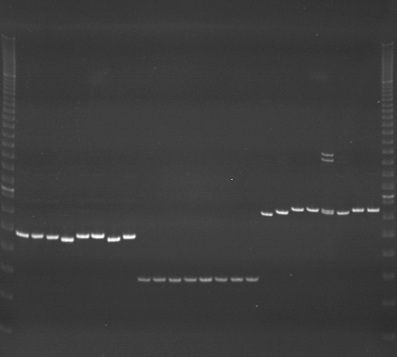
VES1194
VES1195
VES1196
m
Ac
Aw
Bc
Bw
Rc
Rw
Mc
Mw
Ac
Aw
Bc
Bw
Rc
Rw
Mc
Mw
Ac
Aw
Bc
Bw
Rc
Rw
Mc
Mw
m

Slide 5
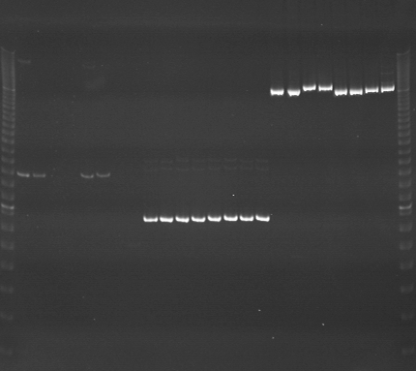
VES1197
VES1198
VES1199
m
Ac
Aw
Bc
Bw
Rc
Rw
Mc
Mw
Ac
Aw
Bc
Bw
Rc
Rw
Mc
Mw
Ac
Aw
Bc
Bw
Rc
Rw
Mc
Mw
m

Slide 6
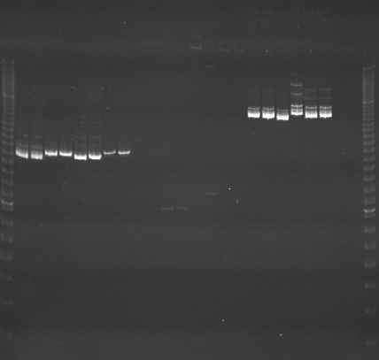
VES1200
VES1201
VES120
m
Ac
Aw
Bc
Bw
Rc
Rw
Mc
Mw
Ac
Aw
Bc
Bw
Rc
Rw
Mc
Mw
Ac
Aw
Bc
Bw
Rc
Rw
Mc
Mw
m

Slide 7
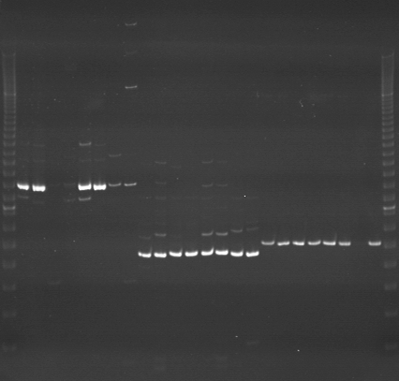
VES1203
VES1204
VES1205
m
Ac
Aw
Bc
Bw
Rc
Rw
Mc
Mw
Ac
Aw
Bc
Bw
Rc
Rw
Mc
Mw
Ac
Aw
Bc
Bw
Rc
Rw
Mc
Mw
m

Slide 8
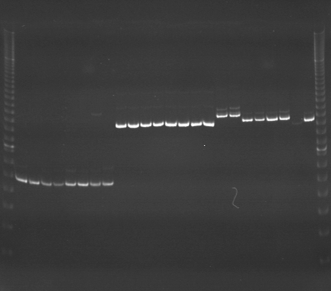
VES1206
VES1207
VES1207
m
Ac
Aw
Bc
Bw
Rc
Rw
Mc
Mw
Ac
Aw
Bc
Bw
Rc
Rw
Mc
Mw
Ac
Aw
Bc
Bw
Rc
Rw
Mc
Mw
m

Slide 9
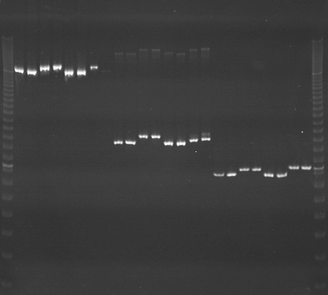
VES1209
VES1210
VES1211
m
Ac
Aw
Bc
Bw
Rc
Rw
Mc
Mw
Ac
Aw
Bc
Bw
Rc
Rw
Mc
Mw
Ac
Aw
Bc
Bw
Rc
Rw
Mc
Mw
m

Slide 10
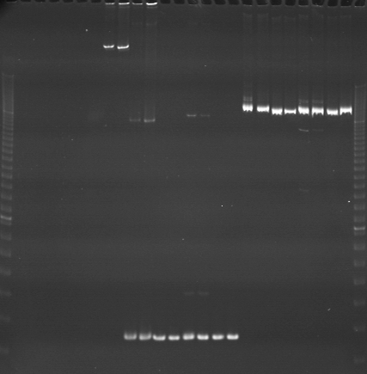
VES1212
VES1213
VES1214
m
Ac
Aw
Bc
Bw
Rc
Rw
Mc
Mw
Ac
Aw
Bc
Bw
Rc
Rw
Mc
Mw
Ac
Aw
Bc
Bw
Rc
Rw
Mc
Mw
m

Slide 11
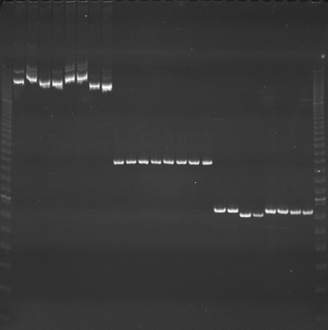
VES1215
VES1216
VES1217
m
Ac
Aw
Bc
Bw
Rc
Rw
Mc
Mw
Ac
Aw
Bc
Bw
Rc
Rw
Mc
Mw
Ac
Aw
Bc
Bw
Rc
Rw
Mc
Mw
m

Slide 12
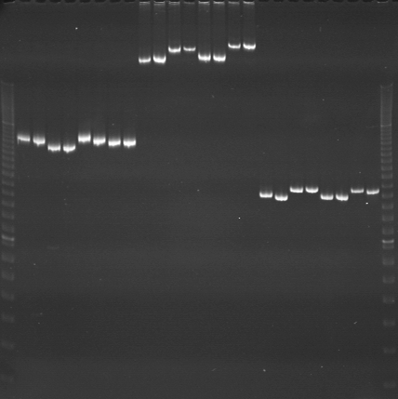
VES1218
VES1219
VES1220
m
Ac
Aw
Bc
Bw
Rc
Rw
Mc
Mw
Ac
Aw
Bc
Bw
Rc
Rw
Mc
Mw
Ac
Aw
Bc
Bw
Rc
Rw
Mc
Mw
m

Slide 13
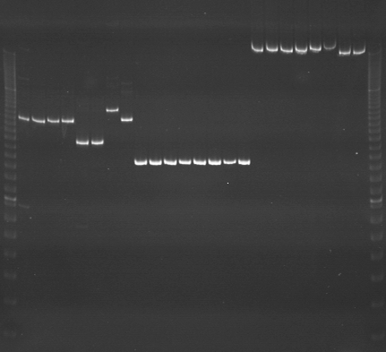
VES1221
VES1222
VES1223
m
Ac
Aw
Bc
Bw
Rc
Rw
Mc
Mw
Ac
Aw
Bc
Bw
Rc
Rw
Mc
Mw
Ac
Aw
Bc
Bw
Rc
Rw
Mc
Mw
m

Slide 14
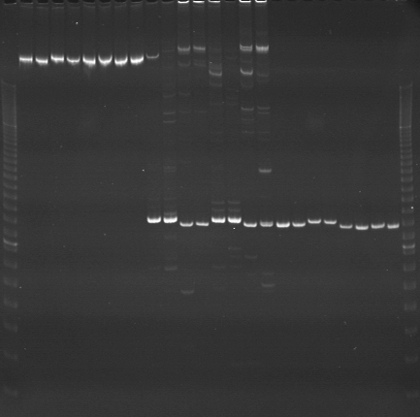
VES1224
VES1225
VES1226
m
Ac
Aw
Bc
Bw
Rc
Rw
Mc
Mw
Ac
Aw
Bc
Bw
Rc
Rw
Mc
Mw
Ac
Aw
Bc
Bw
Rc
Rw
Mc
Mw
m

Slide 15
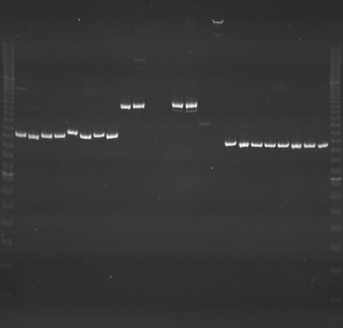
VES1227
VES1228
VES1229
m
Ac
Aw
Bc
Bw
Rc
Rw
Mc
Mw
Ac
Aw
Bc
Bw
Rc
Rw
Mc
Mw
Ac
Aw
Bc
Bw
Rc
Rw
Mc
Mw
m

Slide 16
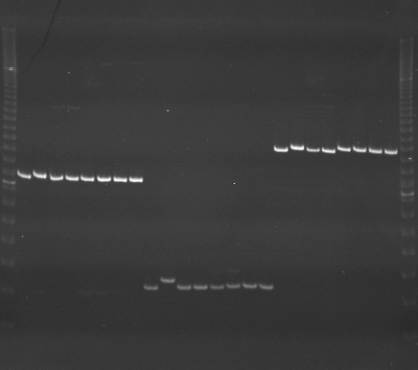
VES1230
VES1231
VES1232
m
Ac
Aw
Bc
Bw
Rc
Rw
Mc
Mw
Ac
Aw
Bc
Bw
Rc
Rw
Mc
Mw
Ac
Aw
Bc
Bw
Rc
Rw
Mc
Mw
m

