Slide 1
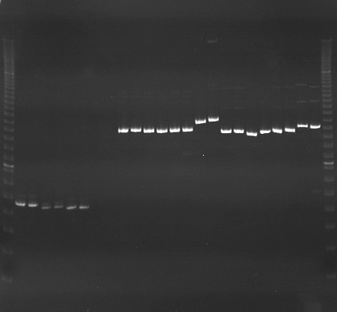
VES1233
VES1234
VES1235
m
Ac
Aw
Bc
Bw
Rc
Rw
Mc
Mw
Ac
Aw
Bc
Bw
Rc
Rw
Mc
Mw
Ac
Aw
Bc
Bw
Rc
Rw
Mc
Mw
m

Slide 2
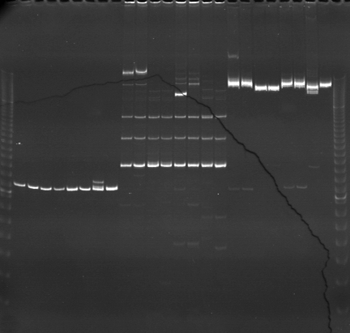
VES1236
VES1237
VES1238
m
Ac
Aw
Bc
Bw
Rc
Rw
Mc
Mw
Ac
Aw
Bc
Bw
Rc
Rw
Mc
Mw
Ac
Aw
Bc
Bw
Rc
Rw
Mc
Mw
m

Slide 3
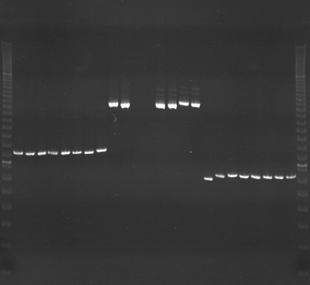
VES1239
VES1240
VES1241
m
Ac
Aw
Bc
Bw
Rc
Rw
Mc
Mw
Ac
Aw
Bc
Bw
Rc
Rw
Mc
Mw
Ac
Aw
Bc
Bw
Rc
Rw
Mc
Mw
m

Slide 4
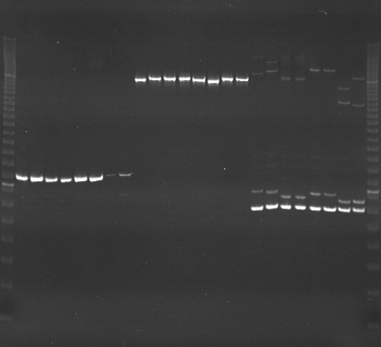
VES1242
VES1243
VES1244
m
Ac
Aw
Bc
Bw
Rc
Rw
Mc
Mw
Ac
Aw
Bc
Bw
Rc
Rw
Mc
Mw
Ac
Aw
Bc
Bw
Rc
Rw
Mc
Mw
m

Slide 5
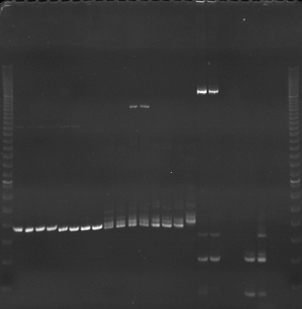
VES1245
VES1246
VES1247
m
Ac
Aw
Bc
Bw
Rc
Rw
Mc
Mw
Ac
Aw
Bc
Bw
Rc
Rw
Mc
Mw
Ac
Aw
Bc
Bw
Rc
Rw
Mc
Mw
m

Slide 6
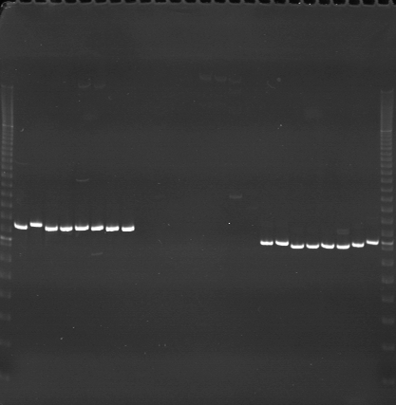
VES1248
VES1249
VES1250
m
Ac
Aw
Bc
Bw
Rc
Rw
Mc
Mw
Ac
Aw
Bc
Bw
Rc
Rw
Mc
Mw
Ac
Aw
Bc
Bw
Rc
Rw
Mc
Mw
m

Slide 7
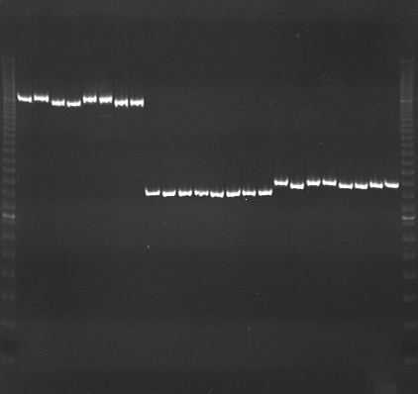
VES1251
VES1252
VES1253
m
Ac
Aw
Bc
Bw
Rc
Rw
Mc
Mw
Ac
Aw
Bc
Bw
Rc
Rw
Mc
Mw
Ac
Aw
Bc
Bw
Rc
Rw
Mc
Mw
m

Slide 8
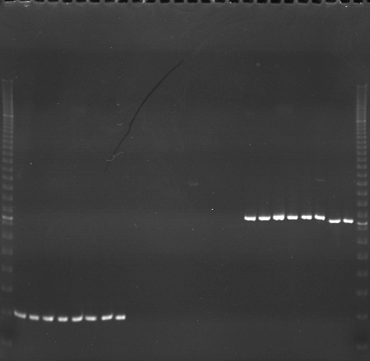
VES1254
VES1255
VES1256
m
Ac
Aw
Bc
Bw
Rc
Rw
Mc
Mw
Ac
Aw
Bc
Bw
Rc
Rw
Mc
Mw
Ac
Aw
Bc
Bw
Rc
Rw
Mc
Mw
m

Slide 9
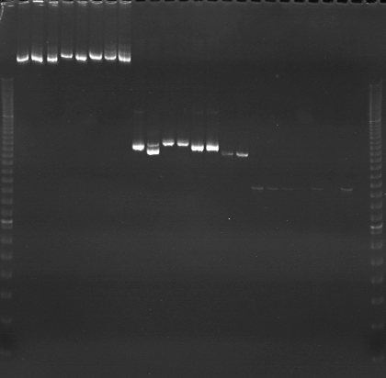
VES1257
VES1258
VES1259
m
Ac
Aw
Bc
Bw
Rc
Rw
Mc
Mw
Ac
Aw
Bc
Bw
Rc
Rw
Mc
Mw
Ac
Aw
Bc
Bw
Rc
Rw
Mc
Mw
m

Slide 10
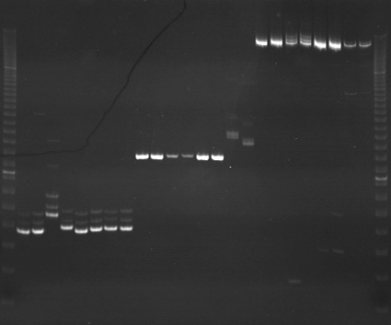
VES1260
VES1261
VES1262
m
Ac
Aw
Bc
Bw
Rc
Rw
Mc
Mw
Ac
Aw
Bc
Bw
Rc
Rw
Mc
Mw
Ac
Aw
Bc
Bw
Rc
Rw
Mc
Mw
m

Slide 11
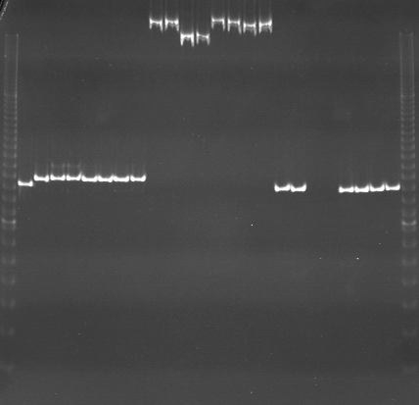
VES1263
VES1264
VES1265
m
Ac
Aw
Bc
Bw
Rc
Rw
Mc
Mw
Ac
Aw
Bc
Bw
Rc
Rw
Mc
Mw
Ac
Aw
Bc
Bw
Rc
Rw
Mc
Mw
m

Slide 12
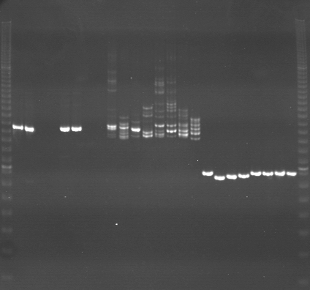
VES1266
VES1267
VES1268
m
Ac
Aw
Bc
Bw
Rc
Rw
Mc
Mw
Ac
Aw
Bc
Bw
Rc
Rw
Mc
Mw
Ac
Aw
Bc
Bw
Rc
Rw
Mc
Mw
m

Slide 13
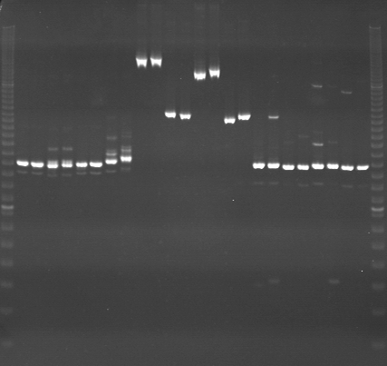
VES1269
VES1270
VES1271
m
Ac
Aw
Bc
Bw
Rc
Rw
Mc
Mw
Ac
Aw
Bc
Bw
Rc
Rw
Mc
Mw
Ac
Aw
Bc
Bw
Rc
Rw
Mc
Mw
m

Slide 14
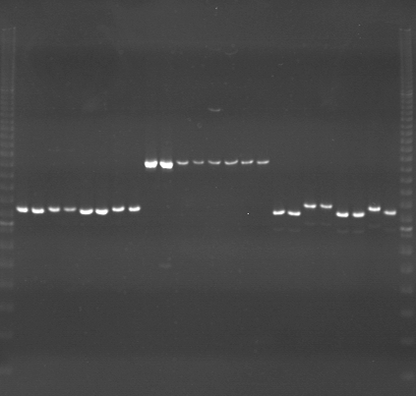
VES1272
VES1273
VES1274
m
Ac
Aw
Bc
Bw
Rc
Rw
Mc
Mw
Ac
Aw
Bc
Bw
Rc
Rw
Mc
Mw
Ac
Aw
Bc
Bw
Rc
Rw
Mc
Mw
m

Slide 15
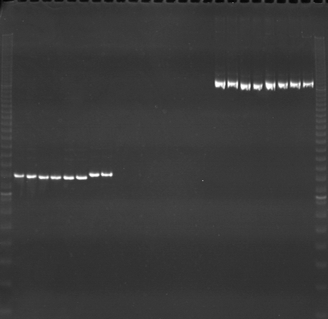
VES1275
VES1276
VES1277
m
Ac
Aw
Bc
Bw
Rc
Rw
Mc
Mw
Ac
Aw
Bc
Bw
Rc
Rw
Mc
Mw
Ac
Aw
Bc
Bw
Rc
Rw
Mc
Mw
m

Slide 16
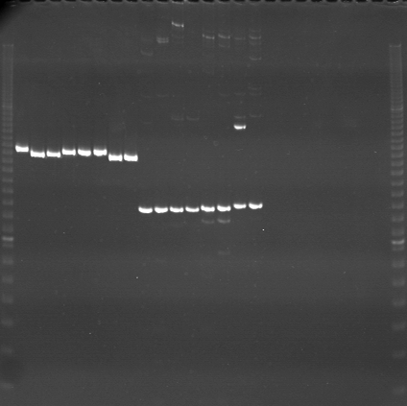
VES1278
VES1279
VES1280
m
Ac
Aw
Bc
Bw
Rc
Rw
Mc
Mw
Ac
Aw
Bc
Bw
Rc
Rw
Mc
Mw
Ac
Aw
Bc
Bw
Rc
Rw
Mc
Mw
m

