Slide 1
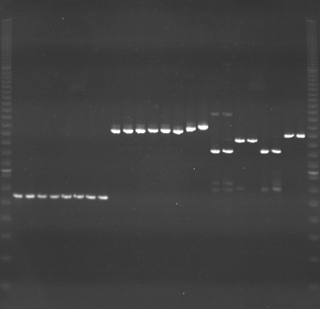
VES1281
VES1282
VES1283
m
Ac
Aw
Bc
Bw
Rc
Rw
Mc
Mw
Ac
Aw
Bc
Bw
Rc
Rw
Mc
Mw
Ac
Aw
Bc
Bw
Rc
Rw
Mc
Mw
m

Slide 2
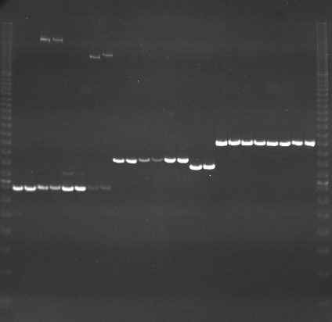
VES1284
VES1285
VES1286
m
Ac
Aw
Bc
Bw
Rc
Rw
Mc
Mw
Ac
Aw
Bc
Bw
Rc
Rw
Mc
Mw
Ac
Aw
Bc
Bw
Rc
Rw
Mc
Mw
m

Slide 3
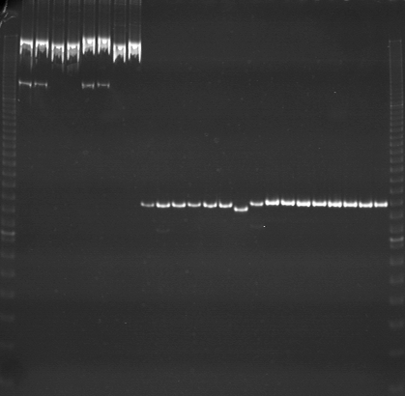
VES1287
VES1288
VES1289
m
Ac
Aw
Bc
Bw
Rc
Rw
Mc
Mw
Ac
Aw
Bc
Bw
Rc
Rw
Mc
Mw
Ac
Aw
Bc
Bw
Rc
Rw
Mc
Mw
m

Slide 4
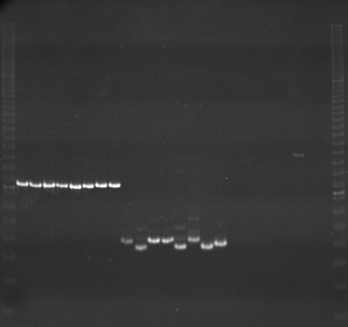
VES1290
VES1291
VES1292
m
Ac
Aw
Bc
Bw
Rc
Rw
Mc
Mw
Ac
Aw
Bc
Bw
Rc
Rw
Mc
Mw
Ac
Aw
Bc
Bw
Rc
Rw
Mc
Mw
m

Slide 5
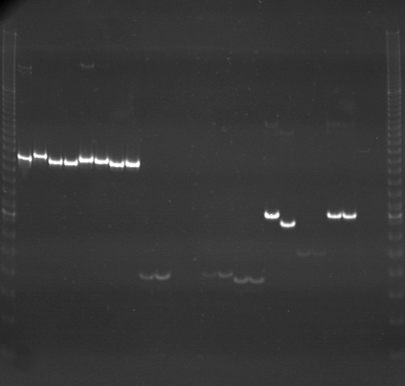
VES1293
VES1294
VES1295
m
Ac
Aw
Bc
Bw
Rc
Rw
Mc
Mw
Ac
Aw
Bc
Bw
Rc
Rw
Mc
Mw
Ac
Aw
Bc
Bw
Rc
Rw
Mc
Mw
m

Slide 6
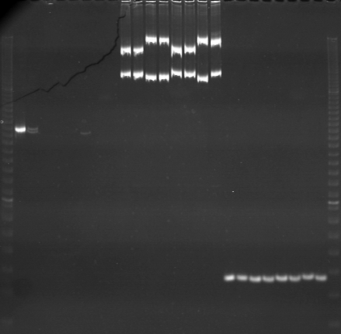
VES1296
VES1297
VES1298
m
Ac
Aw
Bc
Bw
Rc
Rw
Mc
Mw
Ac
Aw
Bc
Bw
Rc
Rw
Mc
Mw
Ac
Aw
Bc
Bw
Rc
Rw
Mc
Mw
m

Slide 7
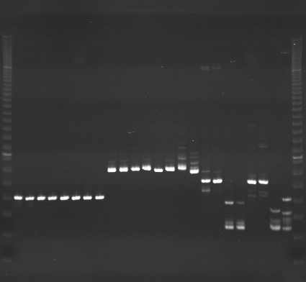
VES1299
VES1300
VES1301
m
Ac
Aw
Bc
Bw
Rc
Rw
Mc
Mw
Ac
Aw
Bc
Bw
Rc
Rw
Mc
Mw
Ac
Aw
Bc
Bw
Rc
Rw
Mc
Mw
m

Slide 8
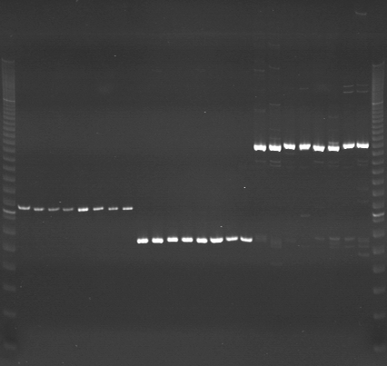
VES1302
VES1303
VES1304
m
Ac
Aw
Bc
Bw
Rc
Rw
Mc
Mw
Ac
Aw
Bc
Bw
Rc
Rw
Mc
Mw
Ac
Aw
Bc
Bw
Rc
Rw
Mc
Mw
m

Slide 9
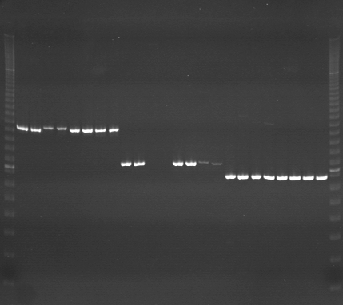
VES1305
VES1306
VES1307
m
Ac
Aw
Bc
Bw
Rc
Rw
Mc
Mw
Ac
Aw
Bc
Bw
Rc
Rw
Mc
Mw
Ac
Aw
Bc
Bw
Rc
Rw
Mc
Mw
m

Slide 10
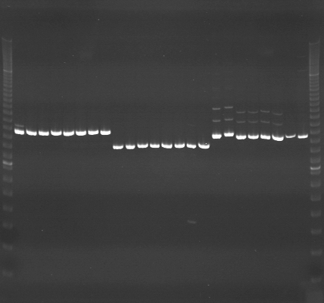
VES1308
VES1309
VES1310
m
Ac
Aw
Bc
Bw
Rc
Rw
Mc
Mw
Ac
Aw
Bc
Bw
Rc
Rw
Mc
Mw
Ac
Aw
Bc
Bw
Rc
Rw
Mc
Mw
m

Slide 11
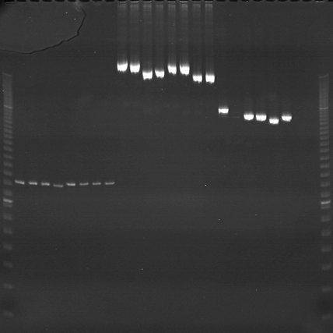
VES1311
VES1312
VES1313
m
Ac
Aw
Bc
Bw
Rc
Rw
Mc
Mw
Ac
Aw
Bc
Bw
Rc
Rw
Mc
Mw
Ac
Aw
Bc
Bw
Rc
Rw
Mc
Mw
m

Slide 12
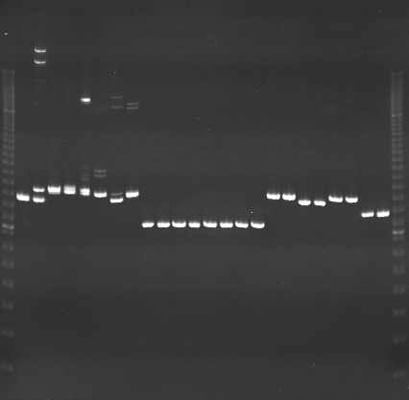
VES1314
VES1315
VES1316
m
Ac
Aw
Bc
Bw
Rc
Rw
Mc
Mw
Ac
Aw
Bc
Bw
Rc
Rw
Mc
Mw
Ac
Aw
Bc
Bw
Rc
Rw
Mc
Mw
m

Slide 13
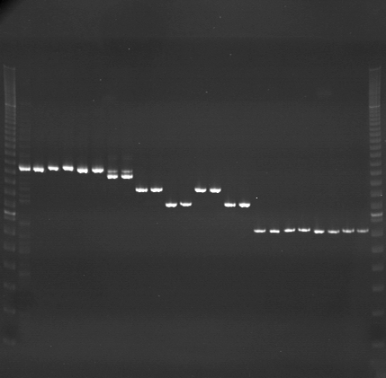
VES1317
VES1318
VES1319
m
Ac
Aw
Bc
Bw
Rc
Rw
Mc
Mw
Ac
Aw
Bc
Bw
Rc
Rw
Mc
Mw
Ac
Aw
Bc
Bw
Rc
Rw
Mc
Mw
m

Slide 14
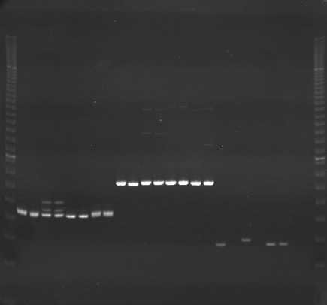
VES1320
VES1321
VES1322
m
Ac
Aw
Bc
Bw
Rc
Rw
Mc
Mw
Ac
Aw
Bc
Bw
Rc
Rw
Mc
Mw
Ac
Aw
Bc
Bw
Rc
Rw
Mc
Mw
m

Slide 15
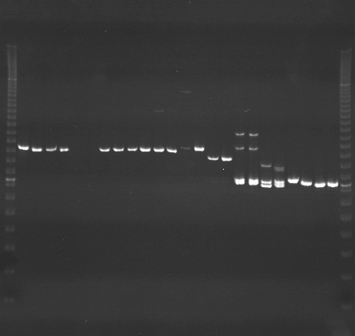
VES1323
VES1324
VES1325
m
Ac
Aw
Bc
Bw
Rc
Rw
Mc
Mw
Ac
Aw
Bc
Bw
Rc
Rw
Mc
Mw
Ac
Aw
Bc
Bw
Rc
Rw
Mc
Mw
m

Slide 16
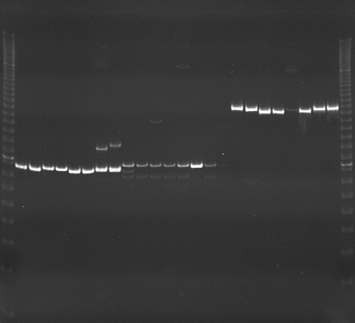
VES1326
VES1327
VES1328
m
Ac
Aw
Bc
Bw
Rc
Rw
Mc
Mw
Ac
Aw
Bc
Bw
Rc
Rw
Mc
Mw
Ac
Aw
Bc
Bw
Rc
Rw
Mc
Mw
m

