Slide 1
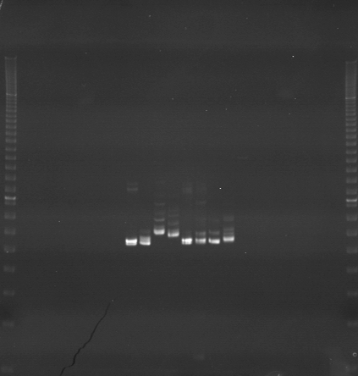
VES1329
VES1330
VES1331
m
Ac
Aw
Bc
Bw
Rc
Rw
Mc
Mw
Ac
Aw
Bc
Bw
Rc
Rw
Mc
Mw
Ac
Aw
Bc
Bw
Rc
Rw
Mc
Mw
m

Slide 2
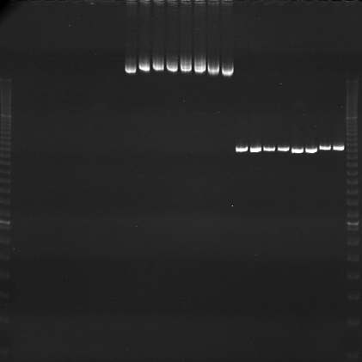
VES1332
VES1333
VES1334
m
Ac
Aw
Bc
Bw
Rc
Rw
Mc
Mw
Ac
Aw
Bc
Bw
Rc
Rw
Mc
Mw
Ac
Aw
Bc
Bw
Rc
Rw
Mc
Mw
m

Slide 3
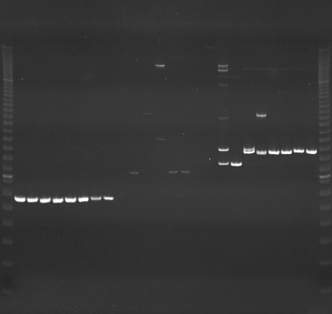
VES1335
VES1336
VES1337
m
Ac
Aw
Bc
Bw
Rc
Rw
Mc
Mw
Ac
Aw
Bc
Bw
Rc
Rw
Mc
Mw
Ac
Aw
Bc
Bw
Rc
Rw
Mc
Mw
m

Slide 4
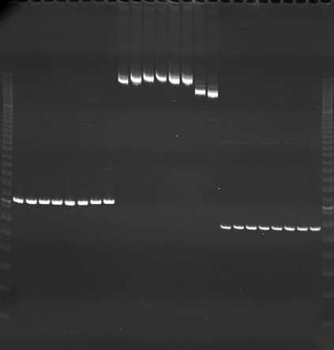
VES1338
VES1339
VES1340
m
Ac
Aw
Bc
Bw
Rc
Rw
Mc
Mw
Ac
Aw
Bc
Bw
Rc
Rw
Mc
Mw
Ac
Aw
Bc
Bw
Rc
Rw
Mc
Mw
m

Slide 5
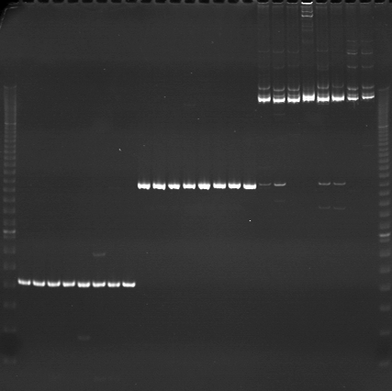
VES1341
VES1342
VES1343
m
Ac
Aw
Bc
Bw
Rc
Rw
Mc
Mw
Ac
Aw
Bc
Bw
Rc
Rw
Mc
Mw
Ac
Aw
Bc
Bw
Rc
Rw
Mc
Mw
m

Slide 6
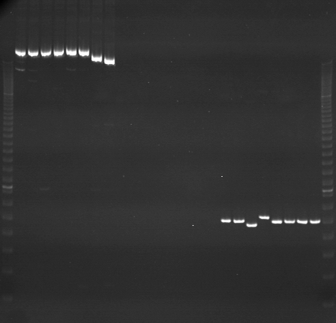
VES1344
VES1345
VES1346
m
Ac
Aw
Bc
Bw
Rc
Rw
Mc
Mw
Ac
Aw
Bc
Bw
Rc
Rw
Mc
Mw
Ac
Aw
Bc
Bw
Rc
Rw
Mc
Mw
m

Slide 7
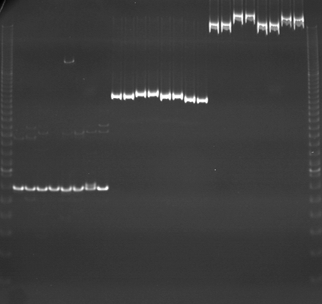
VES1347
VES1348
VES1349
m
Ac
Aw
Bc
Bw
Rc
Rw
Mc
Mw
Ac
Aw
Bc
Bw
Rc
Rw
Mc
Mw
Ac
Aw
Bc
Bw
Rc
Rw
Mc
Mw
m

Slide 8
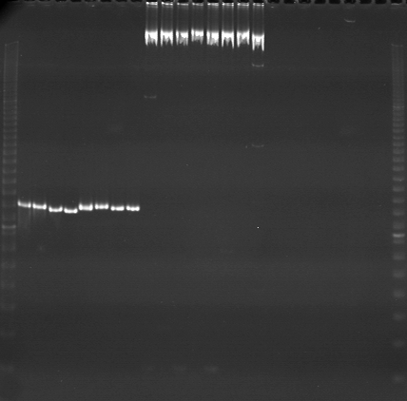
VES1350
VES1351
VES1352
m
Ac
Aw
Bc
Bw
Rc
Rw
Mc
Mw
Ac
Aw
Bc
Bw
Rc
Rw
Mc
Mw
Ac
Aw
Bc
Bw
Rc
Rw
Mc
Mw
m

Slide 9
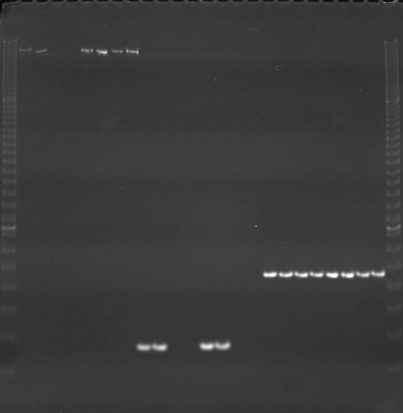
VES1353
VES1354
VES1355
m
Ac
Aw
Bc
Bw
Rc
Rw
Mc
Mw
Ac
Aw
Bc
Bw
Rc
Rw
Mc
Mw
Ac
Aw
Bc
Bw
Rc
Rw
Mc
Mw
m

Slide 10
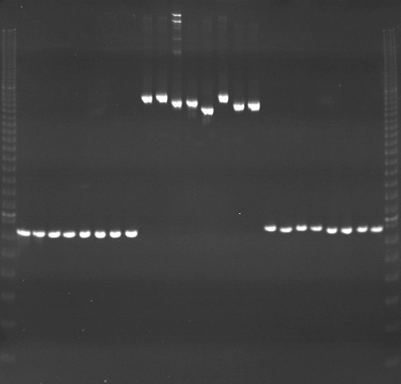
VES1356
VES1357
VES1358
m
Ac
Aw
Bc
Bw
Rc
Rw
Mc
Mw
Ac
Aw
Bc
Bw
Rc
Rw
Mc
Mw
Ac
Aw
Bc
Bw
Rc
Rw
Mc
Mw
m

Slide 11
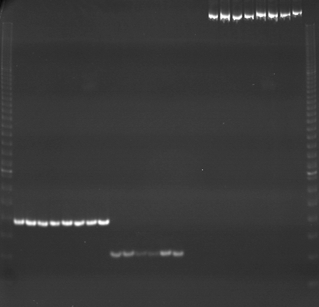
VES1359
VES1360
VES1361
m
Ac
Aw
Bc
Bw
Rc
Rw
Mc
Mw
Ac
Aw
Bc
Bw
Rc
Rw
Mc
Mw
Ac
Aw
Bc
Bw
Rc
Rw
Mc
Mw
m

Slide 12
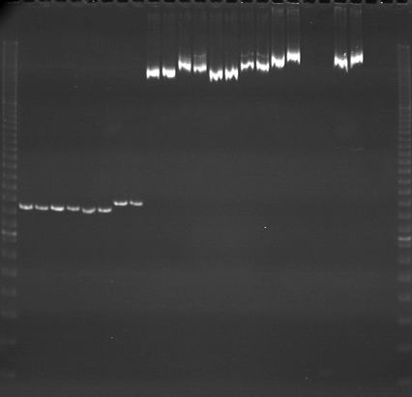
VES1362
VES1363
VES1364
m
Ac
Aw
Bc
Bw
Rc
Rw
Mc
Mw
Ac
Aw
Bc
Bw
Rc
Rw
Mc
Mw
Ac
Aw
Bc
Bw
Rc
Rw
Mc
Mw
m

Slide 13
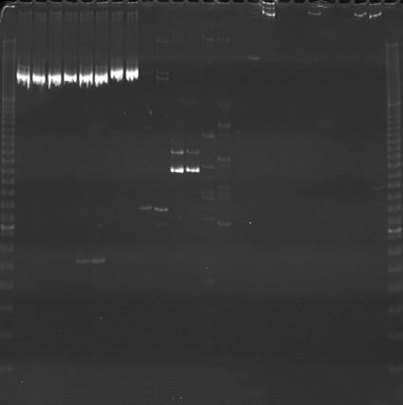
VES1365
VES1366
VES1367
m
Ac
Aw
Bc
Bw
Rc
Rw
Mc
Mw
Ac
Aw
Bc
Bw
Rc
Rw
Mc
Mw
Ac
Aw
Bc
Bw
Rc
Rw
Mc
Mw
m

Slide 14
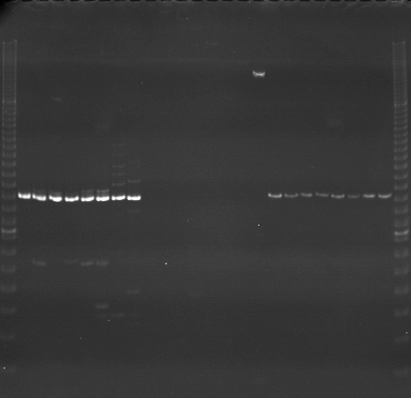
VES1368
VES1369
VES1370
m
Ac
Aw
Bc
Bw
Rc
Rw
Mc
Mw
Ac
Aw
Bc
Bw
Rc
Rw
Mc
Mw
Ac
Aw
Bc
Bw
Rc
Rw
Mc
Mw
m

Slide 15
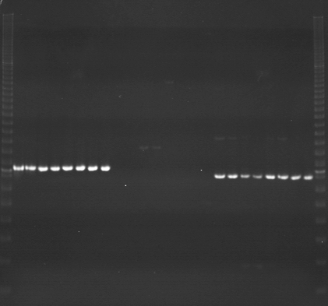
VES1371
VES1372
VES1373
m
Ac
Aw
Bc
Bw
Rc
Rw
Mc
Mw
Ac
Aw
Bc
Bw
Rc
Rw
Mc
Mw
Ac
Aw
Bc
Bw
Rc
Rw
Mc
Mw
m

Slide 16
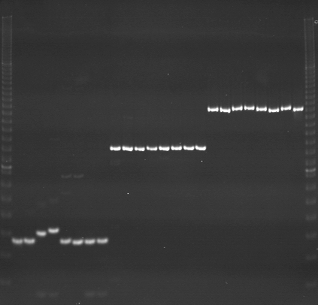
VES1374
VES1375
VES1376
m
Ac
Aw
Bc
Bw
Rc
Rw
Mc
Mw
Ac
Aw
Bc
Bw
Rc
Rw
Mc
Mw
Ac
Aw
Bc
Bw
Rc
Rw
Mc
Mw
m

Slide 17
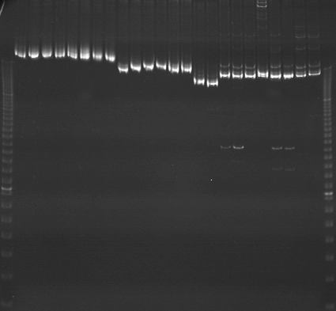
VES1333（再泳動）
VES1339（再泳動）
VES1343（再泳動）
m
Ac
Aw
Bc
Bw
Rc
Rw
Mc
Mw
Ac
Aw
Bc
Bw
Rc
Rw
Mc
Mw
Ac
Aw
Bc
Bw
Rc
Rw
Mc
Mw
m

Slide 18
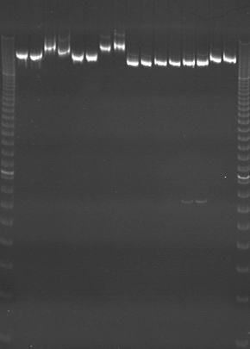
VES1363（再泳動）
VES1365（再泳動）
m
Ac
Aw
Bc
Bw
Rc
Rw
Mc
Mw
Ac
Aw
Bc
Bw
Rc
Rw
Mc
Mw
m

