Slide 1
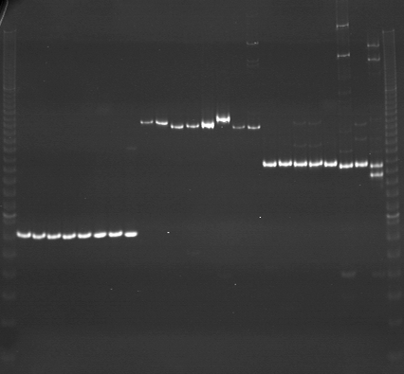
VES1377
VES1378
VES1379
m
Ac
Aw
Bc
Bw
Rc
Rw
Mc
Mw
Ac
Aw
Bc
Bw
Rc
Rw
Mc
Mw
Ac
Aw
Bc
Bw
Rc
Rw
Mc
Mw
m

Slide 2
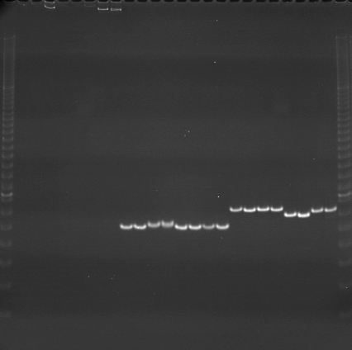
VES1380
VES1381
VES1382
m
Ac
Aw
Bc
Bw
Rc
Rw
Mc
Mw
Ac
Aw
Bc
Bw
Rc
Rw
Mc
Mw
Ac
Aw
Bc
Bw
Rc
Rw
Mc
Mw
m

Slide 3
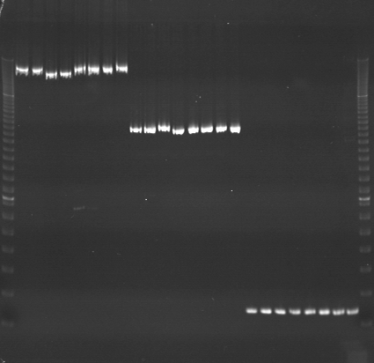
VES1383
VES1384
VES1385
m
Ac
Aw
Bc
Bw
Rc
Rw
Mc
Mw
Ac
Aw
Bc
Bw
Rc
Rw
Mc
Mw
Ac
Aw
Bc
Bw
Rc
Rw
Mc
Mw
m

Slide 4
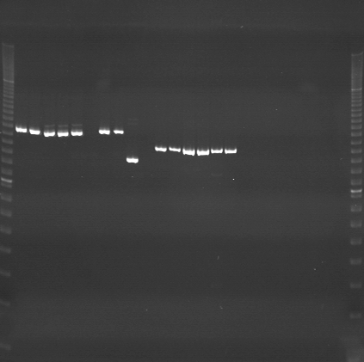
VES1386
VES1387
VES1388
m
Ac
Aw
Bc
Bw
Rc
Rw
Mc
Mw
Ac
Aw
Bc
Bw
Rc
Rw
Mc
Mw
Ac
Aw
Bc
Bw
Rc
Rw
Mc
Mw
m

Slide 5
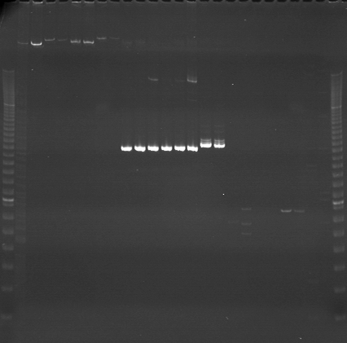
VES1389
VES1390
VES1391
m
Ac
Aw
Bc
Bw
Rc
Rw
Mc
Mw
Ac
Aw
Bc
Bw
Rc
Rw
Mc
Mw
Ac
Aw
Bc
Bw
Rc
Rw
Mc
Mw
m

Slide 6
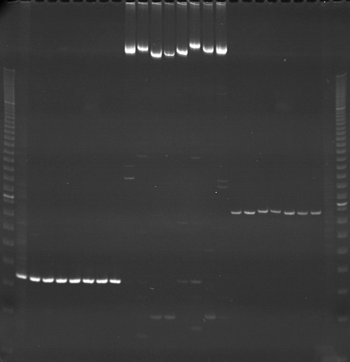
VES1392
VES1393
VES1394
m
Ac
Aw
Bc
Bw
Rc
Rw
Mc
Mw
Ac
Aw
Bc
Bw
Rc
Rw
Mc
Mw
Ac
Aw
Bc
Bw
Rc
Rw
Mc
Mw
m

Slide 7
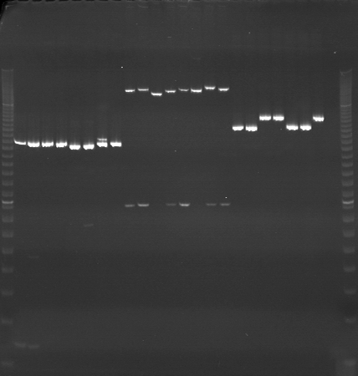
VES1395
VES1396
VES1397
m
Ac
Aw
Bc
Bw
Rc
Rw
Mc
Mw
Ac
Aw
Bc
Bw
Rc
Rw
Mc
Mw
Ac
Aw
Bc
Bw
Rc
Rw
Mc
Mw
m

Slide 8
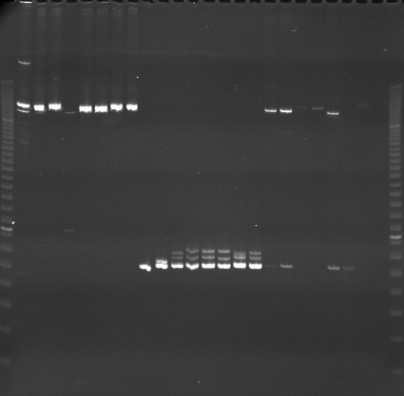
VES1398
VES1399
VES1400
m
Ac
Aw
Bc
Bw
Rc
Rw
Mc
Mw
Ac
Aw
Bc
Bw
Rc
Rw
Mc
Mw
Ac
Aw
Bc
Bw
Rc
Rw
Mc
Mw
m

Slide 9
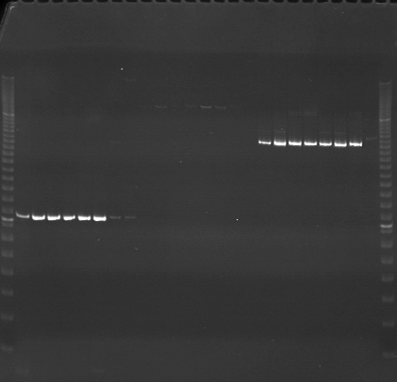
VES1401
VES1402
VES1403
m
Ac
Aw
Bc
Bw
Rc
Rw
Mc
Mw
Ac
Aw
Bc
Bw
Rc
Rw
Mc
Mw
Ac
Aw
Bc
Bw
Rc
Rw
Mc
Mw
m

Slide 10
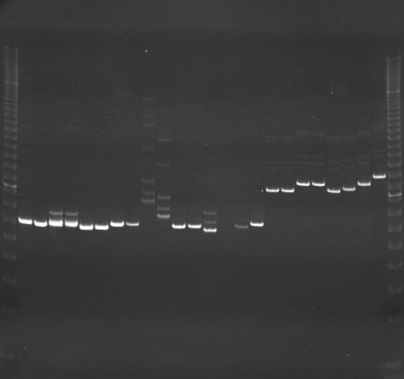
VES1404
VES1405
VES1406
m
Ac
Aw
Bc
Bw
Rc
Rw
Mc
Mw
Ac
Aw
Bc
Bw
Rc
Rw
Mc
Mw
Ac
Aw
Bc
Bw
Rc
Rw
Mc
Mw
m

Slide 11
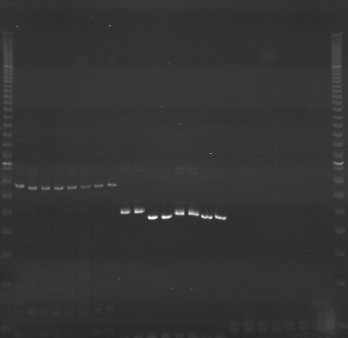
VES1407
VES1408
VES1409
m
Ac
Aw
Bc
Bw
Rc
Rw
Mc
Mw
Ac
Aw
Bc
Bw
Rc
Rw
Mc
Mw
Ac
Aw
Bc
Bw
Rc
Rw
Mc
Mw
m

Slide 12
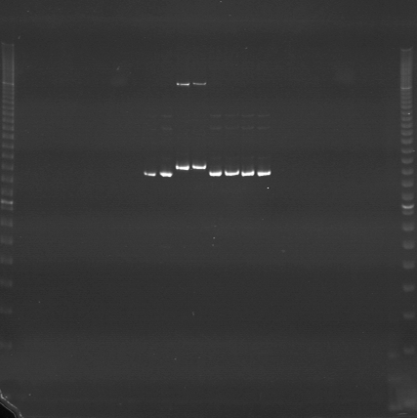
VES1410
VES1411
VES1412
m
Ac
Aw
Bc
Bw
Rc
Rw
Mc
Mw
Ac
Aw
Bc
Bw
Rc
Rw
Mc
Mw
Ac
Aw
Bc
Bw
Rc
Rw
Mc
Mw
m

Slide 13
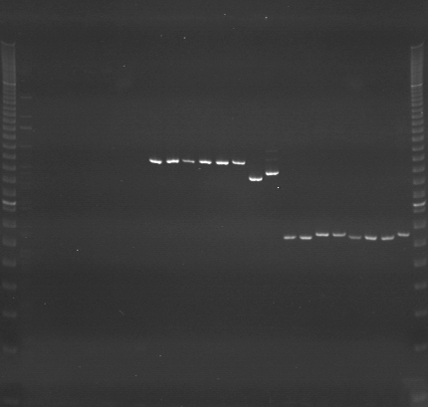
VES1413
VES1414
VES1415
m
Ac
Aw
Bc
Bw
Rc
Rw
Mc
Mw
Ac
Aw
Bc
Bw
Rc
Rw
Mc
Mw
Ac
Aw
Bc
Bw
Rc
Rw
Mc
Mw
m

Slide 14
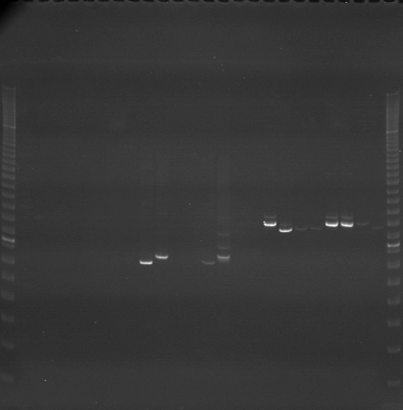
VES1416
VES1417
VES1418
m
Ac
Aw
Bc
Bw
Rc
Rw
Mc
Mw
Ac
Aw
Bc
Bw
Rc
Rw
Mc
Mw
Ac
Aw
Bc
Bw
Rc
Rw
Mc
Mw
m

Slide 15
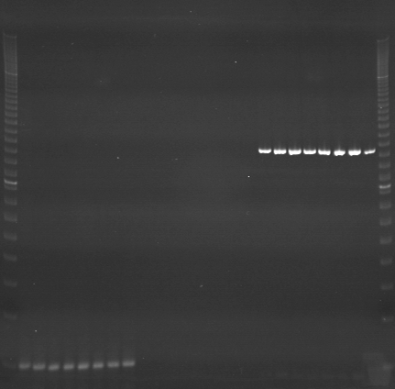
VES1419
VES1420
VES1421
m
Ac
Aw
Bc
Bw
Rc
Rw
Mc
Mw
Ac
Aw
Bc
Bw
Rc
Rw
Mc
Mw
Ac
Aw
Bc
Bw
Rc
Rw
Mc
Mw
m

Slide 16
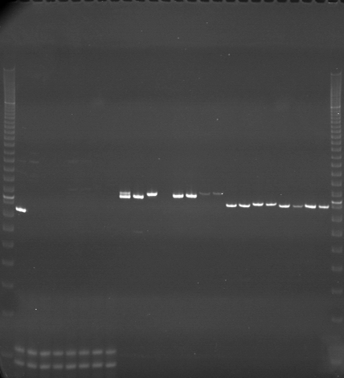
VES1422
VES1423
VES1424
m
Ac
Aw
Bc
Bw
Rc
Rw
Mc
Mw
Ac
Aw
Bc
Bw
Rc
Rw
Mc
Mw
Ac
Aw
Bc
Bw
Rc
Rw
Mc
Mw
m

