Slide 1
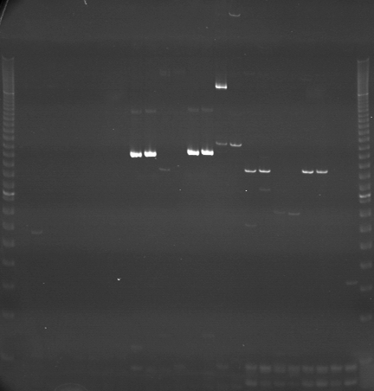
VES1425
VES1426
VES1427
m
Ac
Aw
Bc
Bw
Rc
Rw
Mc
Mw
Ac
Aw
Bc
Bw
Rc
Rw
Mc
Mw
Ac
Aw
Bc
Bw
Rc
Rw
Mc
Mw
m

Slide 2
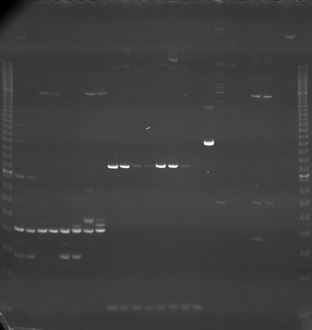
VES1428
VES1429
VES1430
m
Ac
Aw
Bc
Bw
Rc
Rw
Mc
Mw
Ac
Aw
Bc
Bw
Rc
Rw
Mc
Mw
Ac
Aw
Bc
Bw
Rc
Rw
Mc
Mw
m

Slide 3
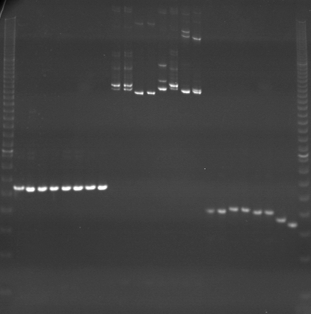
VES1431
VES1432
VES1433
m
Ac
Aw
Bc
Bw
Rc
Rw
Mc
Mw
Ac
Aw
Bc
Bw
Rc
Rw
Mc
Mw
Ac
Aw
Bc
Bw
Rc
Rw
Mc
Mw
m

Slide 4
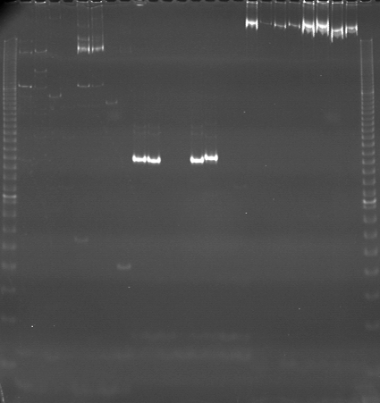
VES1434
VES1435
VES1436
m
Ac
Aw
Bc
Bw
Rc
Rw
Mc
Mw
Ac
Aw
Bc
Bw
Rc
Rw
Mc
Mw
Ac
Aw
Bc
Bw
Rc
Rw
Mc
Mw
m

Slide 5
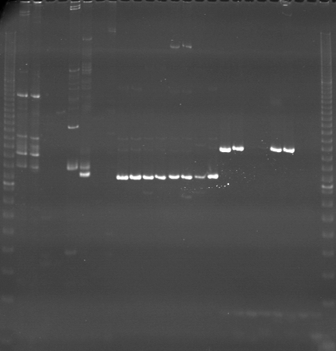
VES1437
VES1438
VES1439
m
Ac
Aw
Bc
Bw
Rc
Rw
Mc
Mw
Ac
Aw
Bc
Bw
Rc
Rw
Mc
Mw
Ac
Aw
Bc
Bw
Rc
Rw
Mc
Mw
m

Slide 6
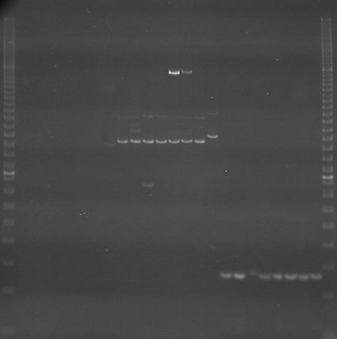
VES1440
VES1441
VES1442
m
Ac
Aw
Bc
Bw
Rc
Rw
Mc
Mw
Ac
Aw
Bc
Bw
Rc
Rw
Mc
Mw
Ac
Aw
Bc
Bw
Rc
Rw
Mc
Mw
m

Slide 7
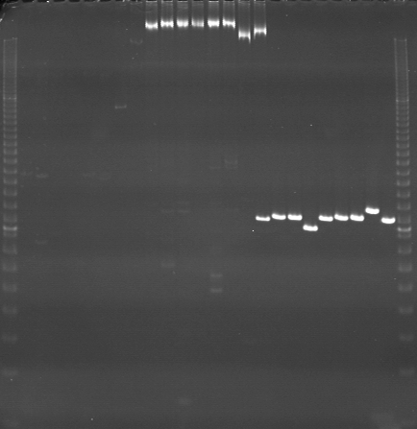
VES1443
VES1444
VES1445
m
Ac
Aw
Bc
Bw
Rc
Rw
Mc
Mw
Ac
Aw
Bc
Bw
Rc
Rw
Mc
Mw
Ac
Aw
Bc
Bw
Rc
Rw
Mc
Mw
m

Slide 8
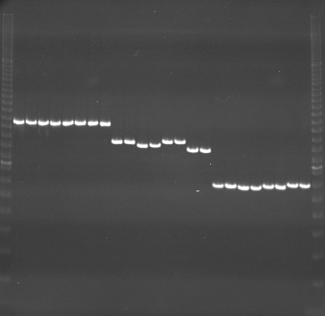
VES1446
VES1447
VES1448
m
Ac
Aw
Aw
Bc
Bw
Rc
Rw
Mc
Mw
Ac
Aw
Bc
Bw
Rc
Rw
Mc
Mw
Ac
Aw
Bc
Bw
Rc
Rw
Mc
Mw
m

Slide 9
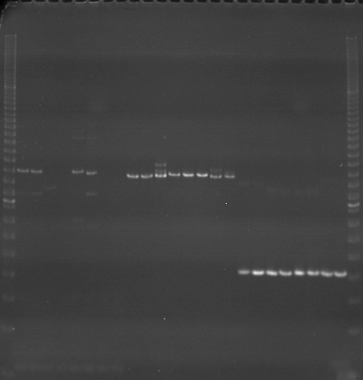
VES1449
VES1450
VES1451
m
Ac
Aw
Bc
Bw
Rc
Rw
Mc
Mw
Ac
Aw
Bc
Bw
Rc
Rw
Mc
Mw
Ac
Aw
Bc
Bw
Rc
Rw
Mc
Mw
m

Slide 10
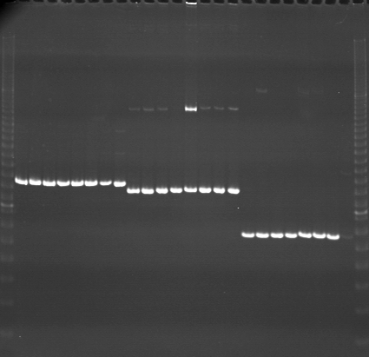
VES1452
VES1453
VES1454
m
Ac
Aw
Bc
Bw
Rc
Rw
Mc
Mw
Ac
Aw
Bc
Bw
Rc
Rw
Mc
Mw
Ac
Aw
Bc
Bw
Rc
Rw
Mc
Mw
m

Slide 11
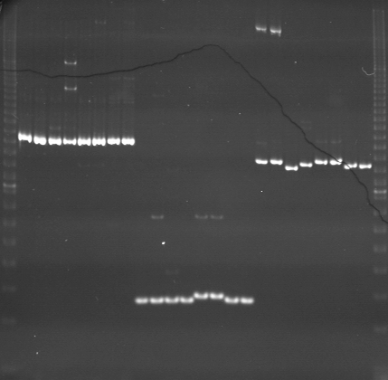
VES1455
VES1456
VES1457
m
Ac
Aw
Bc
Bw
Rc
Rw
Mc
Mw
Ac
Aw
Bc
Bw
Rc
Rw
Mc
Mw
Ac
Aw
Bc
Bw
Rc
Rw
Mc
Mw
m

Slide 12
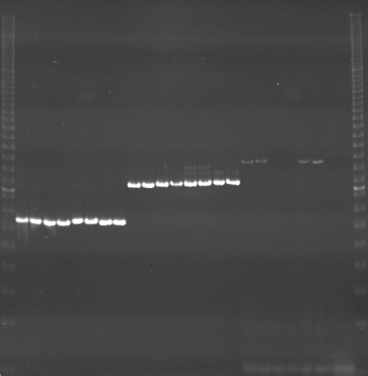
VES1458
VES1459
VES1460
m
Ac
Aw
Bc
Bw
Rc
Rw
Mc
Mw
Ac
Aw
Bc
Bw
Rc
Rw
Mc
Mw
Ac
Aw
Bc
Bw
Rc
Rw
Mc
Mw
m

Slide 13
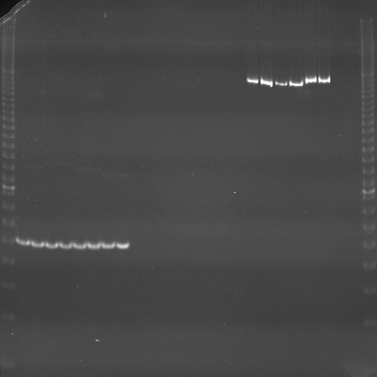
VES1461
VES1462
VES1463
m
Ac
Aw
Bc
Bw
Rc
Rw
Mc
Mw
Ac
Aw
Bc
Bw
Rc
Rw
Mc
Mw
Ac
Aw
Bc
Bw
Rc
Rw
Mc
Mw
m

Slide 14
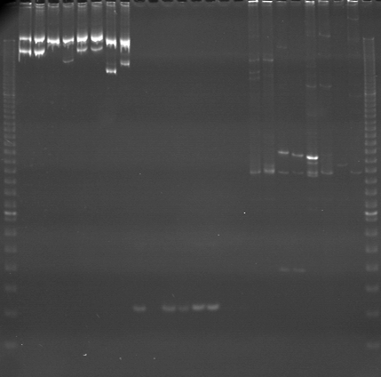
VES1464
VES1465
VES1466
m
Ac
Aw
Bc
Bw
Rc
Rw
Mc
Mw
Ac
Aw
Bc
Bw
Rc
Rw
Mc
Mw
Ac
Aw
Bc
Bw
Rc
Rw
Mc
Mw
m

Slide 15
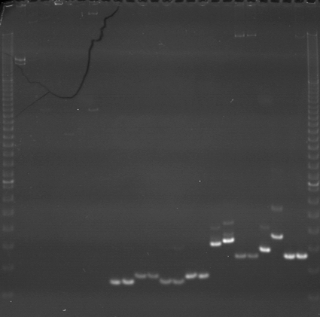
VES1467
VES1468
VES1469
m
Ac
Aw
Bc
Bw
Rc
Rw
Mc
Mw
Ac
Aw
Bc
Bw
Rc
Rw
Mc
Mw
Ac
Aw
Bc
Bw
Rc
Rw
Mc
Mw
m

Slide 16
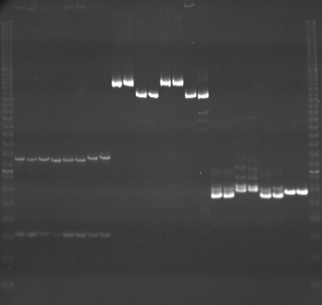
VES1470
VES1471
VES1472
m
Ac
Aw
Bc
Bw
Rc
Rw
Mc
Mw
Ac
Aw
Bc
Bw
Rc
Rw
Mc
Mw
Ac
Aw
Bc
Bw
Rc
Rw
Mc
Mw
m

