Slide 1
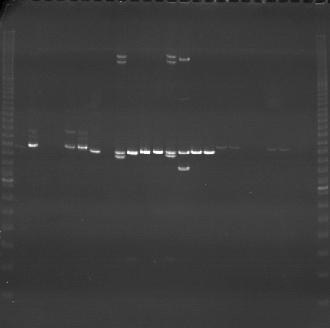
VES1473
VES1474
VES1475
m
Ac
Aw
Bc
Bw
Rc
Rw
Mc
Mw
Ac
Aw
Bc
Bw
Rc
Rw
Mc
Mw
Ac
Aw
Bc
Bw
Rc
Rw
Mc
Mw
m

Slide 2
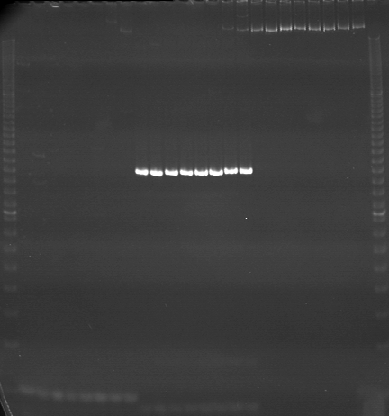
VES1476
VES1477
VES1478
m
Ac
Aw
Bc
Bw
Rc
Rw
Mc
Mw
Ac
Aw
Bc
Bw
Rc
Rw
Mc
Mw
Ac
Aw
Bc
Bw
Rc
Rw
Mc
Mw
m

Slide 3
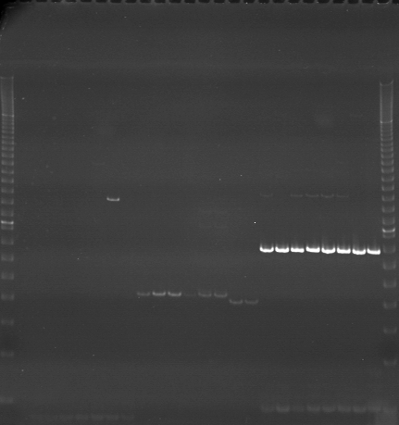
VES1479
VES1480
VES1481
m
Ac
Aw
Bc
Bw
Rc
Rw
Mc
Mw
Ac
Aw
Bc
Bw
Rc
Rw
Mc
Mw
Ac
Aw
Bc
Bw
Rc
Rw
Mc
Mw
m

Slide 4
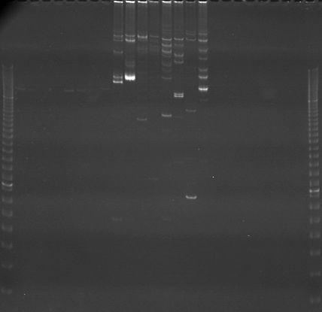
VES1482
VES1483
VES1484
m
Ac
Aw
Bc
Bw
Rc
Rw
Mc
Mw
Ac
Aw
Bc
Bw
Rc
Rw
Mc
Mw
Ac
Aw
Bc
Bw
Rc
Rw
Mc
Mw
m

Slide 5
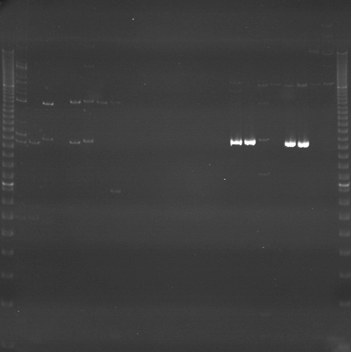
VES1485
VES1486
VES1487
m
Ac
Aw
Bc
Bw
Rc
Rw
Mc
Mw
Ac
Aw
Bc
Bw
Rc
Rw
Mc
Mw
Ac
Aw
Bc
Bw
Rc
Rw
Mc
Mw
m

Slide 6
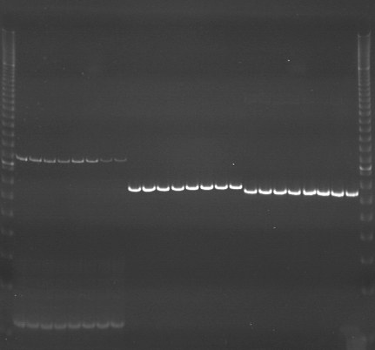
VES1488
VES1489
VES1490
m
Ac
Aw
Bc
Bw
Rc
Rw
Mc
Mw
Ac
Aw
Bc
Bw
Rc
Rw
Mc
Mw
Ac
Aw
Bc
Bw
Rc
Rw
Mc
Mw
m

Slide 7
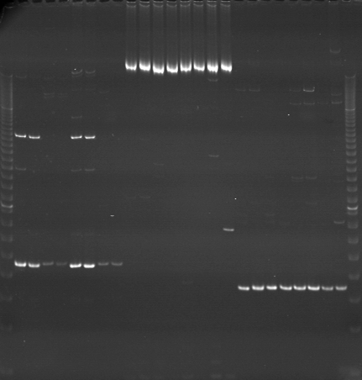
VES1491
VES1492
VES1493
m
Ac
Aw
Bc
Bw
Rc
Rw
Mc
Mw
Ac
Aw
Bc
Bw
Rc
Rw
Mc
Mw
Ac
Aw
Bc
Bw
Rc
Rw
Mc
Mw
m

Slide 8
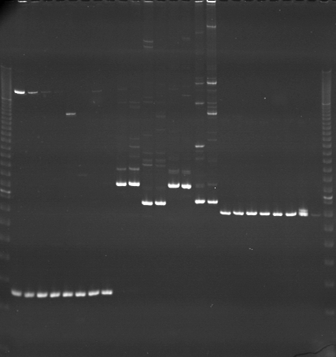
VES1494
VES1495
VES1496
m
Ac
Aw
Bc
Bw
Rc
Rw
Mc
Mw
Ac
Aw
Bc
Bw
Rc
Rw
Mc
Mw
Ac
Aw
Bc
Bw
Rc
Rw
Mc
Mw
m

Slide 9
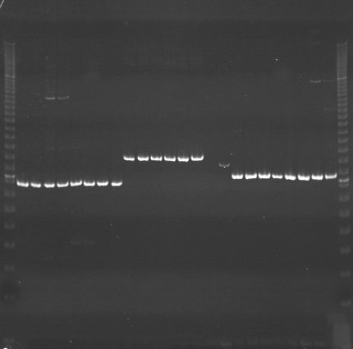
VES1497
VES1498
VES1499
m
Ac
Aw
Bc
Bw
Rc
Rw
Mc
Mw
Ac
Aw
Bc
Bw
Rc
Rw
Mc
Mw
Ac
Aw
Bc
Bw
Rc
Rw
Mc
Mw
m

Slide 10
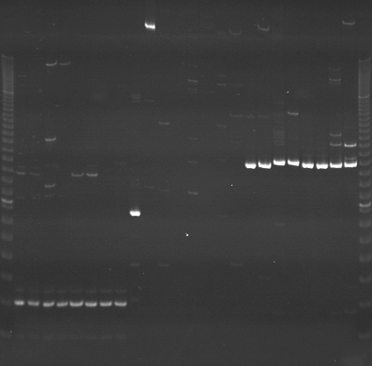
VES1500
VES1501
VES1502
m
Ac
Aw
Bc
Bw
Rc
Rw
Mc
Mw
Ac
Aw
Bc
Bw
Rc
Rw
Mc
Mw
Ac
Aw
Bc
Bw
Rc
Rw
Mc
Mw
m

Slide 11
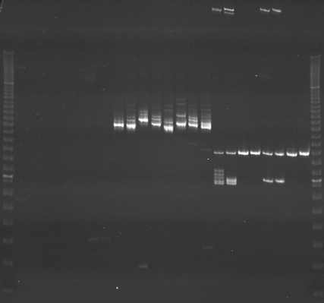
VES1503
VES1504
VES1505
m
Ac
Aw
Bc
Bw
Rc
Rw
Mc
Mw
Ac
Aw
Bc
Bw
Rc
Rw
Mc
Mw
Ac
Aw
Bc
Bw
Rc
Rw
Mc
Mw
m

Slide 12
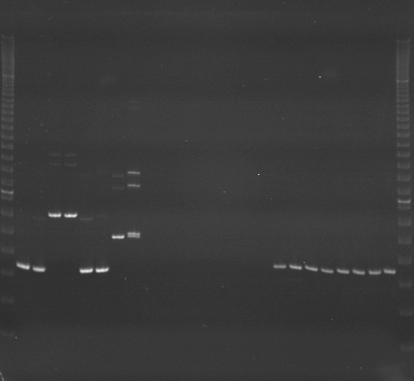
VES1506
VES1507
VES1508
m
Ac
Aw
Bc
Bw
Rc
Rw
Mc
Mw
Ac
Aw
Bc
Bw
Rc
Rw
Mc
Mw
Ac
Aw
Bc
Bw
Rc
Rw
Mc
Mw
m

Slide 13
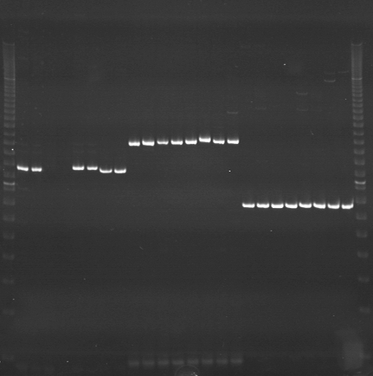
VES1509
VES1510
VES1511
m
Ac
Aw
Bc
Bw
Rc
Rw
Mc
Mw
Ac
Aw
Bc
Bw
Rc
Rw
Mc
Mw
Ac
Aw
Bc
Bw
Rc
Rw
Mc
Mw
m

Slide 14
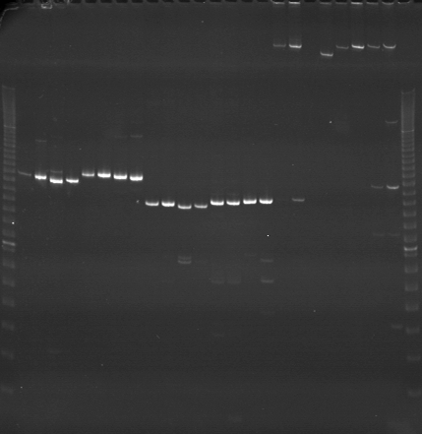
VES1512
VES1513
VES1514
m
Ac
Aw
Bc
Bw
Rc
Rw
Mc
Mw
Ac
Aw
Bc
Bw
Rc
Rw
Mc
Mw
Ac
Aw
Bc
Bw
Rc
Rw
Mc
Mw
m

Slide 15
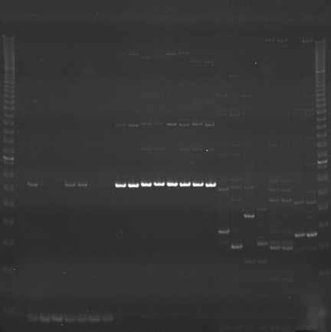
VES1515
VES1516
VES1517
m
Ac
Aw
Bc
Bw
Rc
Rw
Mc
Mw
Ac
Aw
Bc
Bw
Rc
Rw
Mc
Mw
Ac
Aw
Bc
Bw
Rc
Rw
Mc
Mw
m

Slide 16
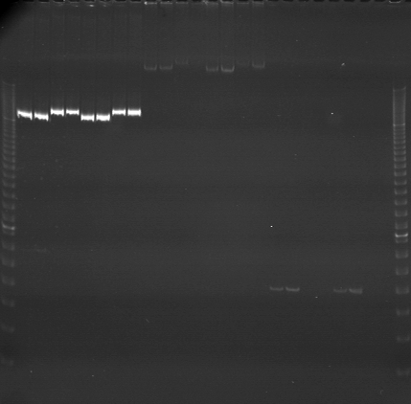
VES1518
VES1519
VES1520
m
Ac
Aw
Bc
Bw
Rc
Rw
Mc
Mw
Ac
Aw
Bc
Bw
Rc
Rw
Mc
Mw
Ac
Aw
Bc
Bw
Rc
Rw
Mc
Mw
m

