Slide 1
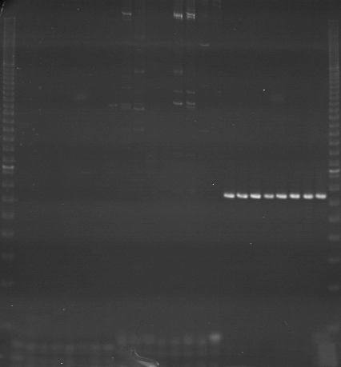
VES1521
VES1522
VES1523
m
Ac
Aw
Bc
Bw
Rc
Rw
Mc
Mw
Ac
Aw
Bc
Bw
Rc
Rw
Mc
Mw
Ac
Aw
Bc
Bw
Rc
Rw
Mc
Mw
m

Slide 2
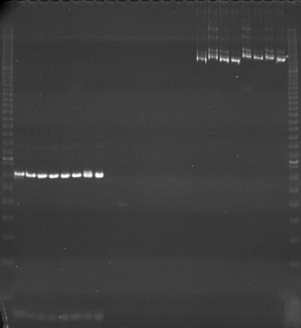
VES1524
VES1525
VES1526
m
Ac
Aw
Bc
Bw
Rc
Rw
Mc
Mw
Ac
Aw
Bc
Bw
Rc
Rw
Mc
Mw
Ac
Aw
Bc
Bw
Rc
Rw
Mc
Mw
m

Slide 3
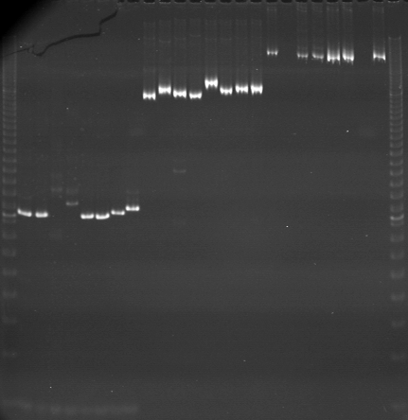
VES1527
VES1528
VES1529
m
Ac
Aw
Bc
Bw
Rc
Rw
Mc
Mw
Ac
Aw
Bc
Bw
Rc
Rw
Mc
Mw
Ac
Aw
Bc
Bw
Rc
Rw
Mc
Mw
m

Slide 4
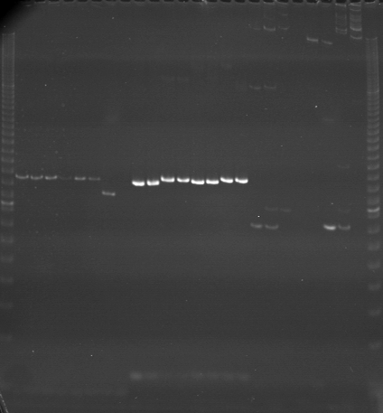
VES1530
VES1531
VES1532
m
Ac
Aw
Bc
Bw
Rc
Rw
Mc
Mw
Ac
Aw
Bc
Bw
Rc
Rw
Mc
Mw
Ac
Aw
Bc
Bw
Rc
Rw
Mc
Mw
m

Slide 5
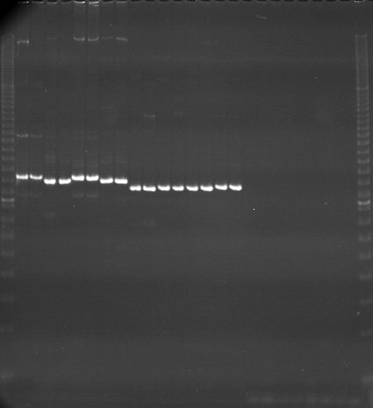
VES1533
VES1534
VES1535
m
Ac
Aw
Bc
Bw
Rc
Rw
Mc
Mw
Ac
Aw
Bc
Bw
Rc
Rw
Mc
Mw
Ac
Aw
Bc
Bw
Rc
Rw
Mc
Mw
m

Slide 6
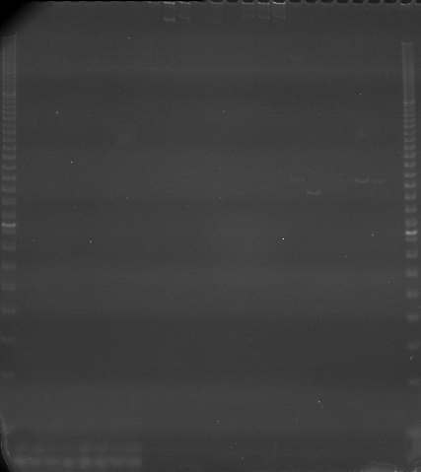
VES1536
VES1537
VES1538
m
Ac
Aw
Bc
Bw
Rc
Rw
Mc
Mw
Ac
Aw
Bc
Bw
Rc
Rw
Mc
Mw
Ac
Aw
Bc
Bw
Rc
Rw
Mc
Mw
m

Slide 7
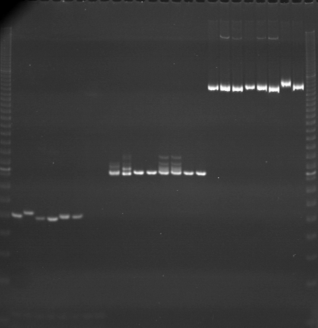
VES1539
VES1540
VES1541
m
Ac
Aw
Bc
Bw
Rc
Rw
Mc
Mw
Ac
Aw
Bc
Bw
Rc
Rw
Mc
Mw
Ac
Aw
Bc
Bw
Rc
Rw
Mc
Mw
m

Slide 8
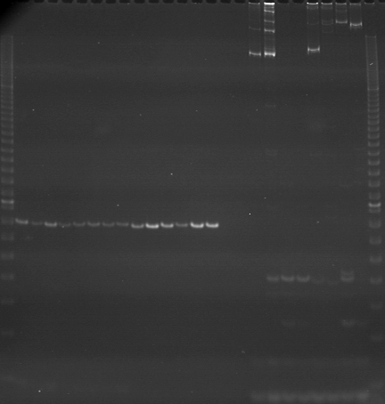
VES1542
VES1543
VES1544
m
Ac
Aw
Bc
Bw
Rc
Rw
Mc
Mw
Ac
Aw
Bc
Bw
Rc
Rw
Mc
Mw
Ac
Aw
Bc
Bw
Rc
Rw
Mc
Mw
m

Slide 9
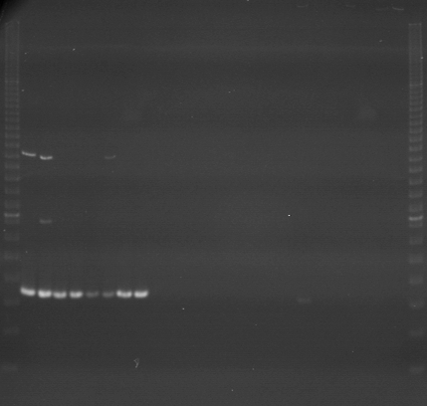
VES1545
VES1546
VES1547
m
Ac
Aw
Bc
Bw
Rc
Rw
Mc
Mw
Ac
Aw
Bc
Bw
Rc
Rw
Mc
Mw
Ac
Aw
Bc
Bw
Rc
Rw
Mc
Mw
m

Slide 10
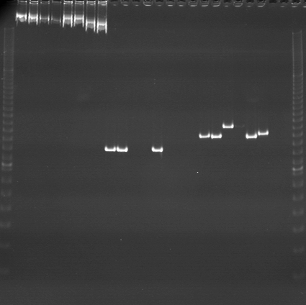
VES1548
VES1549
VES1550
m
Ac
Aw
Bc
Bw
Rc
Rw
Mc
Mw
Ac
Aw
Bc
Bw
Rc
Rw
Mc
Mw
Ac
Aw
Bc
Bw
Rc
Rw
Mc
Mw
m

Slide 11
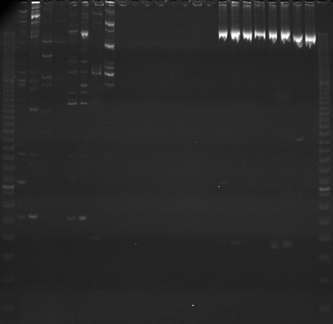
VES1551
VES1552
VES1553
m
Ac
Aw
Bc
Bw
Rc
Rw
Mc
Mw
Ac
Aw
Bc
Bw
Rc
Rw
Mc
Mw
Ac
Aw
Bc
Bw
Rc
Rw
Mc
Mw
m

Slide 12
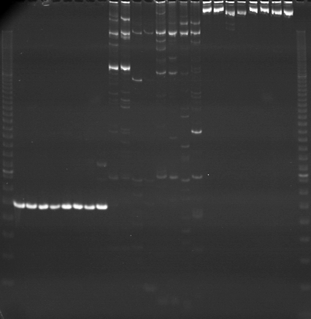
VES1554
VES1555
VES1556
m
Ac
Aw
Bc
Bw
Rc
Rw
Mc
Mw
Ac
Aw
Bc
Bw
Rc
Rw
Mc
Mw
Ac
Aw
Bc
Bw
Rc
Rw
Mc
Mw
m

Slide 13
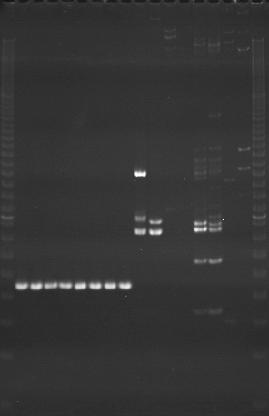
VES1557
VES1558
m
Ac
Aw
Aw
Bc
Bw
Rc
Rw
Mc
Mw
Ac
Aw
Bc
Bw
Rc
Rw
Mc
Mw
m

